Slide 1
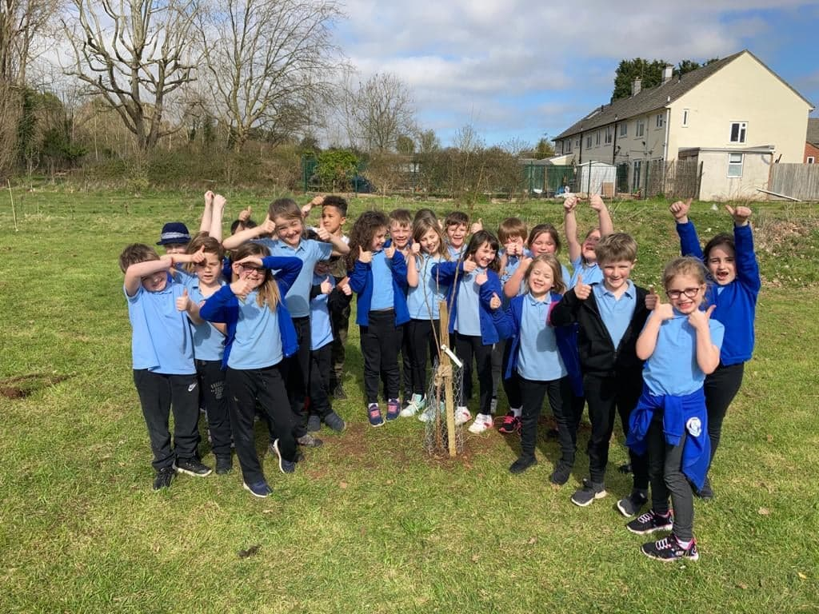
Tree Champions at Brentry Primary School

Slide 2
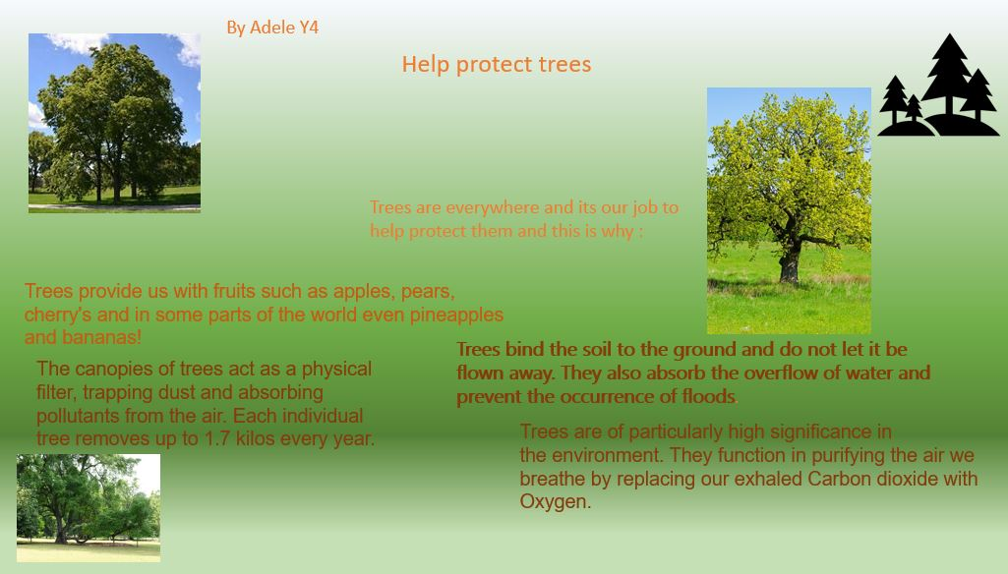

Slide 3
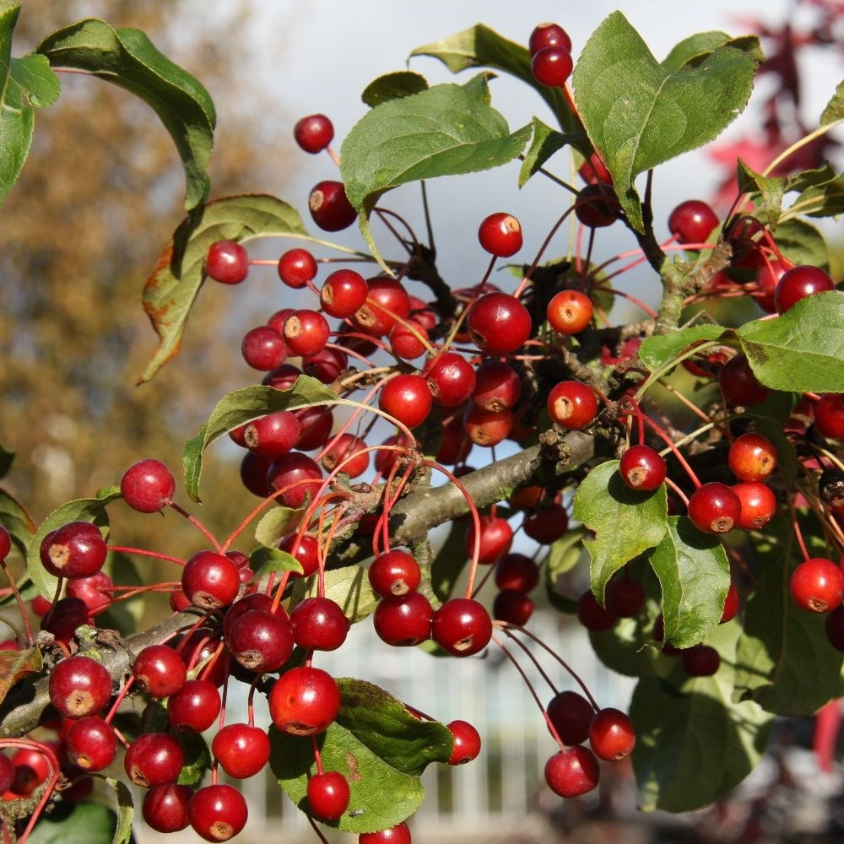
What are we doing?
We are very excited to announce that Reception, Year 1, 2, 3 and 4 have planted their trees.
2 different flowering cherries,
a rowan,
a crab apple
and a holly.

Slide 4
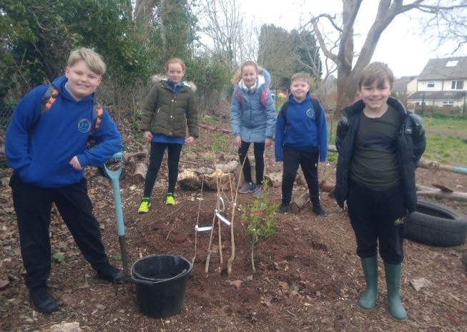
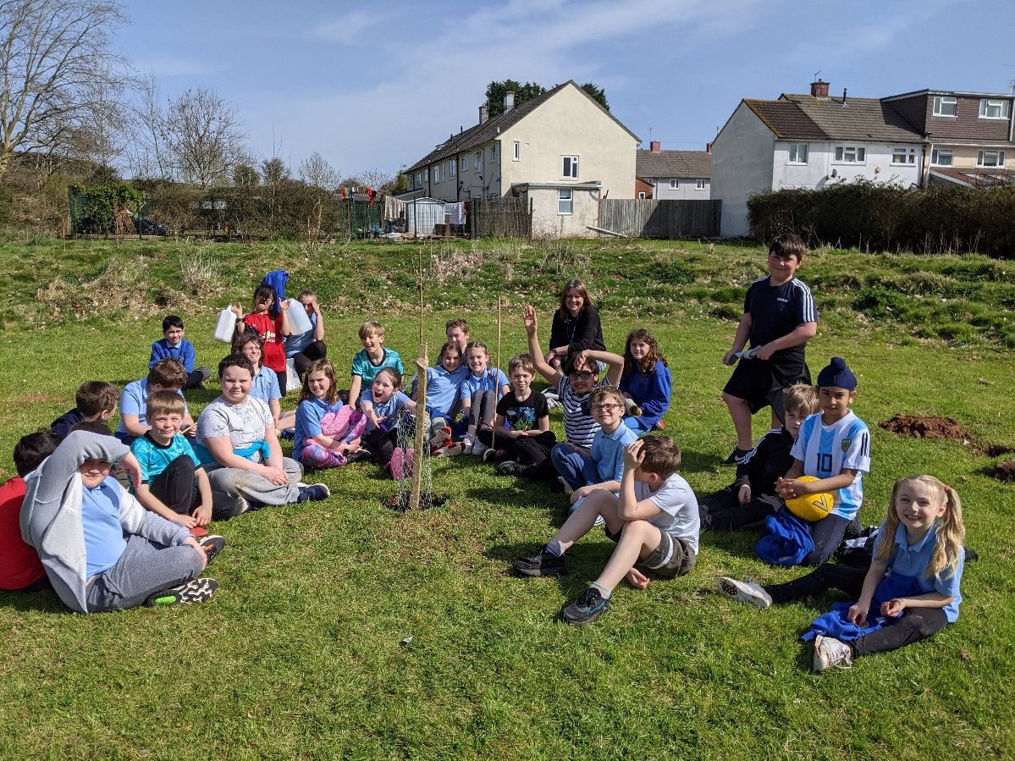
Treemendous team work!

Slide 5
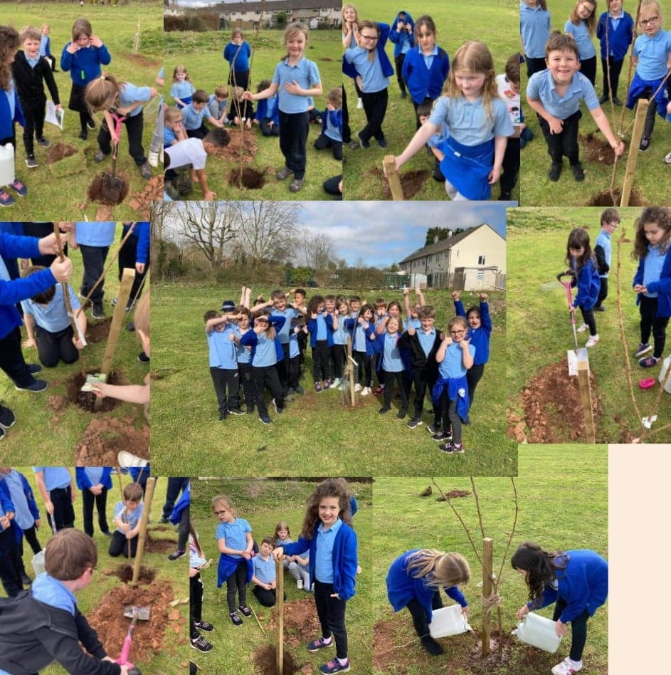
Year 2 tree planting – look how many different jobs there were.
Great team effort!

Slide 6
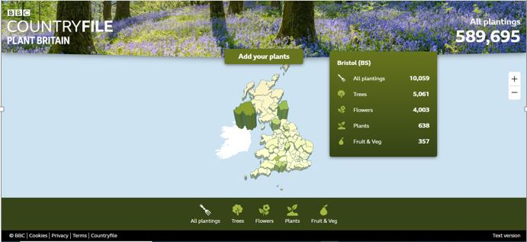
We are part of something much bigger
There are 92 other schools taking part in the Tree Champions project all around the UK.

Slide 7
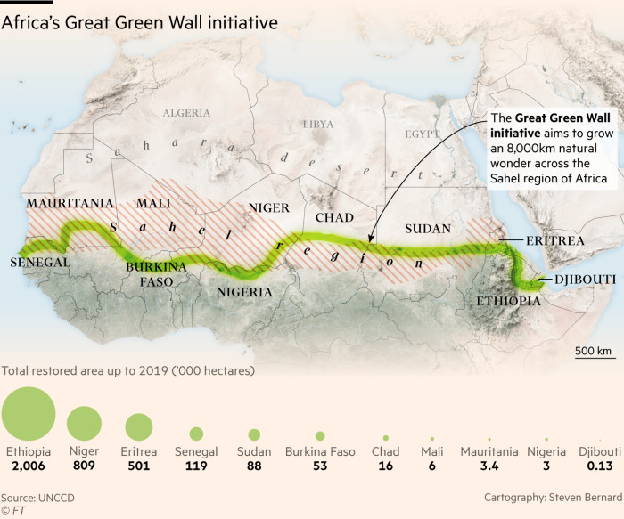
The Great Green Wall
The Great Green Wall is an African-led movement with an epic ambition to grow an 8,000km natural wonder of the world across the entire width of Africa.
The Wall promises to be a compelling solution to the many urgent threats not only facing the African Continent, but the global community as a whole – notably climate change, drought, famine, conflict and migration.
Once complete, the Great Green Wall will be the largest living structure on the planet, 3 times the size of the Great Barrier Reef.

Slide 8
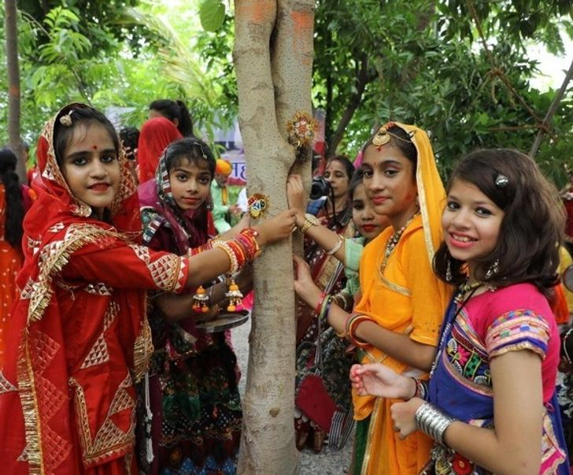
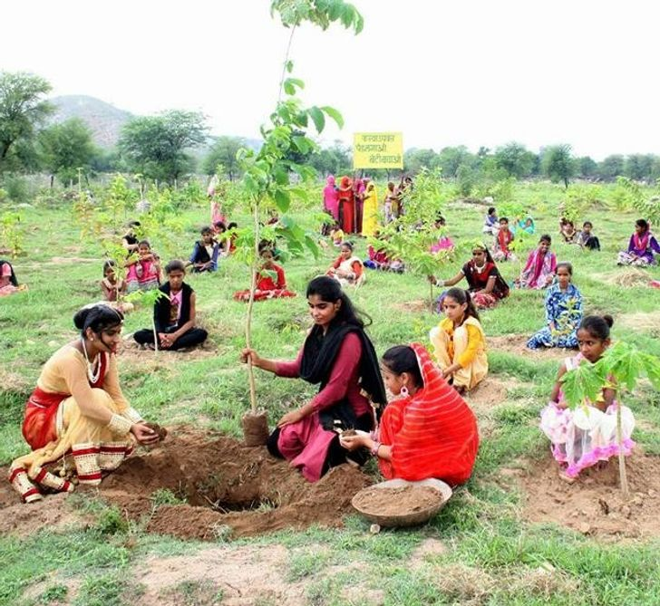
A village in Piplantri, in India, plants 111 trees every time a girl is born, and now they have a whole forest.

Slide 9
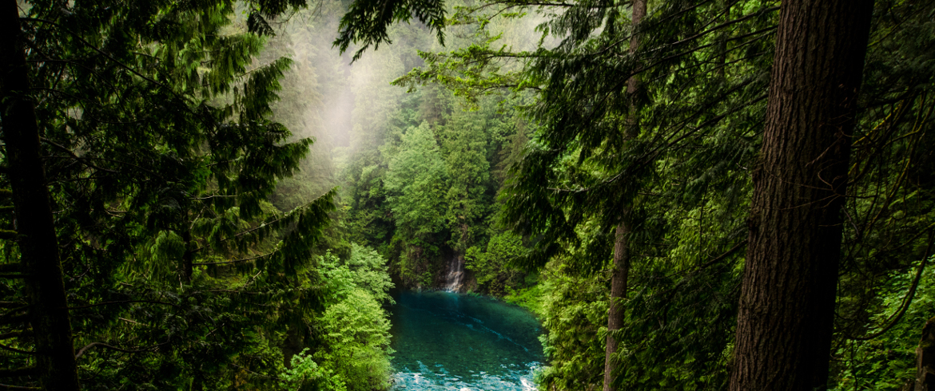
The world’s largest ever tropical reforestation effort is planting 73 million trees in the Brazilian Amazon. After years of devastation, finally good news for our planet’s green lungs.

Slide 10
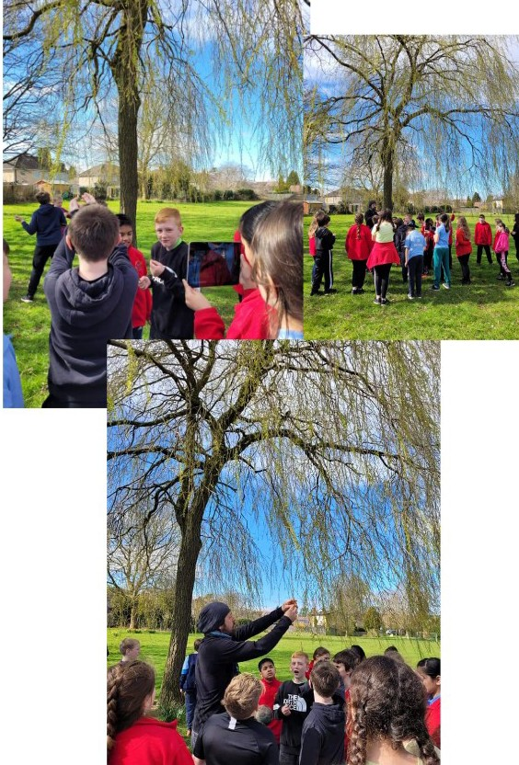
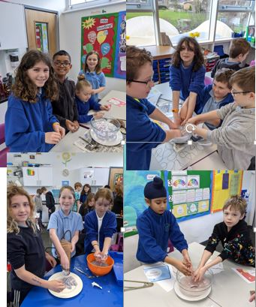
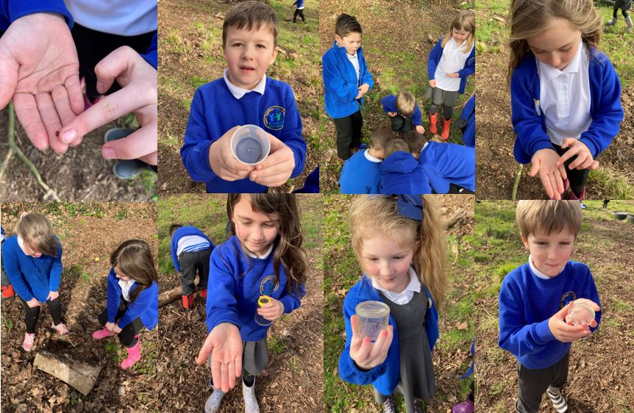
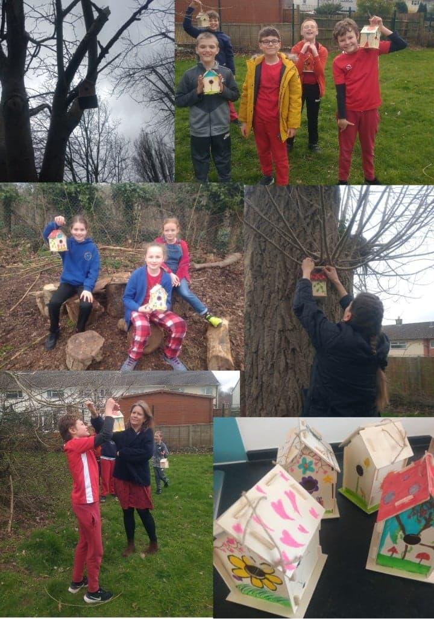
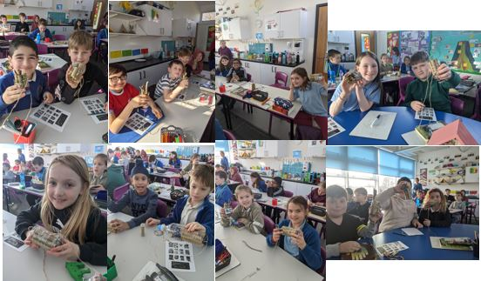
Bug hunts, paper making, bird boxes, bug hotels and tree trails.

Slide 11
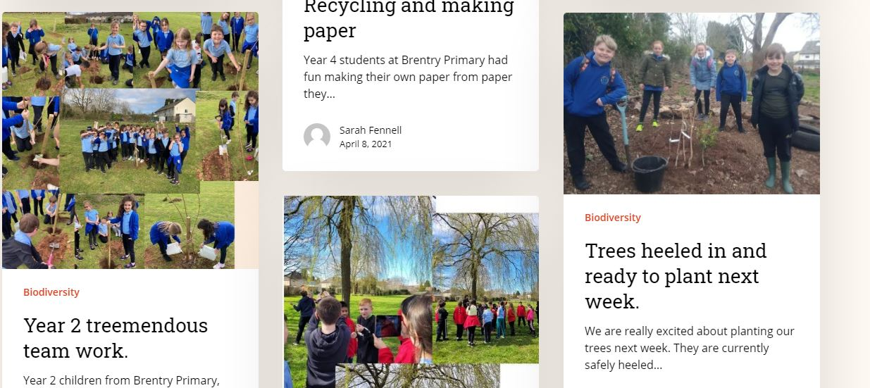
https://youngtreechampions.org/author/sarah-fennell/

Slide 12
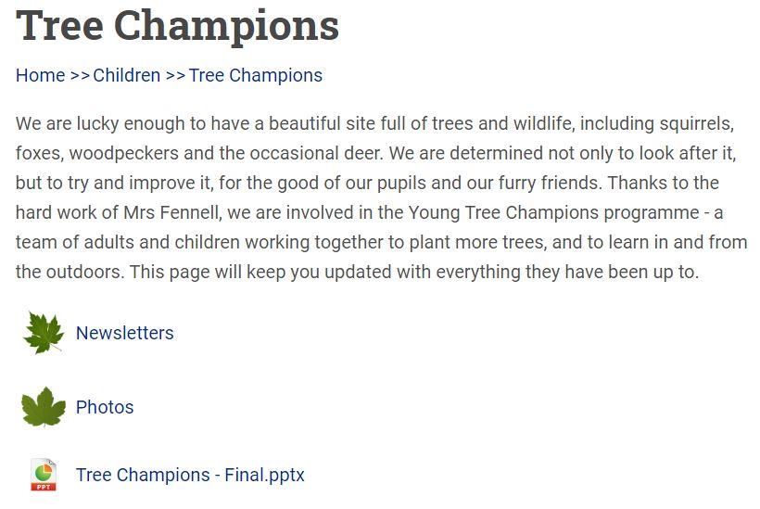
We also have our own place on the school website

Slide 13
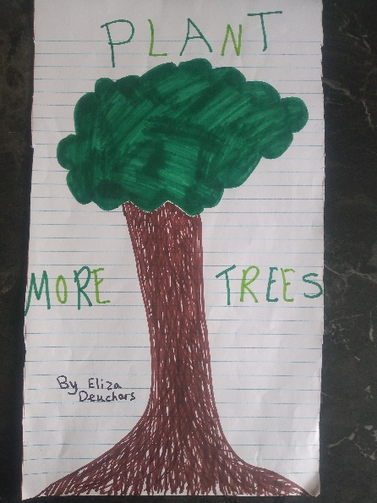
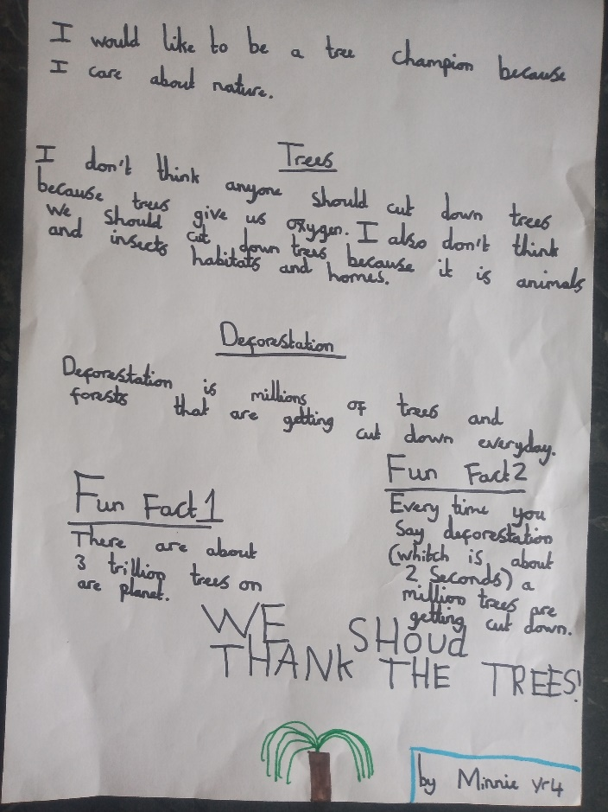
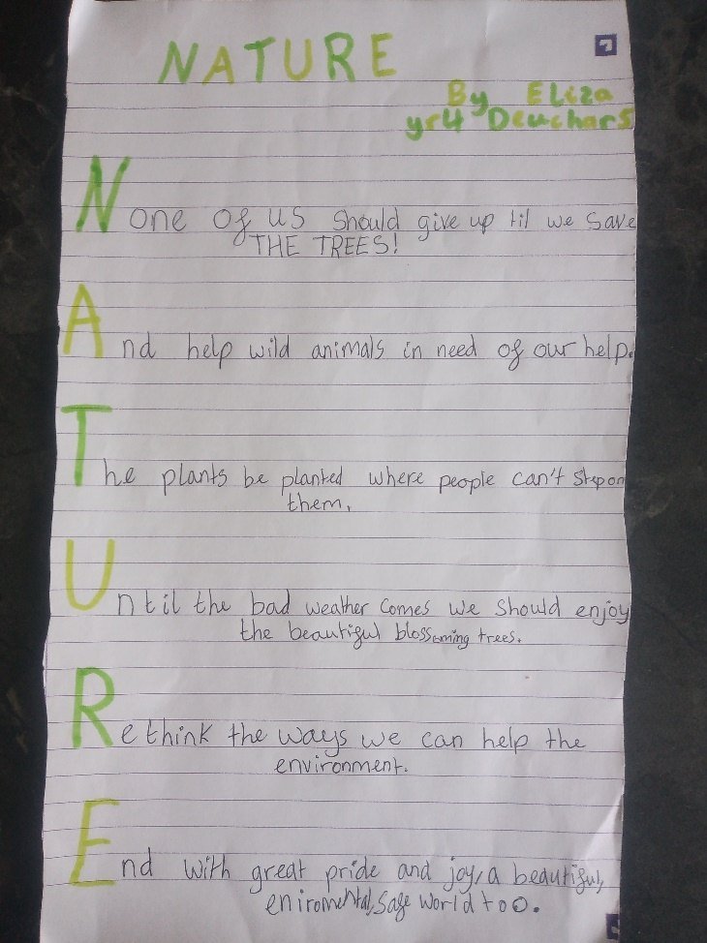
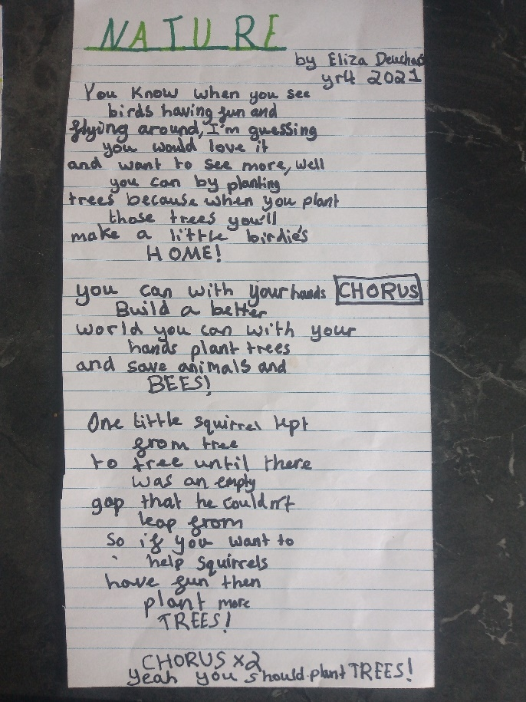
Creative contributions for newsletter, display boards and websites.
NEEDED
You could make your own video or podcast, take photos, sculpture, crafts, dance!
Fun facts, poems, stories, pictures and even songs!

Slide 14
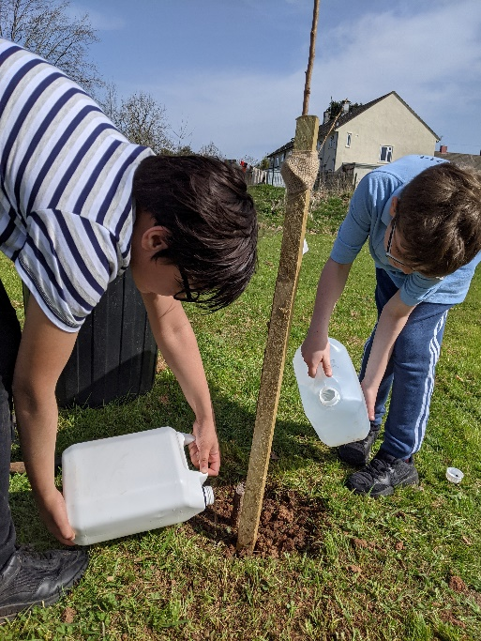
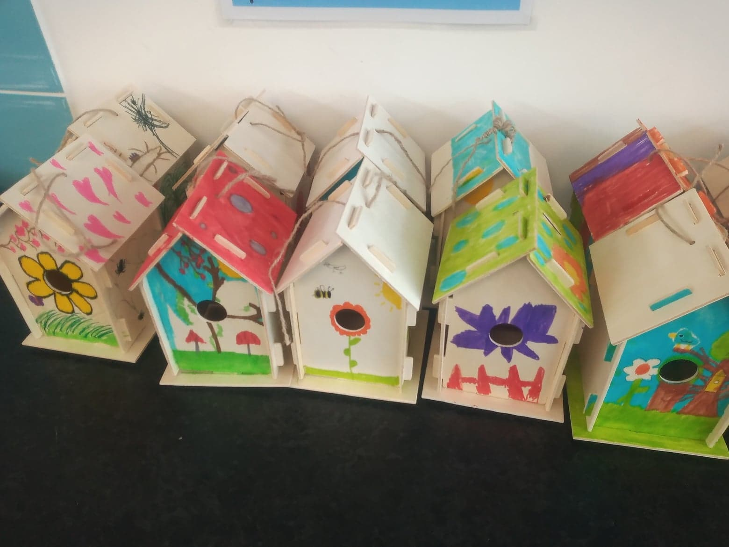
Volunteers wanted
Tree carers – check on the trees we planted and water regularly.
Bird box monitors – watch the bird boxes for 10 minute shifts over break and lunch times and record any behaviour you notice.

Slide 15
Your tree champions
Adele Year 4 (special helpers Minnie and Eliza).
Elliott and Aya Year 5 (special helpers Katy, Lucas and Sofia)
Humaira (Head Tree Champion) and Evan Year 6
You are ALL Tree Champions and together we will make Brentry Primary School a place that is good for our well-being and a place where all creatures in nature will have a home.

Slide 16
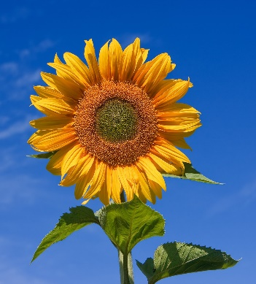
What you can do right now!
Volunteer for one of our jobs – tree carer or bird box observer. Give your names to Mrs Fennell, one of the Tree Champions (or helpers) or your teacher
Plant something – and don’t forget to add it to the Plant Britain website.
Get creative for the newsletter and display board.
Take time out in nature. Persuade your teachers to have classes outside sometimes.
Find out what’s happening locally and globally and sign petitions to protect our environment. Join a local litter pick or environmental group.

Slide 17

Now let’s relax!
https://soundcloud.com/user-292435838/forest-meditation-lively-vocal

