Slide 1
𝓑𝓲𝓸𝓭𝓲𝓿𝓮𝓻𝓼𝓲𝓽𝔂
by Humaira and Evan

Slide 2

Which one do you like better?
A
B

Slide 3
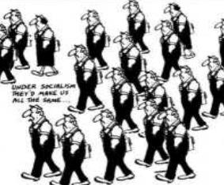
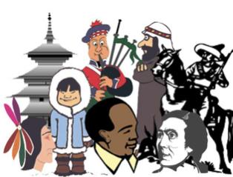
Which one do you like better?

Slide 4
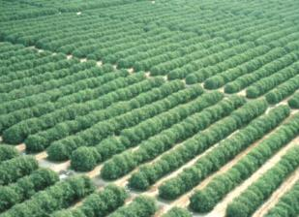
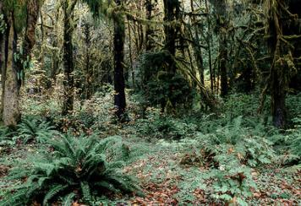
Which one do you like better?

Slide 5
What do you notice about what you have chosen?

Slide 6
What do you think biodiversity means?

Slide 7
What does biodiversity mean?
Bio=life
Diversity = Variety
So, in its broadest sense, biodiversity is the term used to describe life of earth and its variety. In any stretch of woodland or grassland or other habitat there are more organisms then you could count the greater the variety of the plants trees and fungi there is - or how biodiverse it is The healthier the ecosystem is considered to be. This is because more complex habitat can provide different conditions for other species.

Slide 8
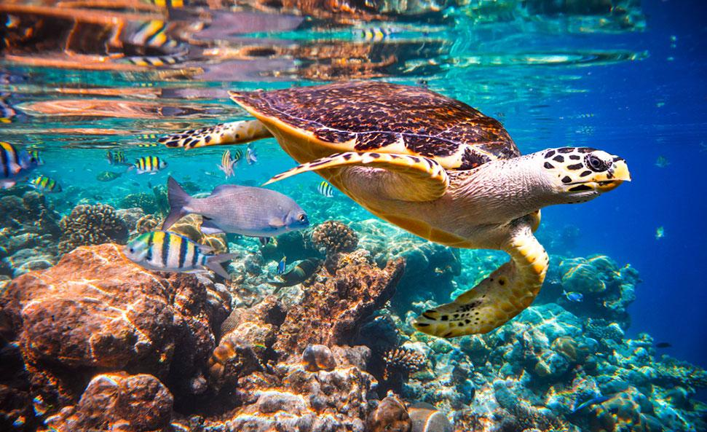
ecosystems
An ecosystem is a community of living organisms that live and interact with each other in a specific environment.
In other words, An ecosystem is a geographic area where plants, animals, and other organisms, as well as weather and landscape, work together to form a bubble of life.
In the previous Slide we discussed how having trees, plants, animals and fungi can give us a healthier ecosystem.

Slide 9
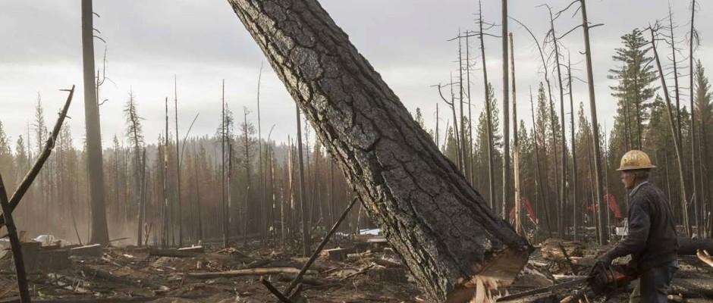
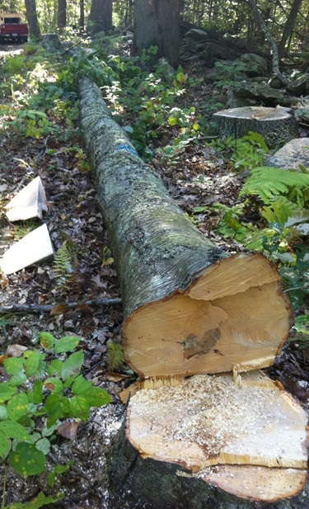
What do you think is happening in these pictures?

Slide 10
.
The way we humans live on earth is sending biodiversity into a decline
The natural world is fading and evidence is all around.

Slide 11
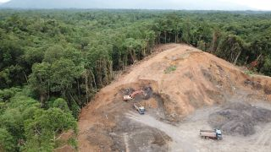
It 𝙞𝙨 𝙚𝙫𝙚𝙧𝙮𝙬𝙝𝙚𝙧𝙚.
𝙁𝙧𝙤𝙢 𝙙𝙚𝙛𝙤𝙧𝙚𝙨𝙩𝙖𝙩𝙞𝙤𝙣 ..

Slide 12
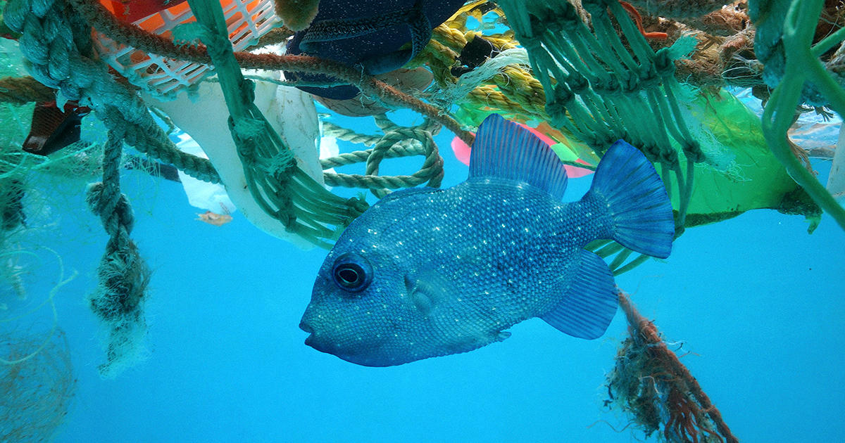
..sea pollution...
.

Slide 13
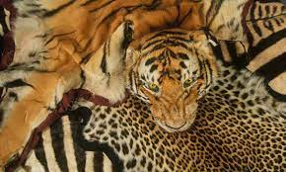
..illegal wildlife trading..

Slide 14
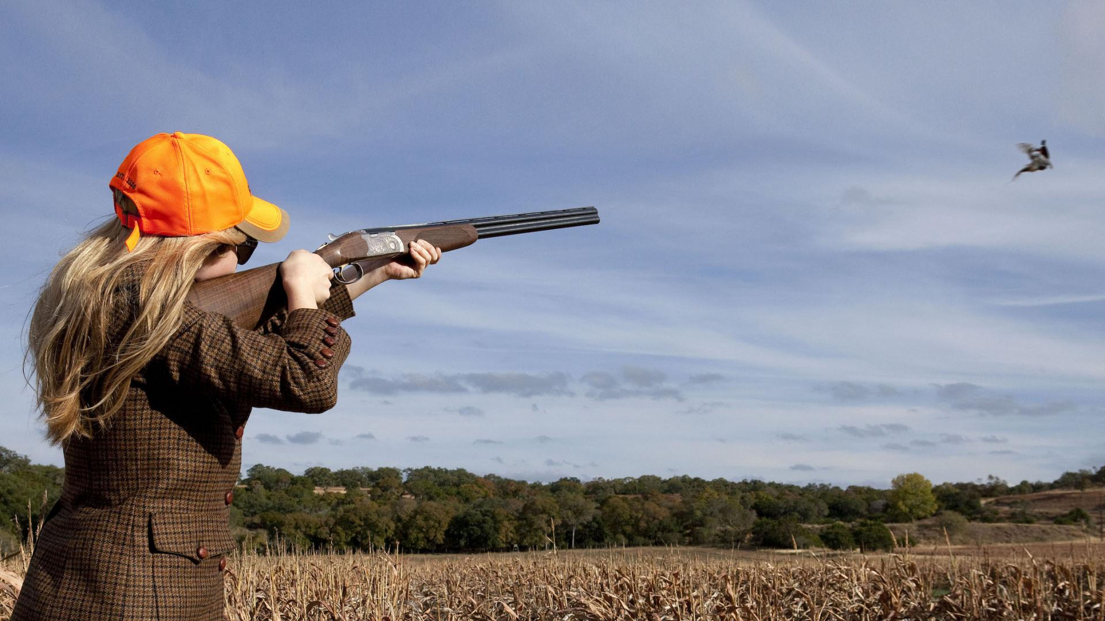
..hunting..

Slide 15
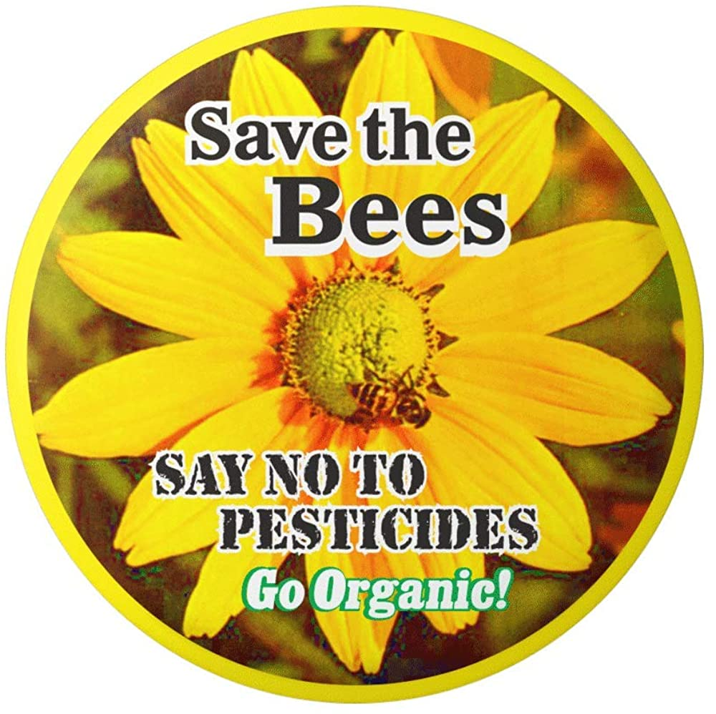
..Over-use of harmful chemicals in agriculture, public spaces and even our gardens……..

Slide 16
Anything else that may be decreasing the biodiversity?

Slide 17
You may not know it but..
We need trees covering the land to lock away carbon and keep the climate stable
We need millions of pollinators,
Billions of soil organisms
And megatons of plankton to keep food we eat in supply.
We need strange plants deep in jungles to create our medicines
Coral reefs and swamps to to protect the coasts we rely on

Slide 18
Our planet's biodiversity provides all the things we depend on for free, but it can only do so if there is lots of it.
At the moment it is under attack.

Slide 19
Over the last 50 years our actions have dramatically reduced biodiversity across the globe.

Slide 20
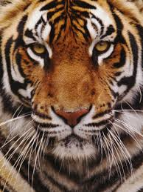
We have reduced populations of wild animals by 60%.. and even driven whole species extinct.

Slide 21
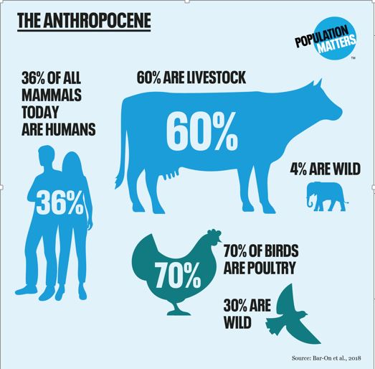
Did you know ……?
So we can choose to eat meat less often and re-wild our world.

Slide 22
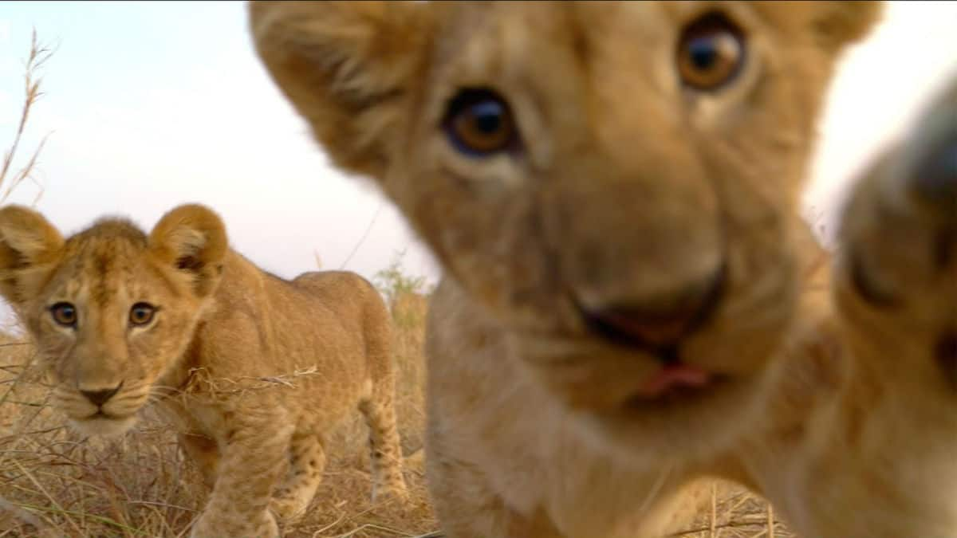
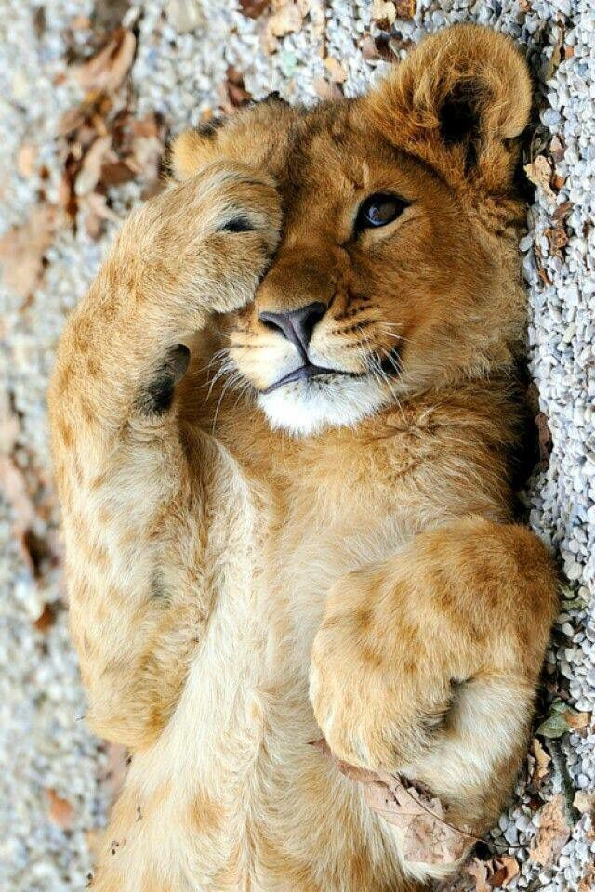
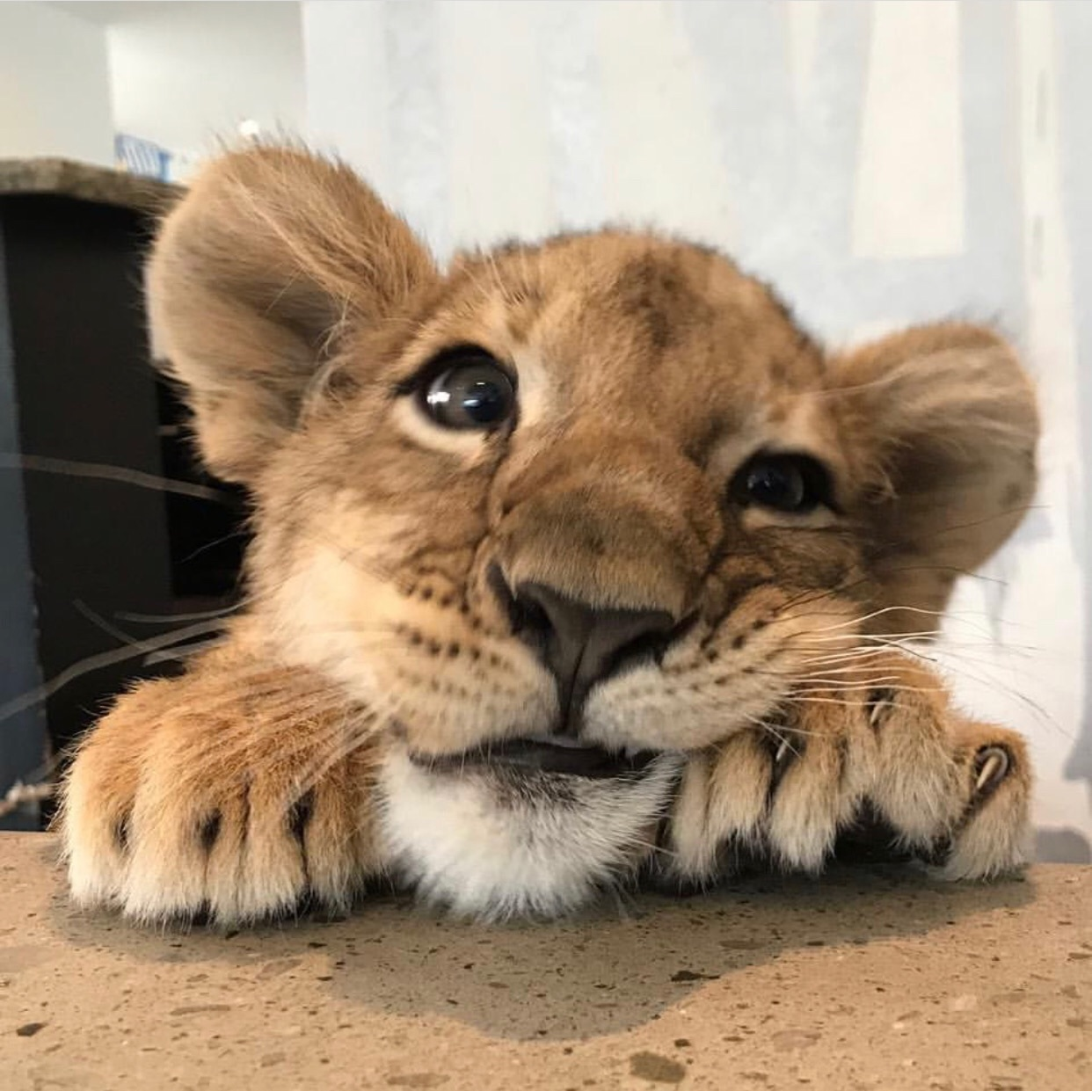
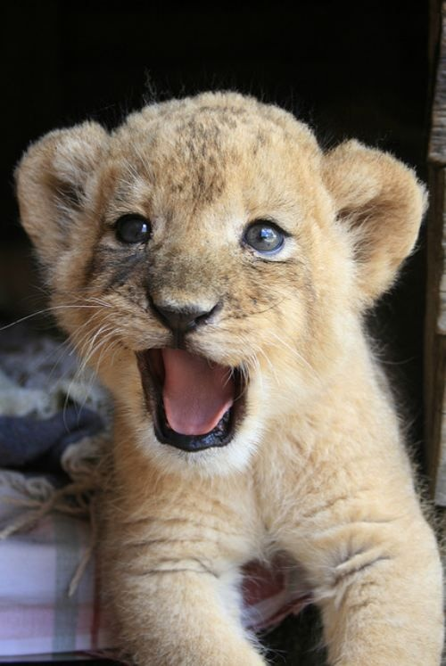
Since humans started hunting Lions ,Panthera leo, their population has dropped by 85%. They are been hunted for their fur for rugs, coats etc.

Slide 23
  65% fewer lions in Africa.
  75% fewer flying insects in Europe
  95% fewer bluefin tuna in the pacific
Biodiversity is dropping everywhere and fast.
This is catastrophic for nature and for ourselves. We talk about climate change a lot but biodiversity is just as big as issue.

Slide 24
We can stop this though!!
Raising money to give to charities
Tree planting
Creating habitats
Petitions for tree planting (trees are habitats too)
Eating plant-based meals more often
Speaking up!!

Slide 25
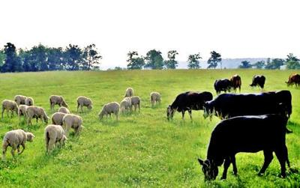
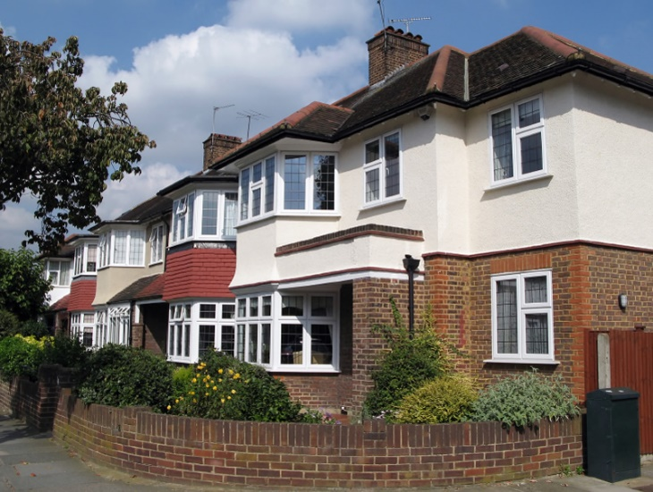
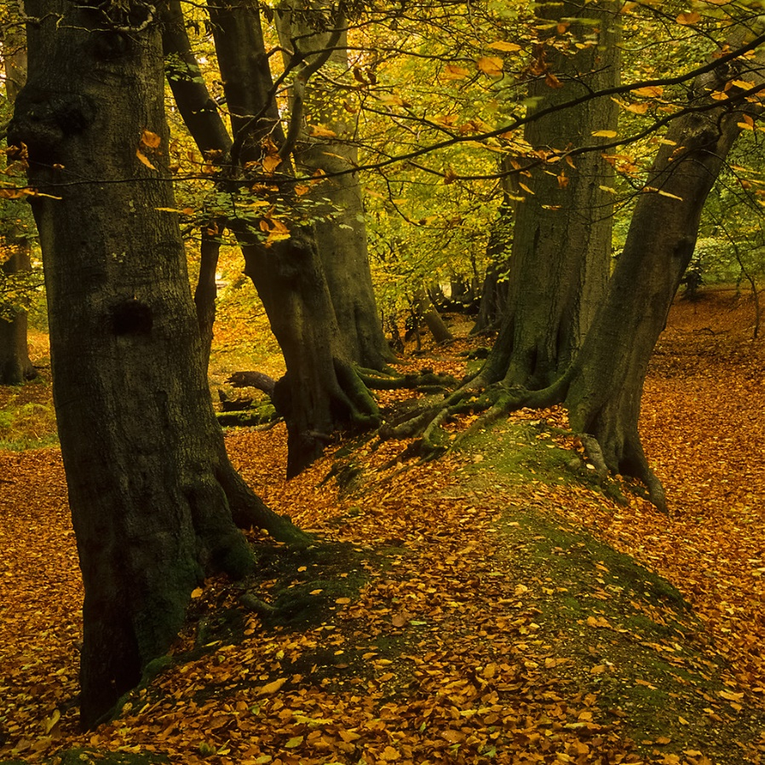
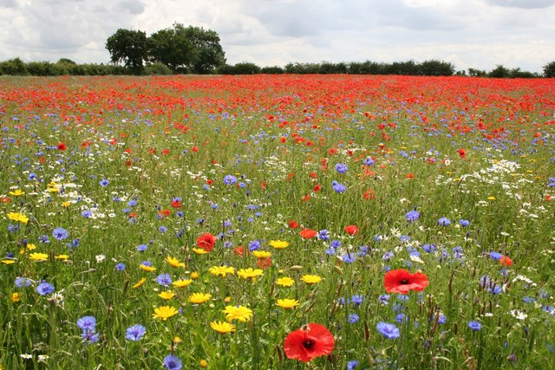
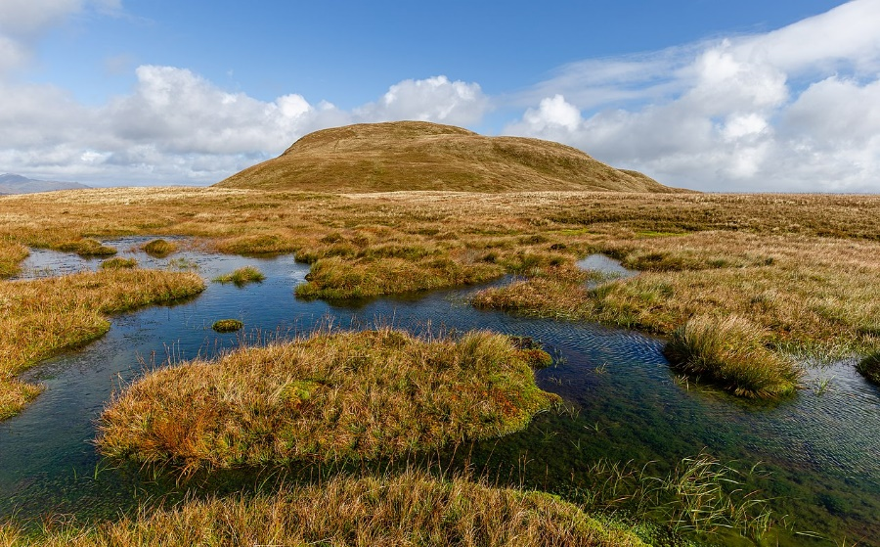
https://www.youtube.com/watch?v=0drvdLYGNuc
The UK in 100 seconds

