Slide 1

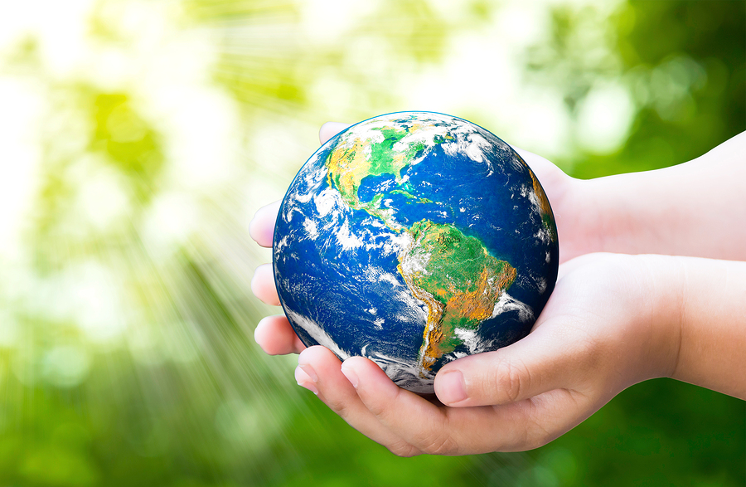
What can WE do to save our planet?

Slide 2
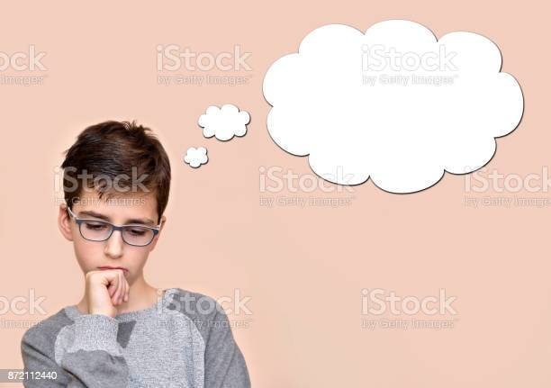
What problems are we facing?
Any ideas?

Slide 3

Covid-19 and other diseases
Did you know 69% of children have been mentally affected by the coronavirus pandemic?

Slide 4
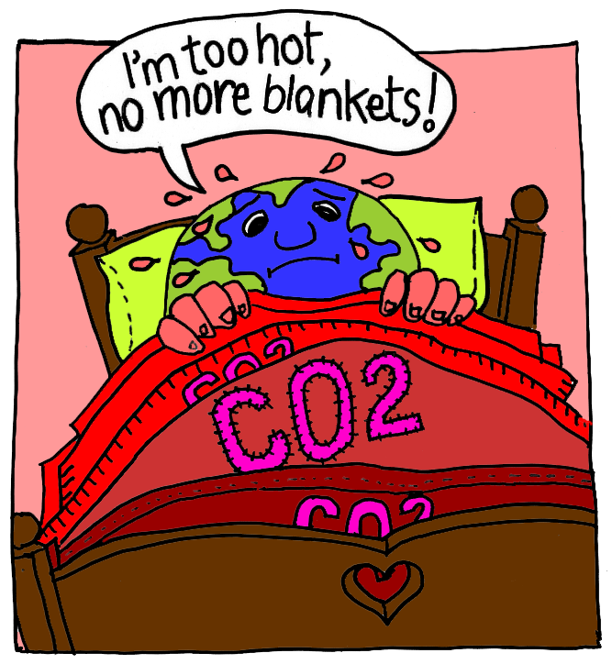
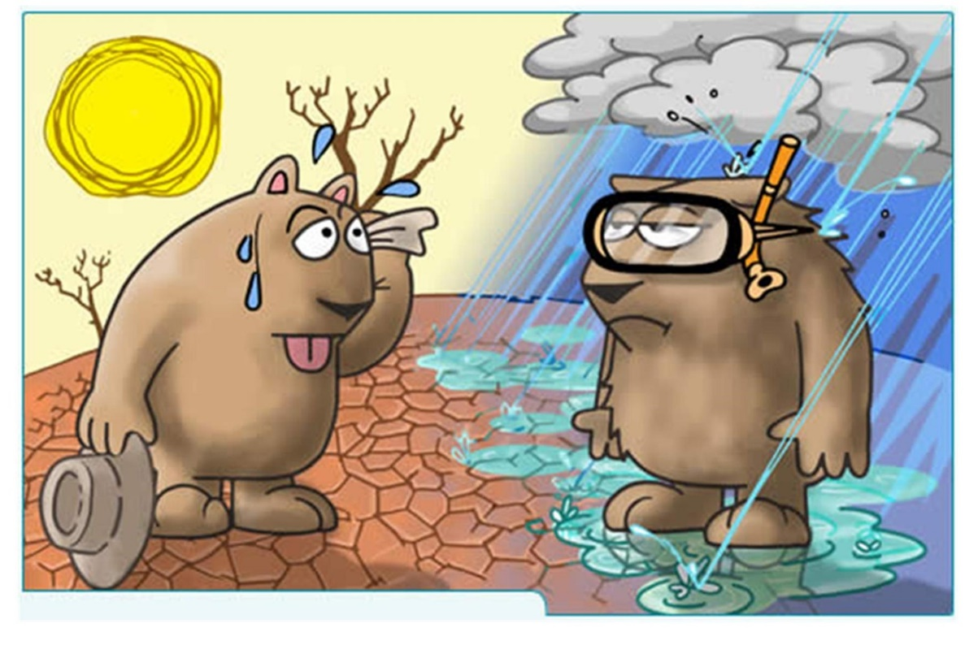
Climate change

Slide 5
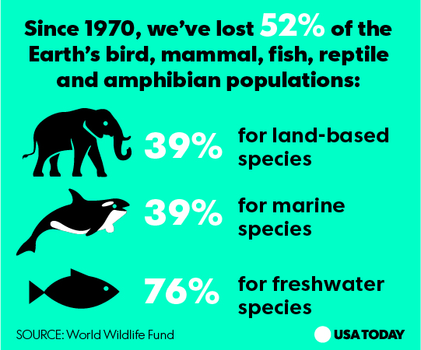
Did you know we are in the 6th mass extinction?
Around the world, 200 species go extinct every DAY!!!!

Slide 6
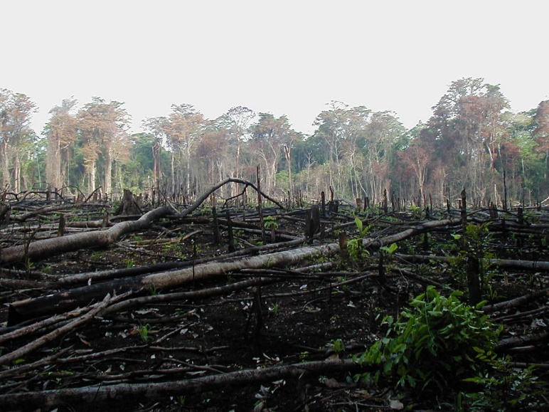
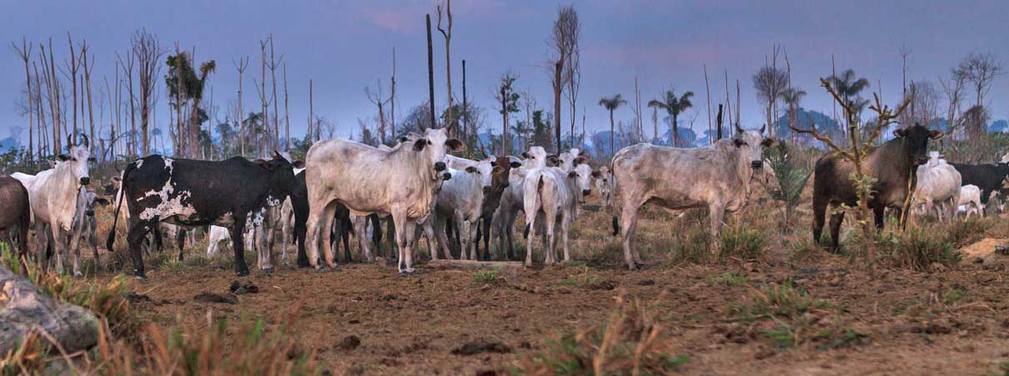
Deforestation
IN THE TIME IT TAKES TO SAY ‘DEFORESTATION’, A Piece OF FOREST THE SIZE OF A FOOTBALL PITCH IS DESTROYED AR0UND THE WORLD.
That’s every two seconds, every single day.
There are only about half the number of trees on the planet today that there were when humans first evolved.
The UK is one of the worst countries in Europe with only 11% forest cover. We are ranked 136/189 in the world.

Slide 7
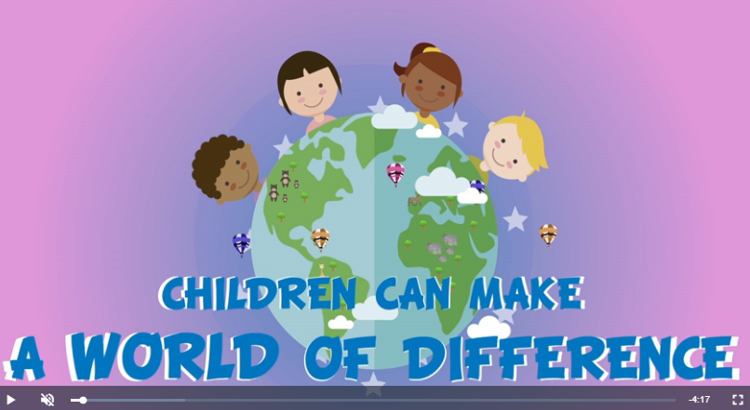
But don’t give up hope!!!!!
https://happylearning.tv/en/trees/
Did you know 89% of surveyed youth think young people can make a difference on climate change?

Slide 8
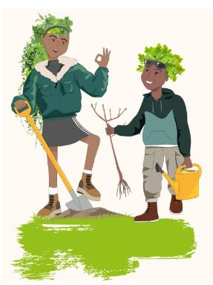
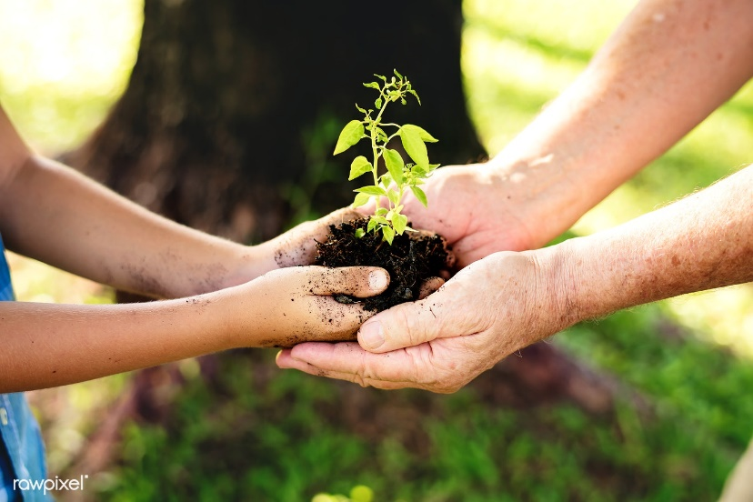
Tree Champions
What we can do here at Brentry Primary School
1. Plant Trees.
We can have 5 small, medium or large trees and you can decide how and where we want to plant them. What kind of area would you like?

Slide 9
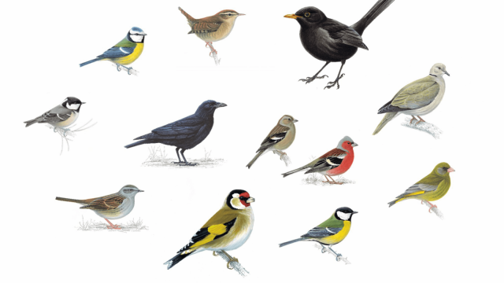
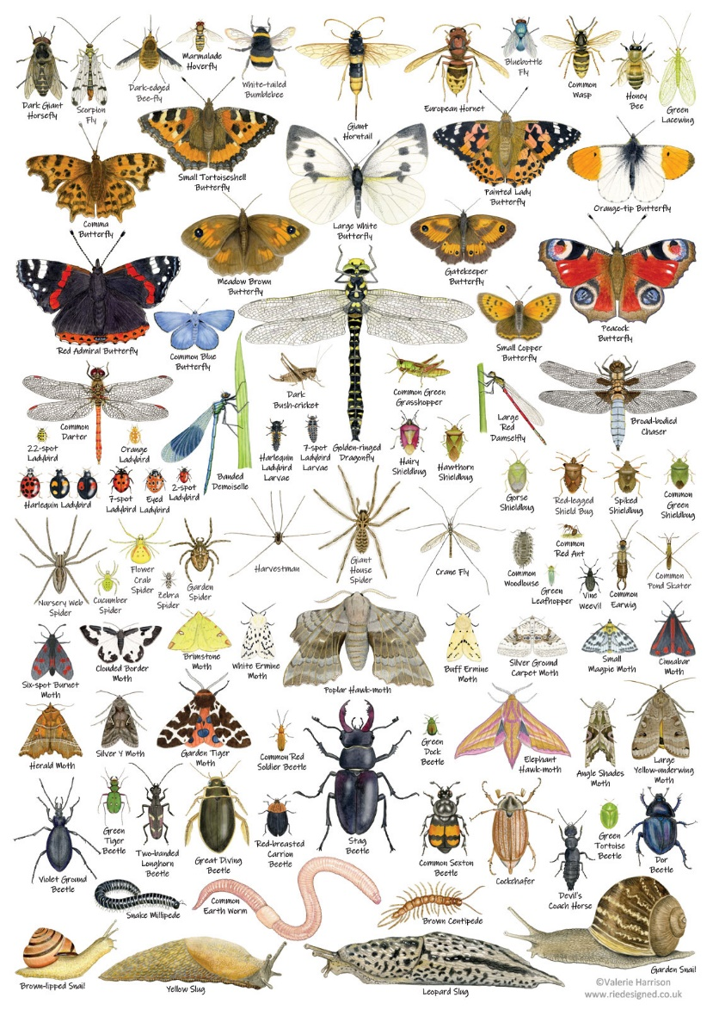
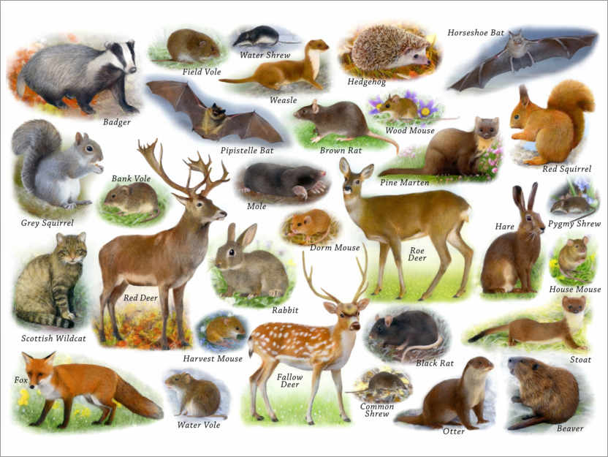
2. Make a home for nature
Having more trees mean more places for animals, insects and birds to live and thrive.
The more flora and fauna we have around us, the more chilled and relaxed we all are.

Slide 10
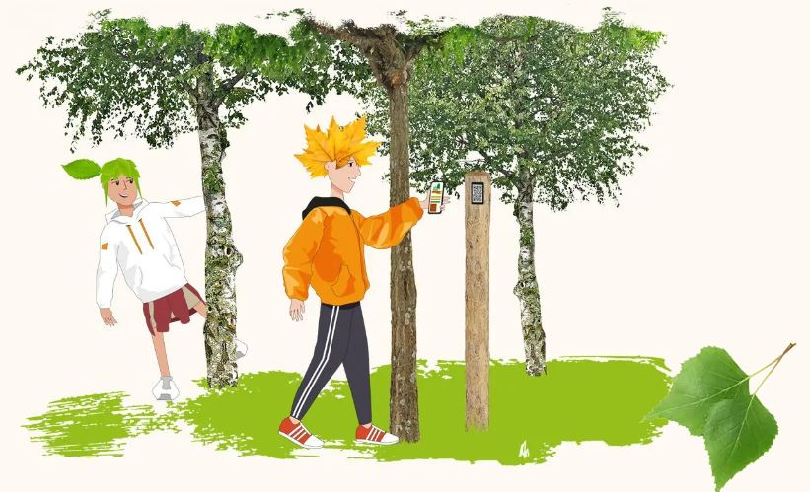
3. Use some exciting technology to make a tree trail
QR codes
microscope
Apps
Sound and video recording

Slide 11
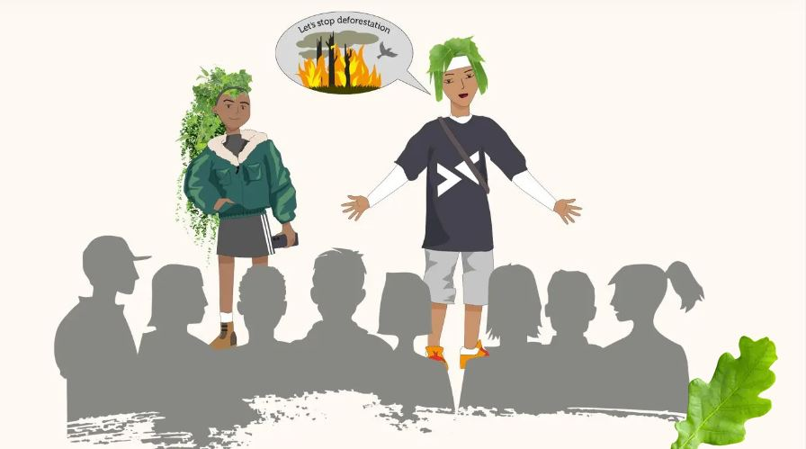
4. Learn how to speak about trees and the environment so you can help lots more people to care and get involved.

Slide 12
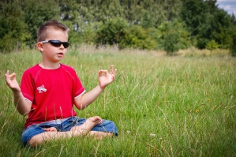
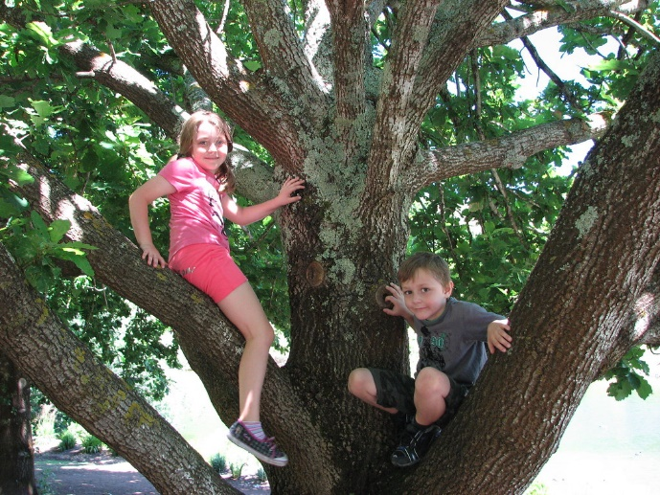
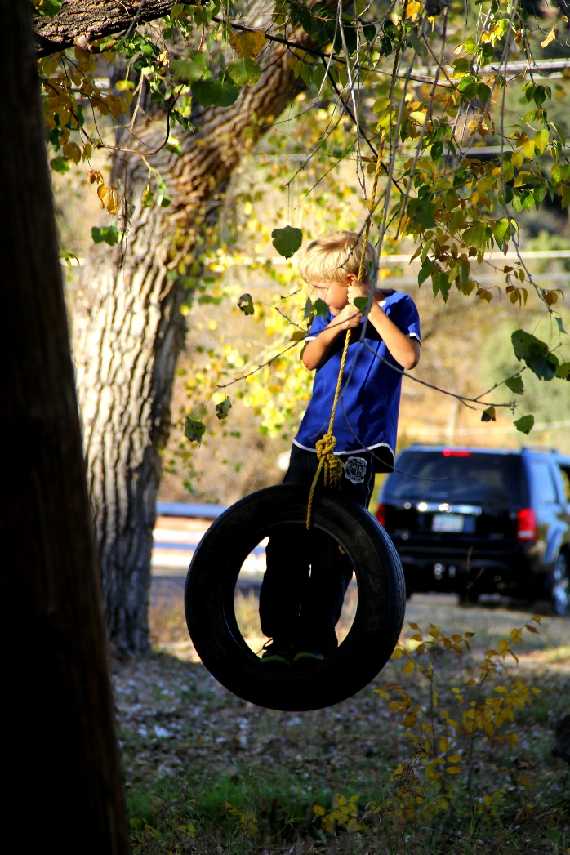

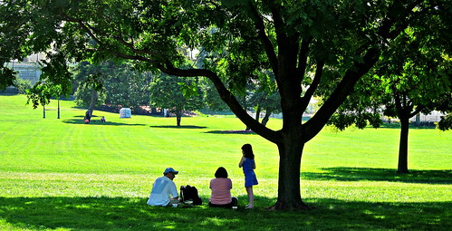
5. Connect with nature to help you feel happy and peaceful.

Slide 13
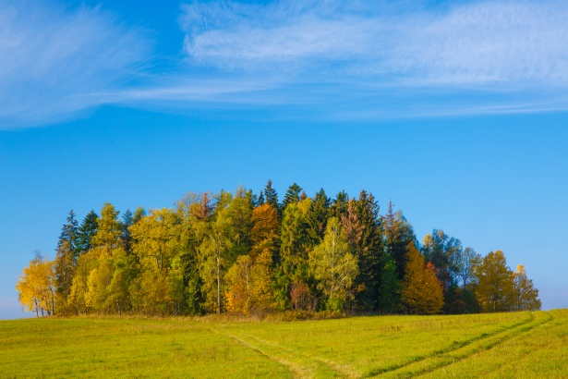
Future plan
Let’s plant our own tiny forest!!!
Tiny Forests can:
Store carbon
Soak up water to reduce local flooding
Attract a range of wildlife
Reduce dust and improve air quality
Help regulate urban temperatures
Grows 10 x faster
30 x denser
100 x more biodiverse

Slide 14
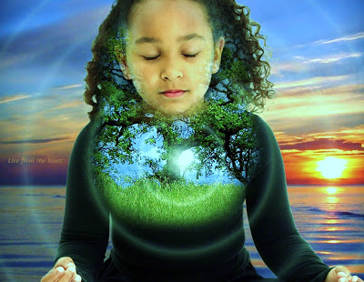
More things you can do:
Petitions to sign:
https://www.woodlandtrust.org.uk/protecting-trees-and-woods/campaign-with-us/
https://friendsoftheearth.uk/climate-change/doubling-trees-will-help-stop-climate-chaos?source=FN0000AWR
https://www.avonneedstrees.org.uk/dont-send-me-a-card/
Take care of your own mental health:
Tree meditation
https://soundcloud.com/user-292435838?utm_campaign=childrens_mental_health_week_310121&utm_medium=email&utm_source=learning

Slide 15
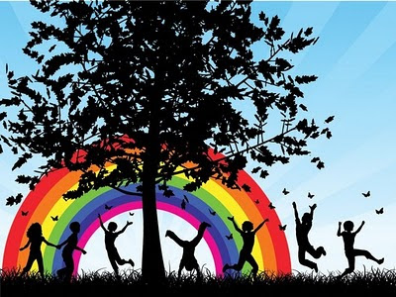
Let’s do it!
Children can make a world of difference

