Slide 1


Geography
What a Wonderful World
Year One
Geography | Year 2 | What a Wonderful World | Hot and Cold Climates of the World | Lesson 4

Slide 2
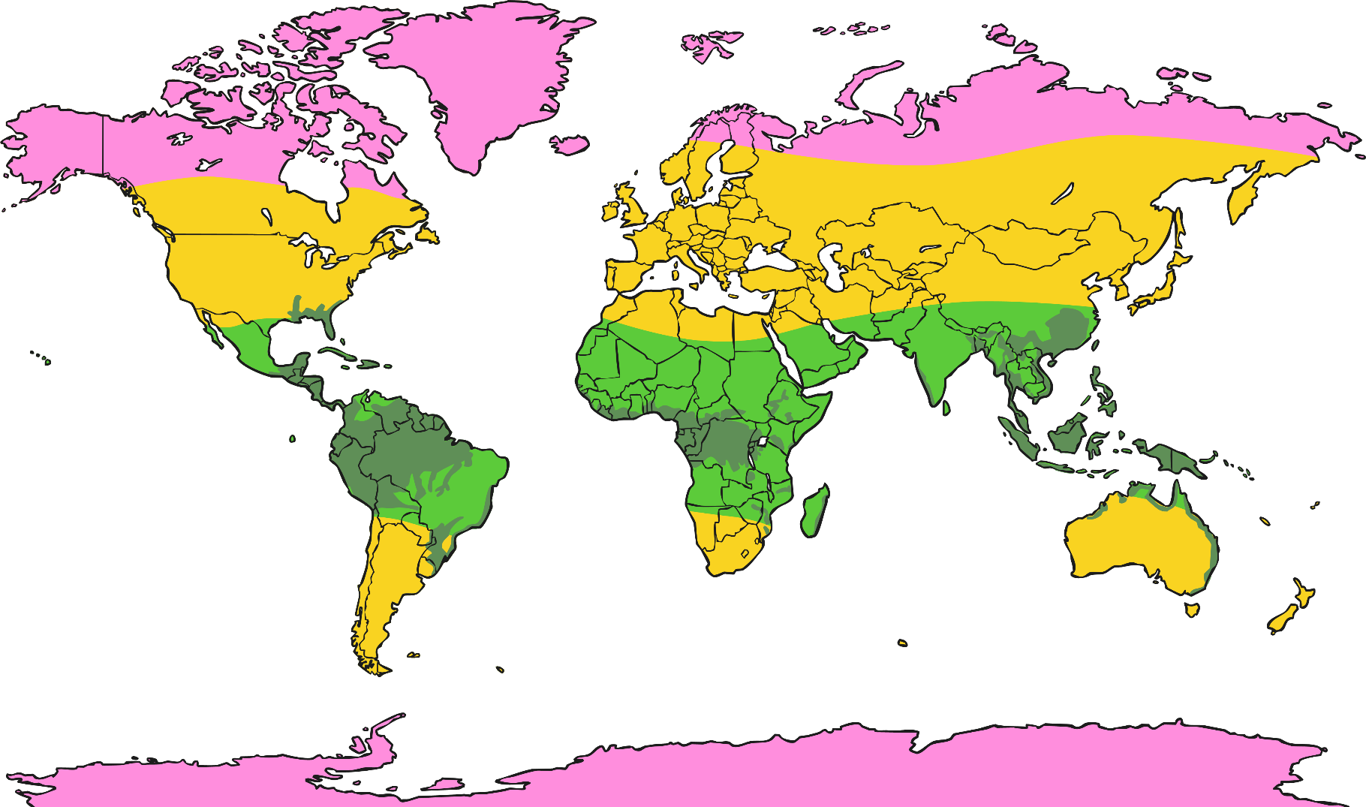

Hot and Cold Climates of the World

Slide 3
Aim
I can understand the location of hot and cold countries around the world.
Success Criteria
I can explain where hot and cold countries are located in the world.
I can begin to name climate zones around the world using key words (temperate, cold, warm, tropical)
I can understand how the location of hot and cold countries affects the different animals that live there.

Slide 4

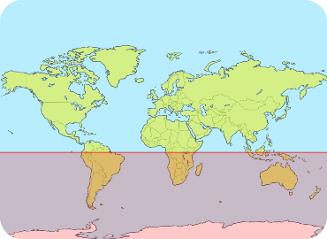
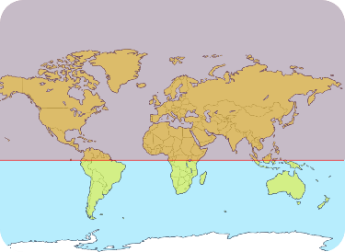
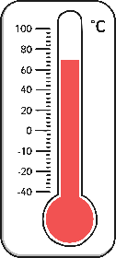
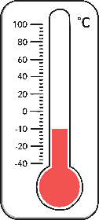
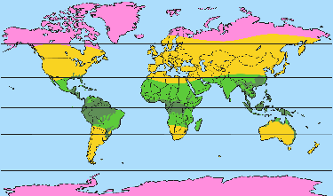
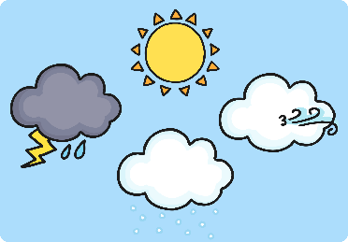
Key Words
Northern Hemisphere
Southern Hemisphere
hot
cold
climate
habitats
climate zones
weather

Slide 5
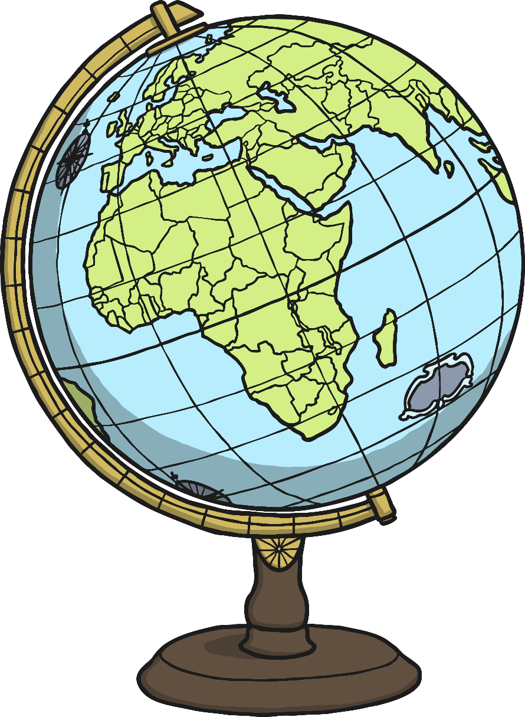
Which Hemisphere?
Northern
Hemisphere
Southern
Hemisphere

Slide 6
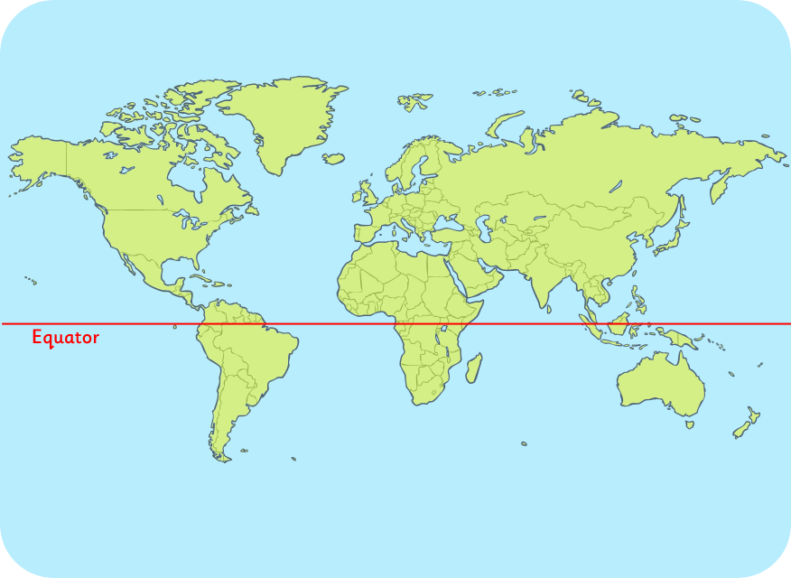
Which Hemisphere?
Can you name a country, continent or ocean in the Northern or Southern Hemisphere?
Northern Hemisphere
Southern Hemisphere

Slide 7
Hot and Cold Climates
What is the difference between weather and climate?
Weather
Weather is the day to day changes that we see happen. So, it can be sunny one day and rainy the next.
Climate
Climate is the average weather usually taken over 30 years for a particular place.
What is the weather like in our country?
Is it hot / cold / changeable?
What would you like our weather to be like?
Countries have different types of ‘climate’ around the world; they can be hot or cold.

Slide 8

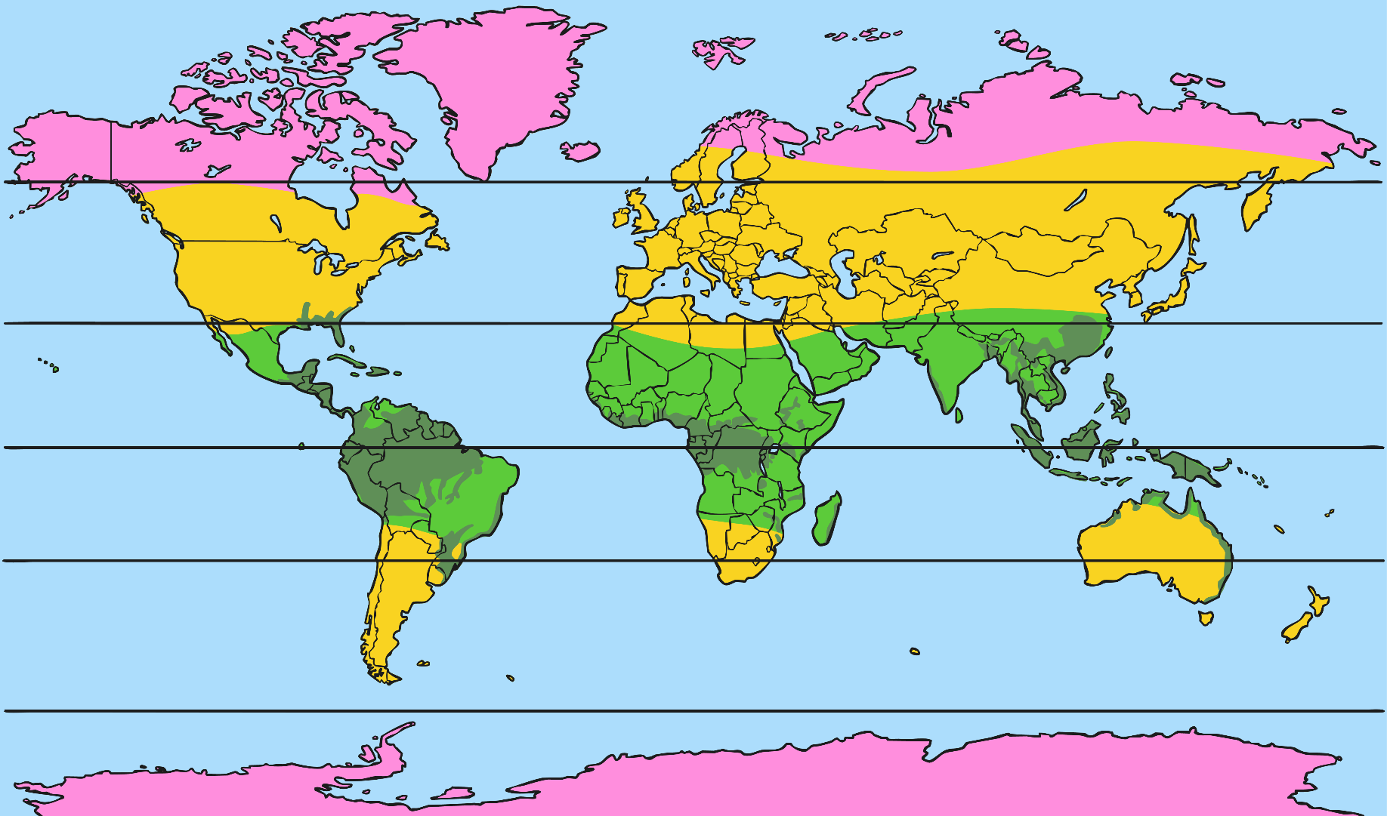
Hot and Cold Climates

Slide 9
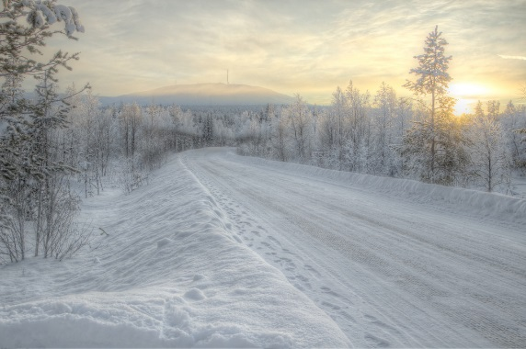
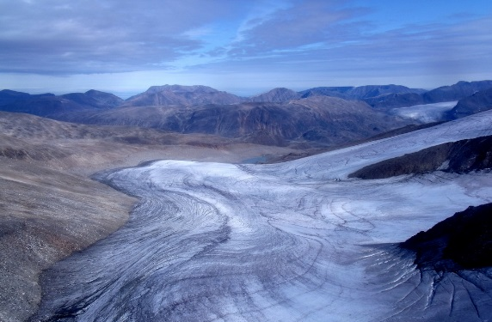
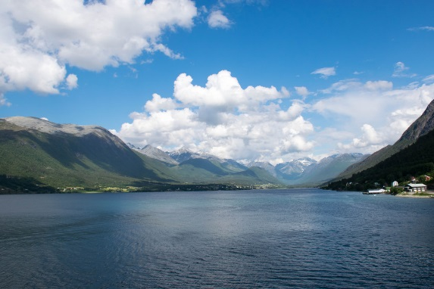
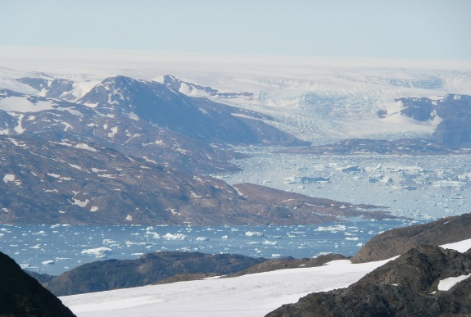
Cold or Polar Climates
Finland
Arctic
Norway
Greenland
Photo courtesy of subarcticmike, edweerdt, Green Explorer (Tom), Kitty Terwolbeck (@flickr.com) - granted under creative commons licence – attribution

Slide 10
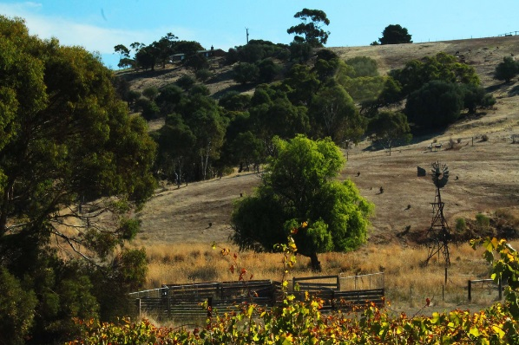
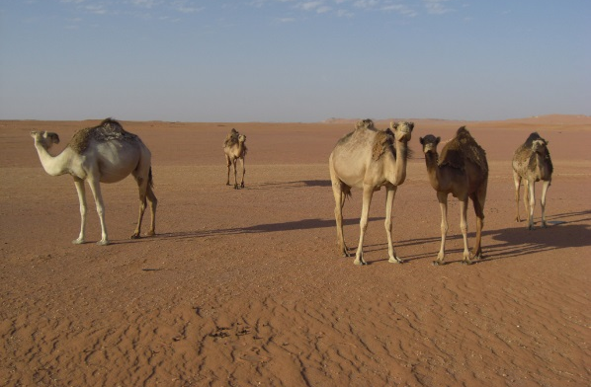
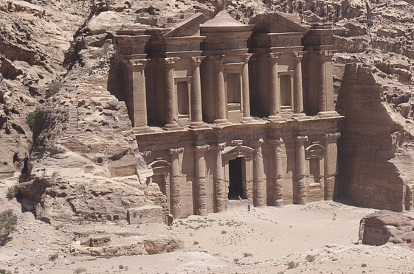
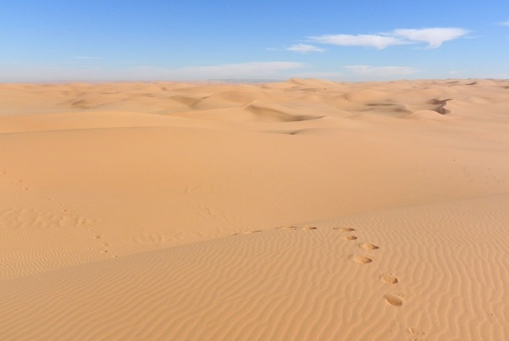
Warm Climates
Australia
North Africa
Middle East
Mexico
Photo courtesy of Leshaines123, albatros11, MSMcCarthy Photography, Pedronet (@flickr.com) - granted under creative commons licence – attribution

Slide 11
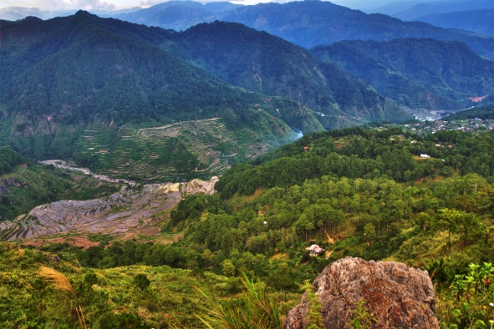
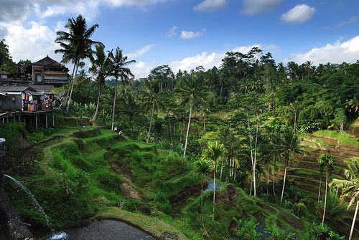
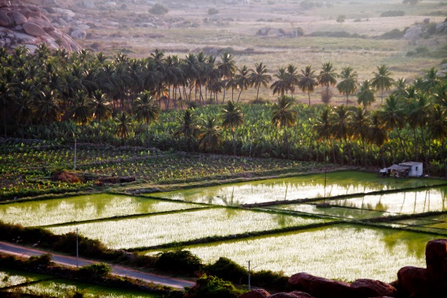
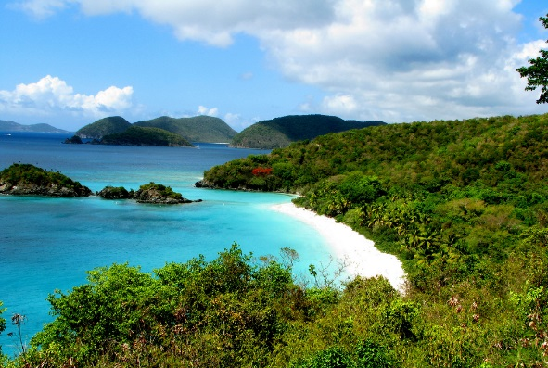
Tropical Climates
Philippines
Indonesia
India
Caribbean
Photo courtesy of williamcho, jojo nicdao, nicocrisafulli, Rennett Stowe (@flickr.com) - granted under creative commons licence – attribution

Slide 12
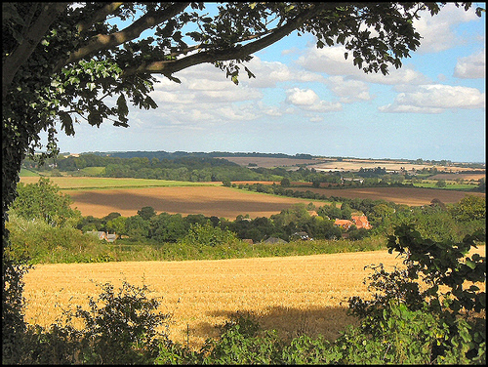
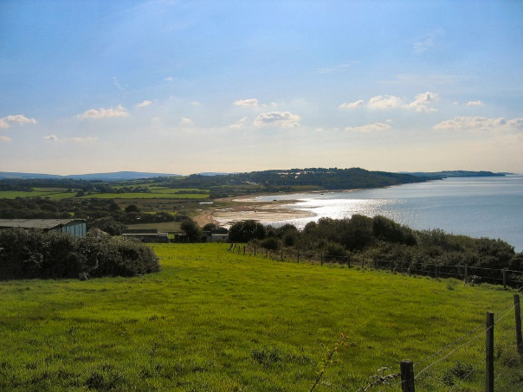
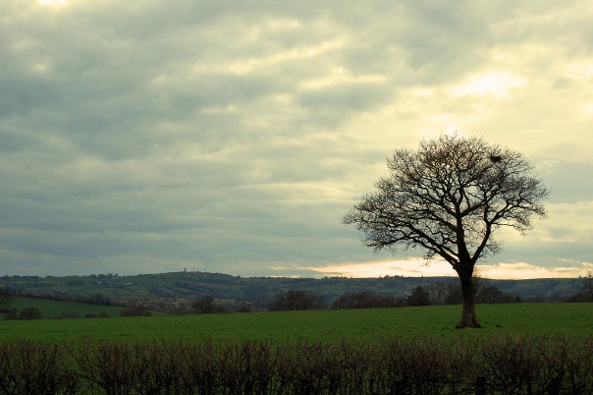
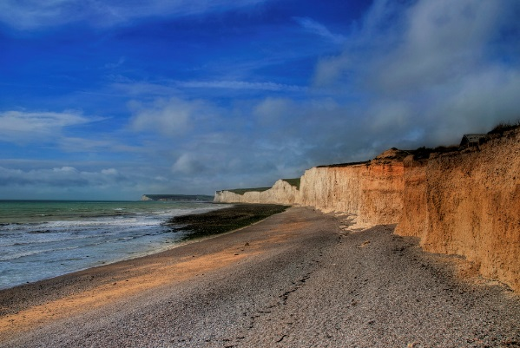
Temperate Climates - UK
Photo courtesy of Lincolnian (Brian), ronsaunders47, [Duncan], Ben124. (@flickr.com) - granted under creative commons licence – attribution

Slide 13

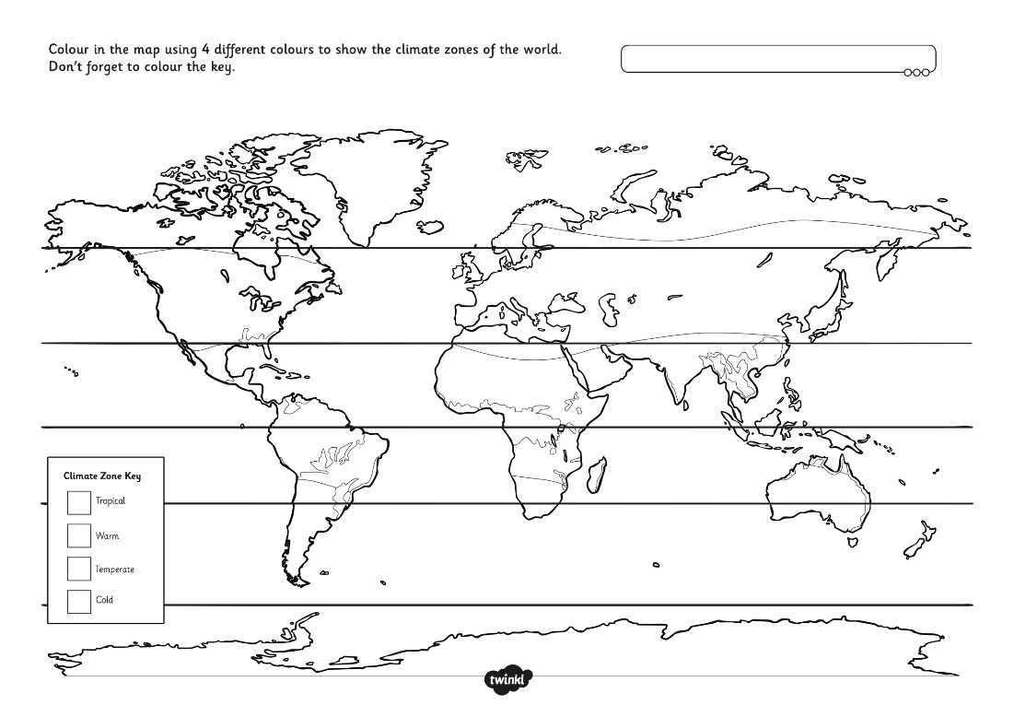
Mapping the World’s Climates
Use your activity sheet to colour code the climate zones of the world use a key to label the different climates.
Challenge: Can you draw on the equator, label the continents, countries and oceans?

Slide 14
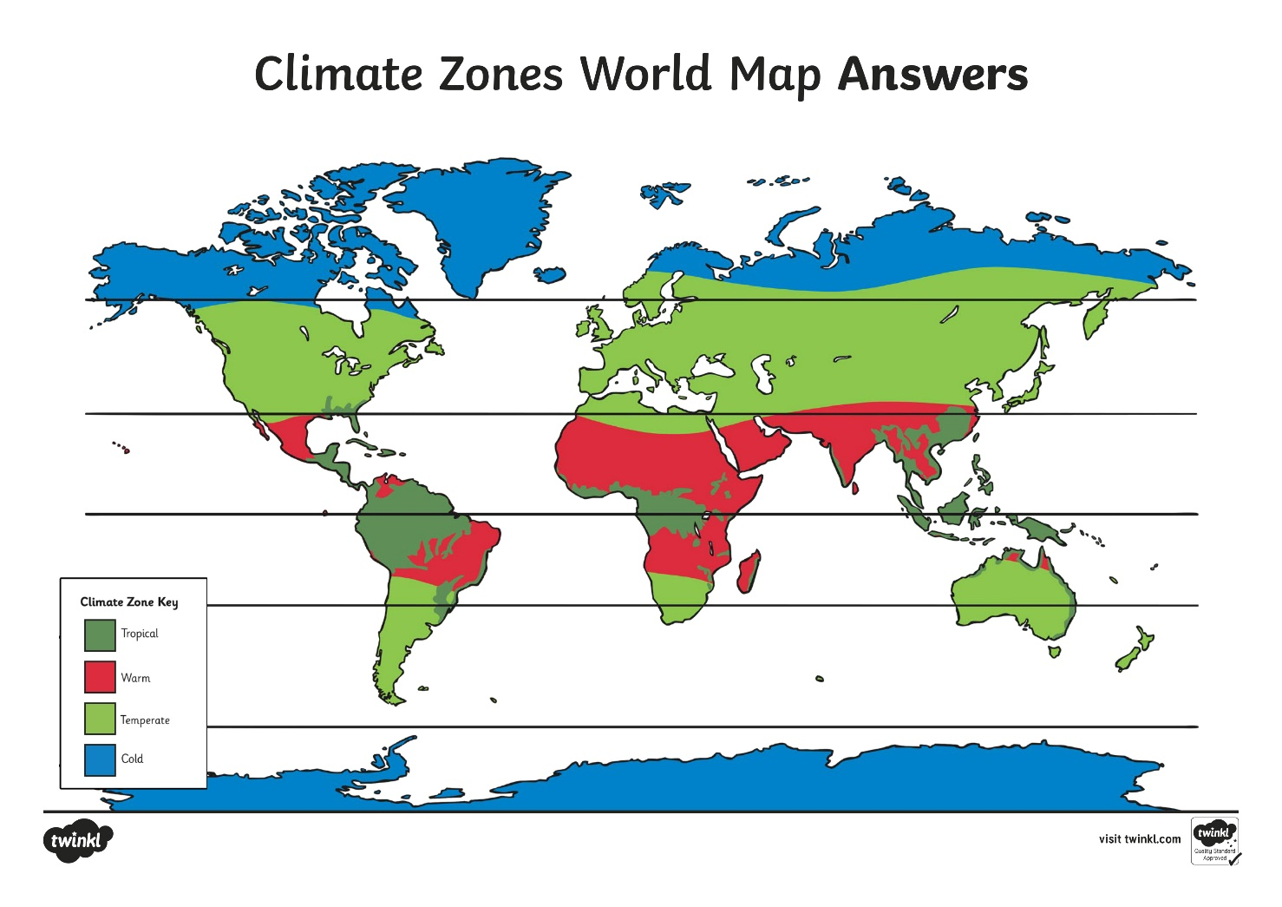
Mapping the World’s Climates

Slide 15

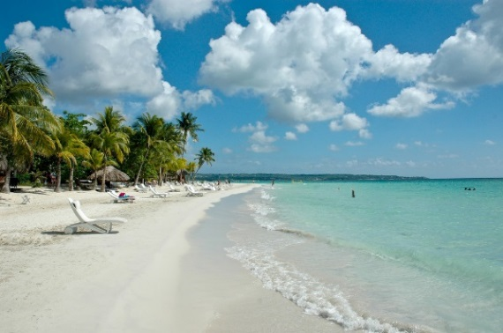


Polar Bears to Pandas
What animals live in hot countries?
What animals live in cold countries?
Photo courtesy of MSMcCarthy Photography, albatross11, nicocrisafulli, edweerdt, Green Explorer (Tom), subarcticmike, (@flickr.com) - granted under creative commons licence – attribution

Slide 16
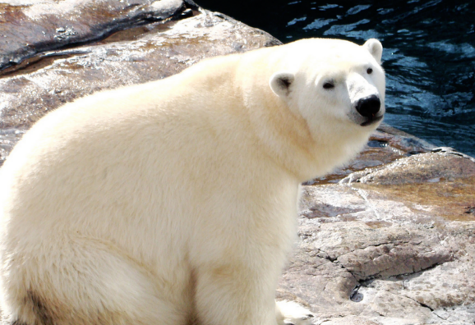
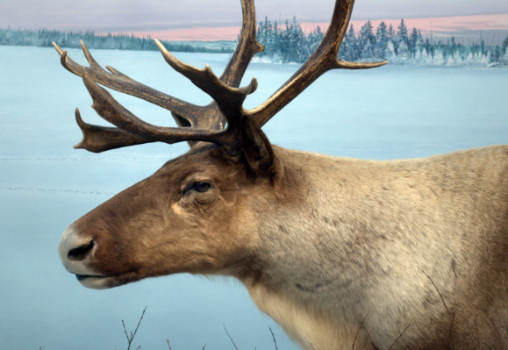
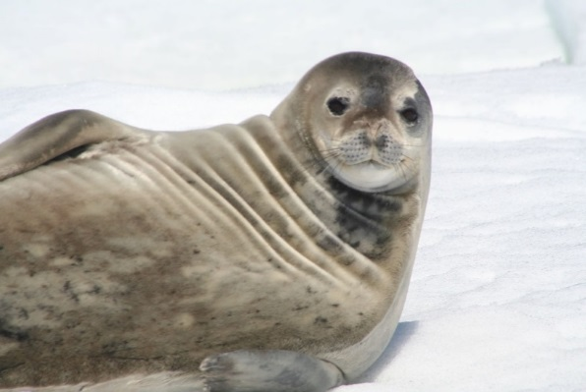
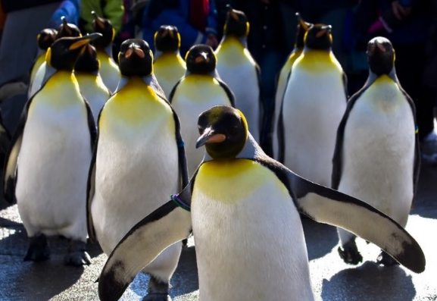
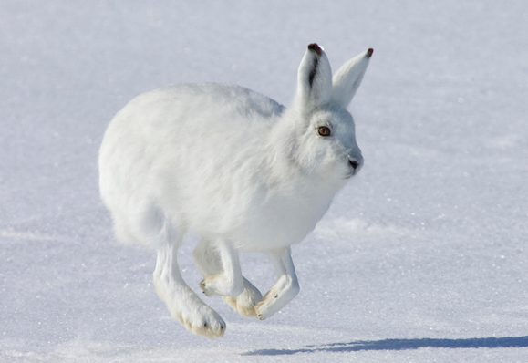
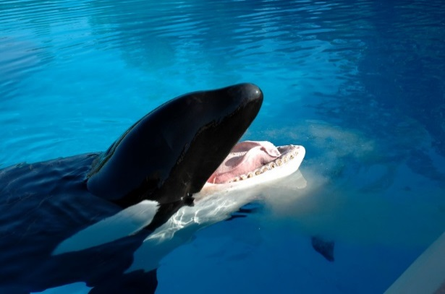
Animals from Cold Countries
Photo courtesy of Chadica, son_gismo, CraigBullard, Remi, Prairie Boy, sheilapic76 (@flickr.com) - granted under creative commons licence - attribution

Slide 17
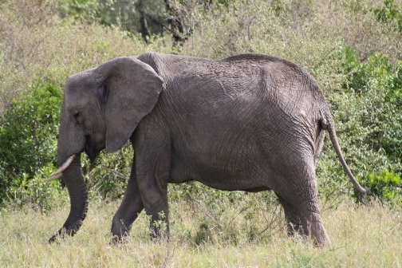
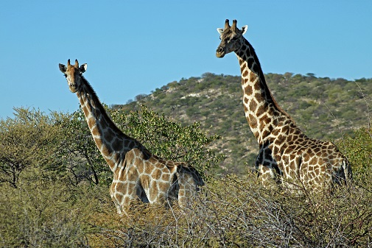
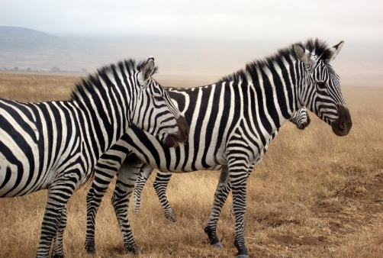
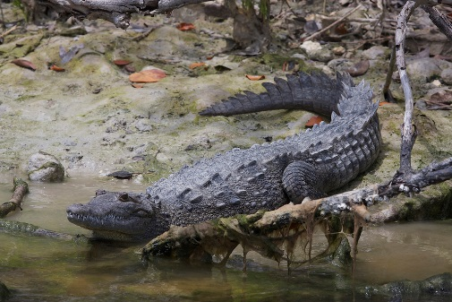
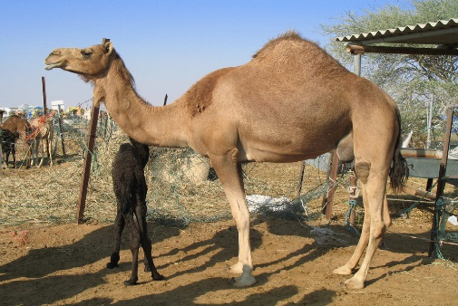
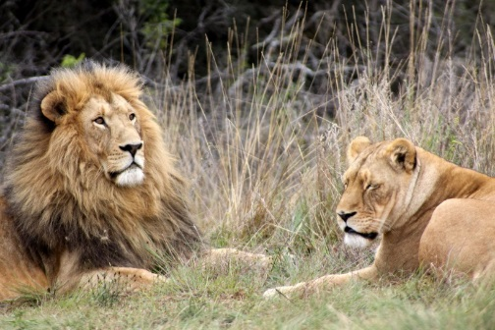
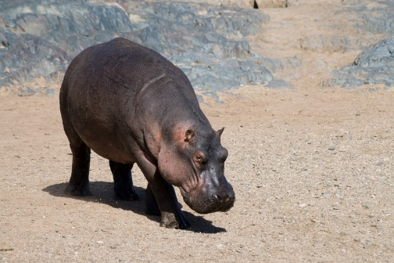
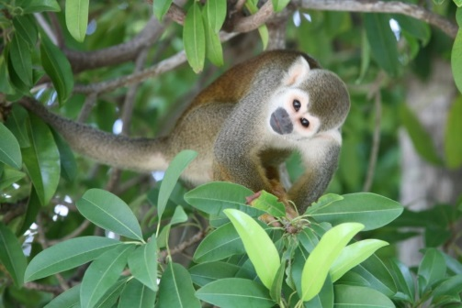
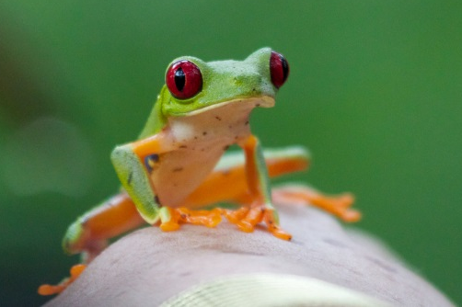
Animals from Hot Countries
Photo courtesy of oldandsolo, Stig Nygaard, Woodlouse, Derek Keats, mahimbi, Gregory Slobirdr Smith, denn, cliff1066, amonic (@flickr.com) - granted under creative commons licence - attribution

Slide 18
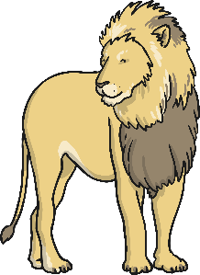
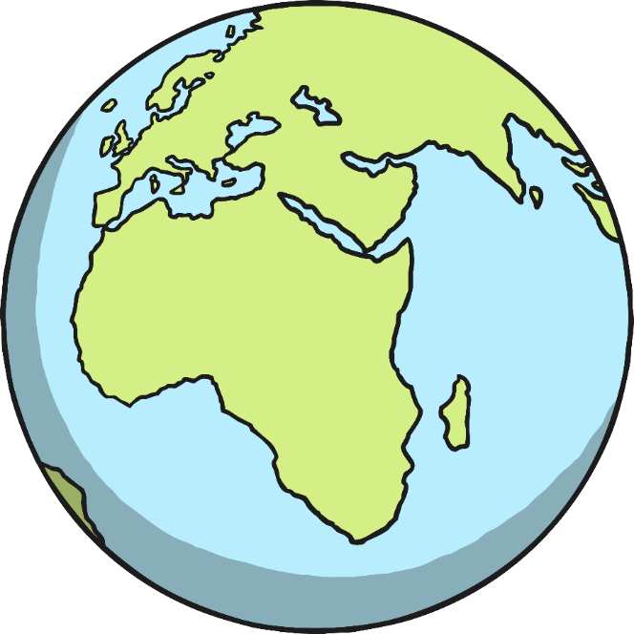
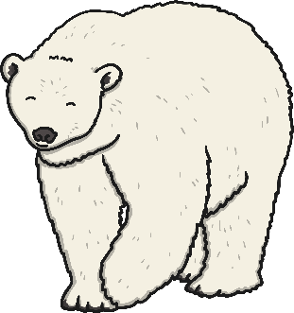
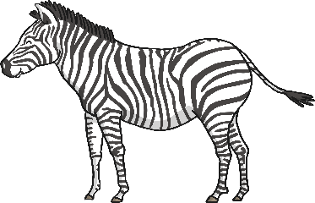
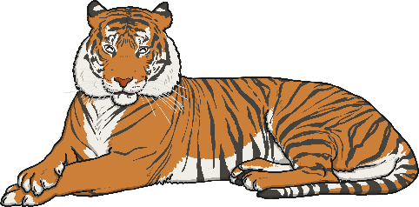
Where Do They Live?
Using your activity sheet, cut out and stick the animals in the correct climate zones on your world map.
Where do the animals live? You could use an Atlas and the Internet to help you.

Slide 19

Aim
I can understand the location of hot and cold countries around the world.
Success Criteria
I can explain where hot and cold countries are located in the world.
I can begin to name climate zones around the world using key words (temperate, cold, warm, tropical)
I can understand how the location of hot and cold countries affects the different animals that live there.

