Slide 1
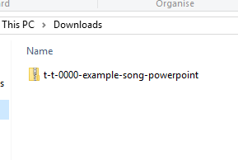
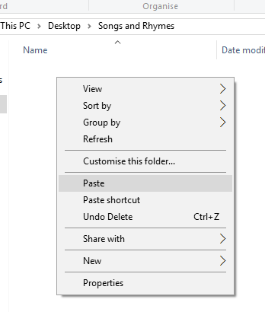


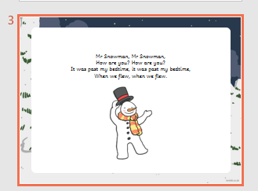
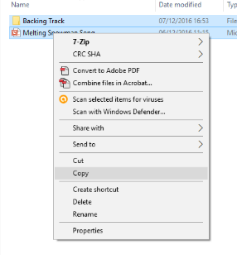
Guidance for Video/Audio in PowerPoints
1. Open the folder and copy all the files.
2. Paste the copied files into a new folder.
3. Open the PowerPoint file, enable editing and enter presentation mode (start the slide show).
Please note the embedded audio may not be compatible with early versions of PowerPoint.
You may wish to delete this slide before beginning the presentation.

Slide 3
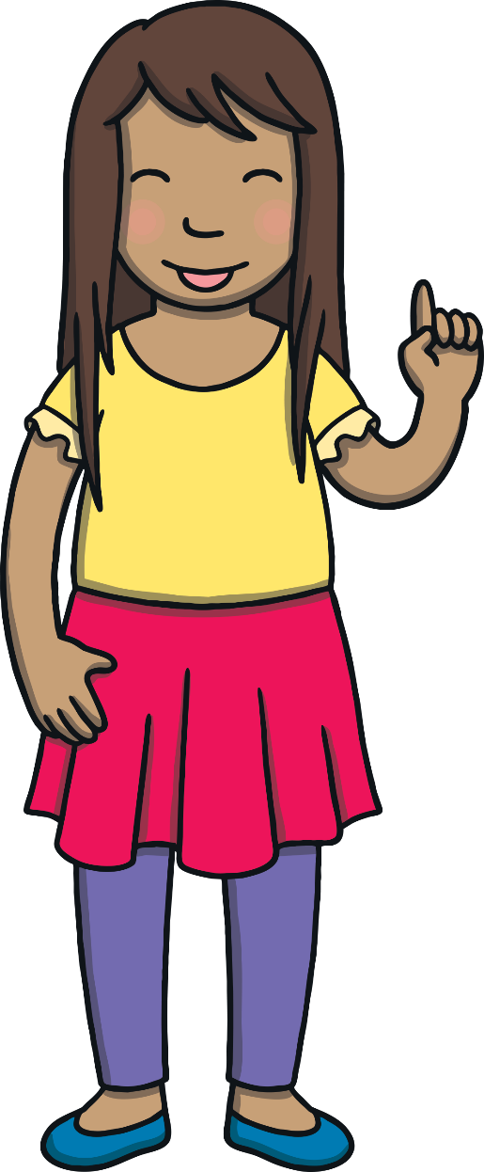
Revisit and Review
Let’s revisit last week’s focus words…
I’ll say them and you write them down!

Slide 4


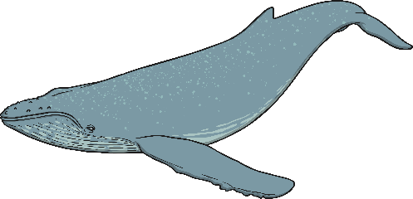
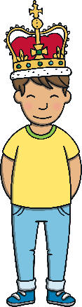


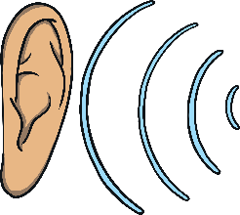
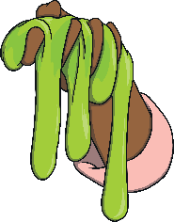

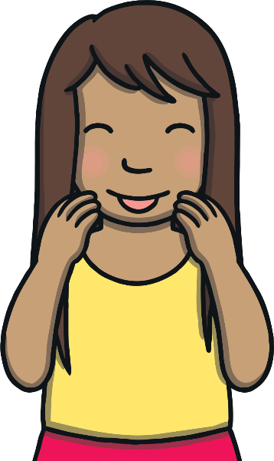


Revisit and Review

Slide 5
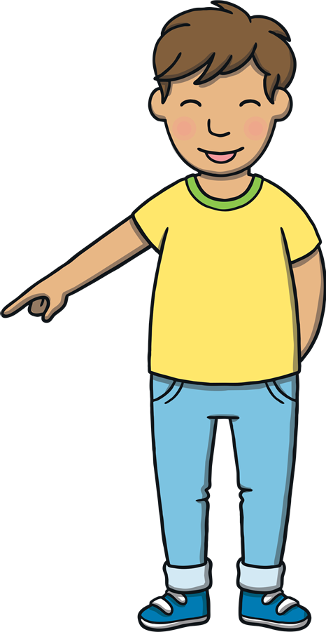

Teach
Watch the magic pencil write the words.
Can you join in?
This week, we are learning to spell the common exception words famous and shoe.

Slide 6


Teach
famous
Play

Slide 7
Teach
shoe
Play

Slide 8
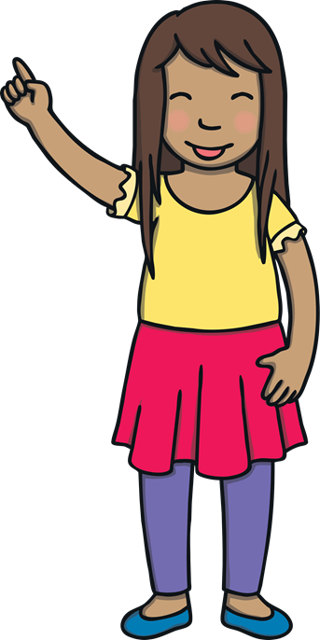
Teach
Today, we are learning to read words containing
mb saying /m/.

Slide 9
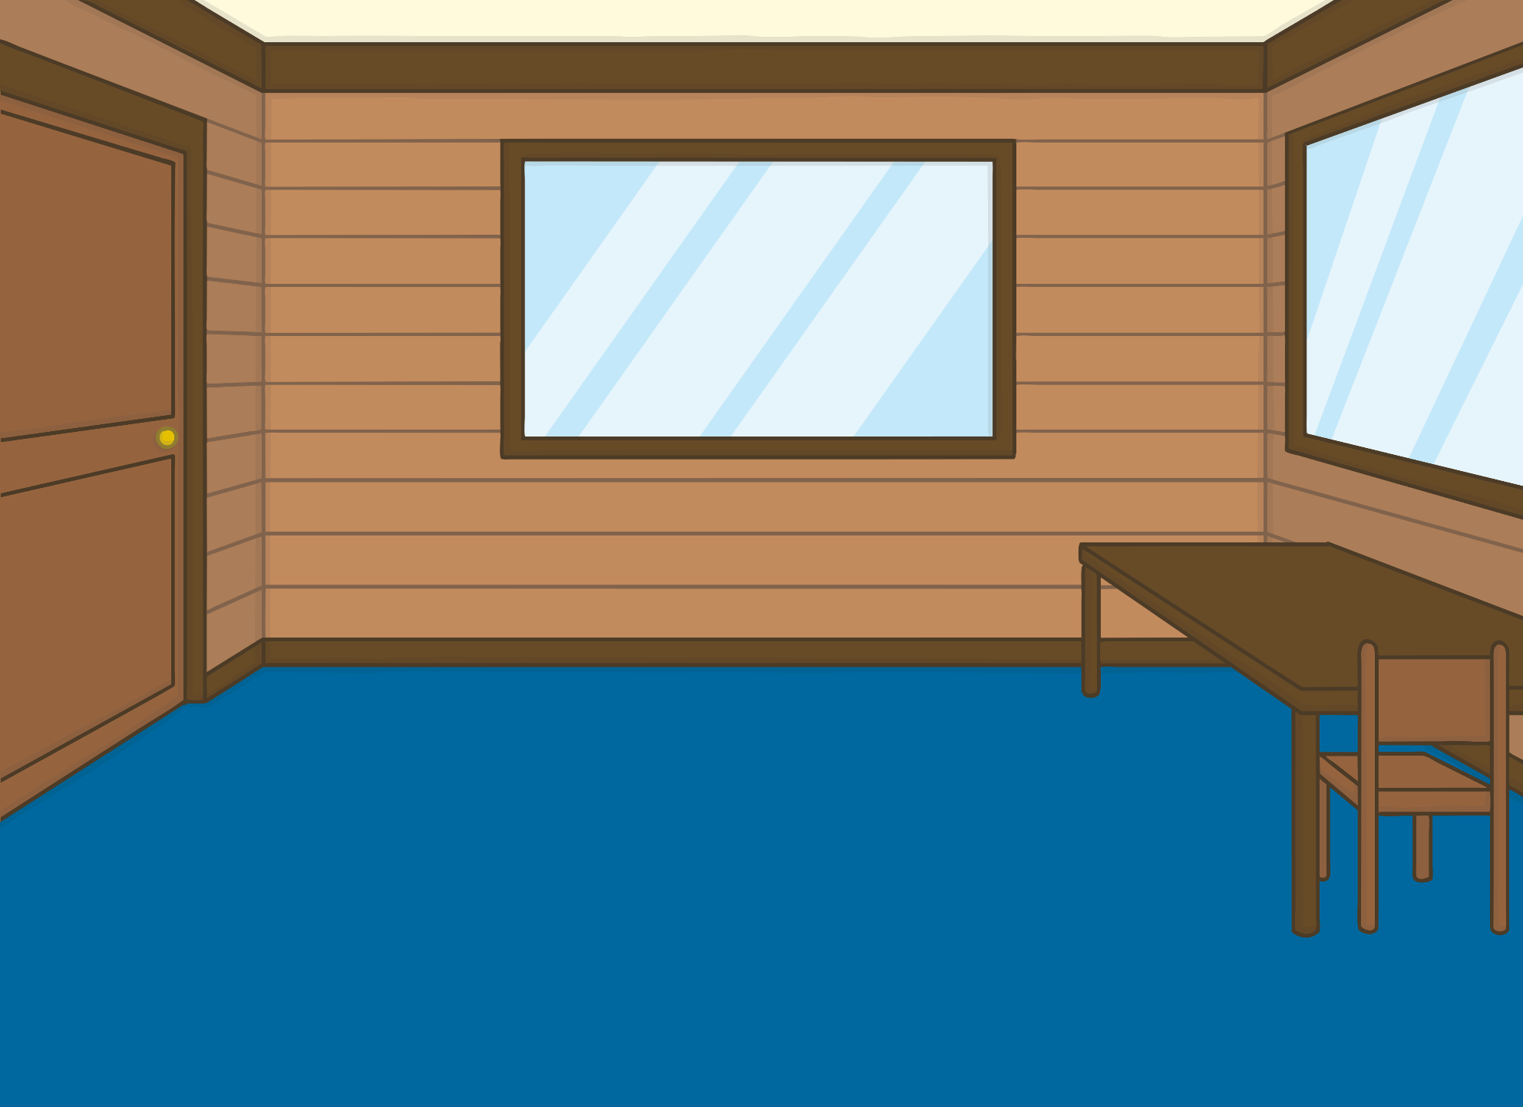
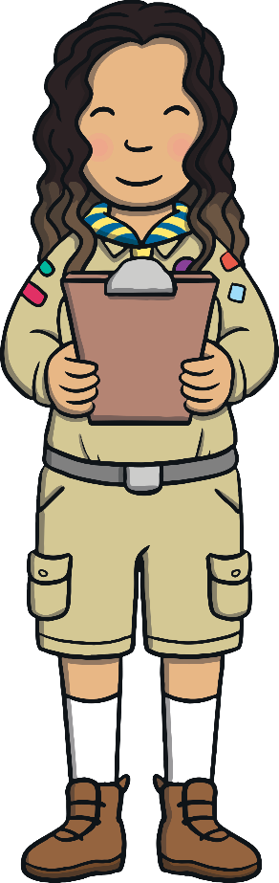
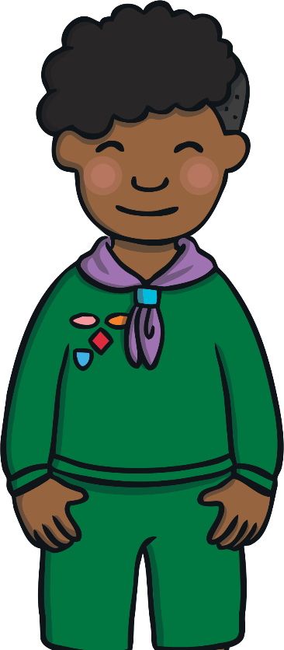
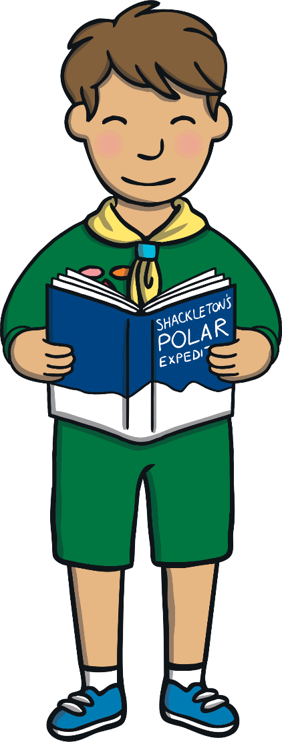
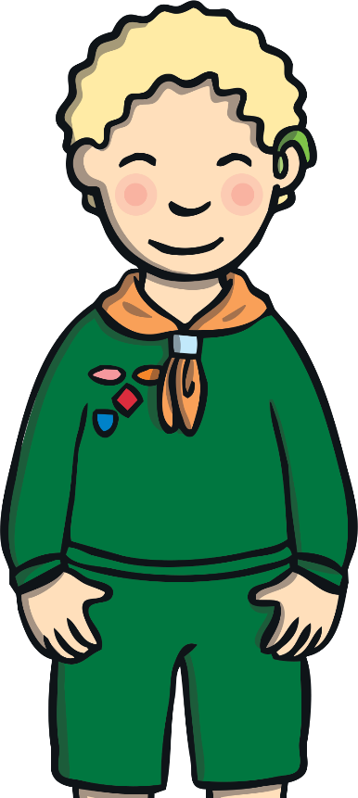
Teach
It was a Beavers club night and Kit, Dan and Jake were looking at a book together while they waited for Sana to start the lesson.

Slide 10

Teach
“What is your book about, boys?” asked Sana.
“It is about a famous explorer called Ernest Shackleton,” explained Kit. “He led an expedition to find the South Pole.”

Slide 11
Teach
“Ah yes, I’ve read about him too,” said Sana. “Brr! I don’t fancy the idea of the South Pole myself. It sounds a bit chilly.”

Slide 12
Teach
“It is,” said Jake. “The temperature can get as low as -60ºC and it’s in the middle of Antarctica!”
“I see you’re a bit of a polar expert, Jake,” said Sana, smiling.

Slide 13

Teach
The spelling pattern mb saying /m/ usually appears at the end of a word.
lamb
comb
X
The root of this spelling pattern is historical, from Old English.
crumb
Click me for Kit’s teaching tips!

Slide 14



Teach
Kit, Jake and Dan are looking at pictures of the South Pole. Click on the icebergs to reveal a word containing mb to read.

Slide 15
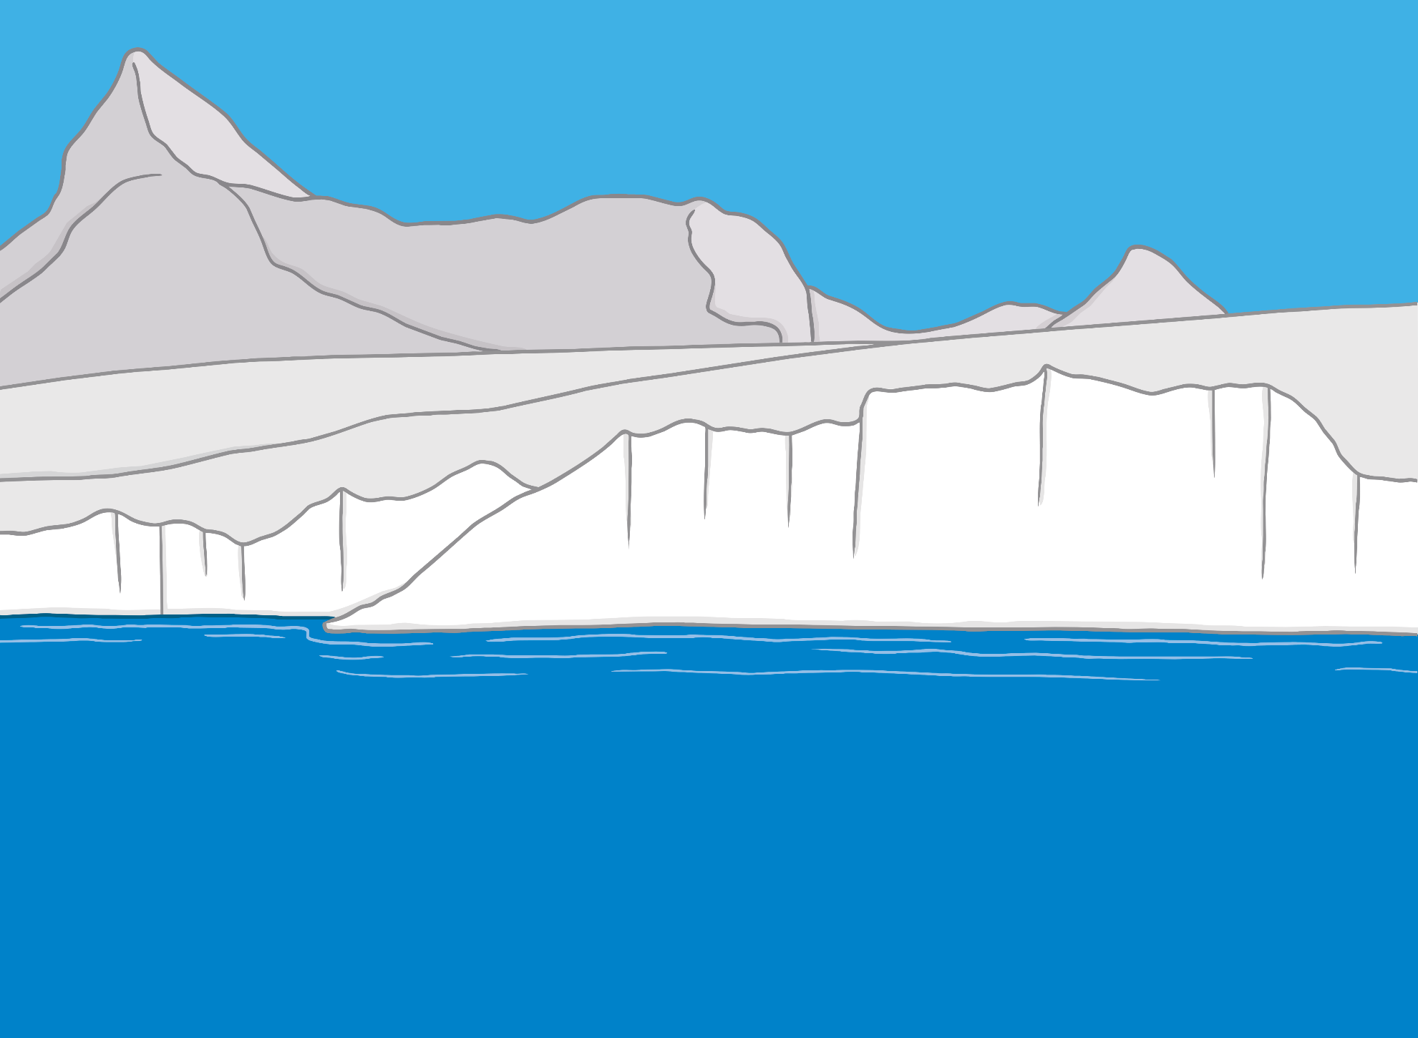
Teach
lamb

Slide 16
Teach
limb

Slide 17
Teach
comb

Slide 18
Teach
numb

Slide 19
Teach
climb

Slide 20
Teach
thumb

Slide 21
Teach
crumb

Slide 22
Teach
bomb

Slide 23

Marching Penguins
Practise
The boys discover that penguins live at the South Pole. Match the picture to the correct penguin.

Slide 24
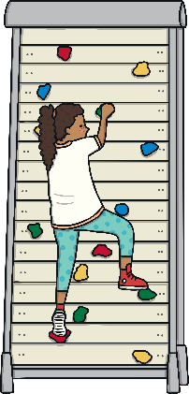

Practise
lamb
crumbs
thumb
comb
climb

Slide 25

Practise
thumb
lamb
crumbs
climb
comb

Slide 26
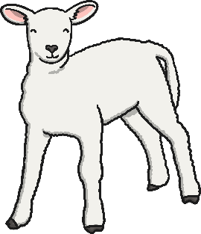
Practise
thumb
lamb
crumbs
comb
climb

Slide 27

Practise
crumbs
thumb
comb
lamb
climb

Slide 28
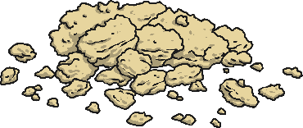
Practise
crumbs
comb
lamb
thumb
climb

Slide 29
Text Detectives
Apply
The boys are quickly finishing their book. Can you spot any words containing mb on the pages?

Slide 30


Apply
Ernest Shackleton went to explore Antarctica. Antarctica is very cold and there is lots of snow. He combed the land to find the South Pole. Shackleton had to cross the ice and climb over windswept mountains to reach the Pole. The animals he saw there were very different from where he was born in Ireland.
Ernest Shackleton went to explore Antarctica. Antarctica is very cold there is lots of snow. He combed the land to find the South Pole. Shackleton had to cross the ice and climb over windswept mountains to reach the Pole. The animals he saw there were very different from where he was born in Ireland.
There were no sheep or lambs but plenty of interesting birds!
Despite the cold numbing his limbs, Shackleton pressed on and came very close to the Pole. Sadly, he became ill and was scared of getting frostbite on his thumbs. He decided to return home.
There were no sheep or lambs but plenty of interesting birds!
Despite the cold numbing his limbs, Shackleton pressed on and came very close to the Pole. Sadly, he became ill and was scared of getting frostbite on his thumbs. He decided to return home.
Check

Slide 31
Apply
“So, Shackleton didn’t make it to the South Pole!” said Jake, looking disappointed.
“No,” said Kit, with a glint in his eye. “He didn’t but do you think that we could?”

Slide 32
Today, we have learnt…
mb
saying /m/
The adventure continues next lesson!

