Slide 1
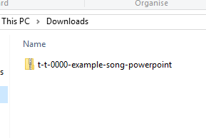
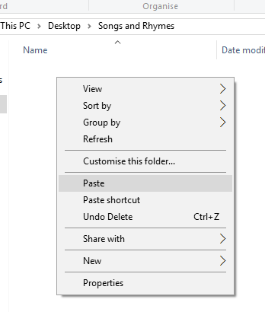

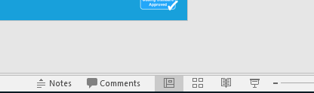
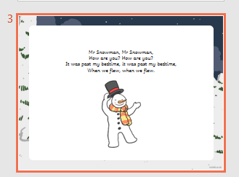
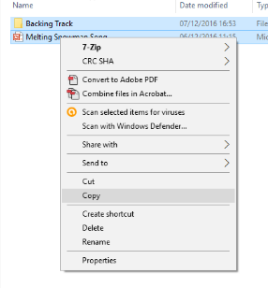
Guidance for Video/Audio in PowerPoints
1. Open the folder and copy all the files.
2. Paste the copied files into a new folder.
3. Open the PowerPoint file, enable editing and enter presentation mode (start the slide show).
Please note the embedded audio may not be compatible with early versions of PowerPoint.
You may wish to delete this slide before beginning the presentation.

Slide 3

Revisit and Review
Let’s practise reading some of this week’s focus words.
numb
comb
lamb
limb

Slide 4


Revisit and Review
Now, let’s write them with the magic pencil.
lamb
Play

Slide 5
Revisit and Review
Now, let’s write them with the magic pencil.
limb
Play

Slide 6
Revisit and Review
Now, let’s write them with the magic pencil.
comb
Play

Slide 7
Revisit and Review
Now, let’s write them with the magic pencil.
numb
Play

Slide 8

Teach
Today, we are learning to spell words containing mb saying /m/.

Slide 9
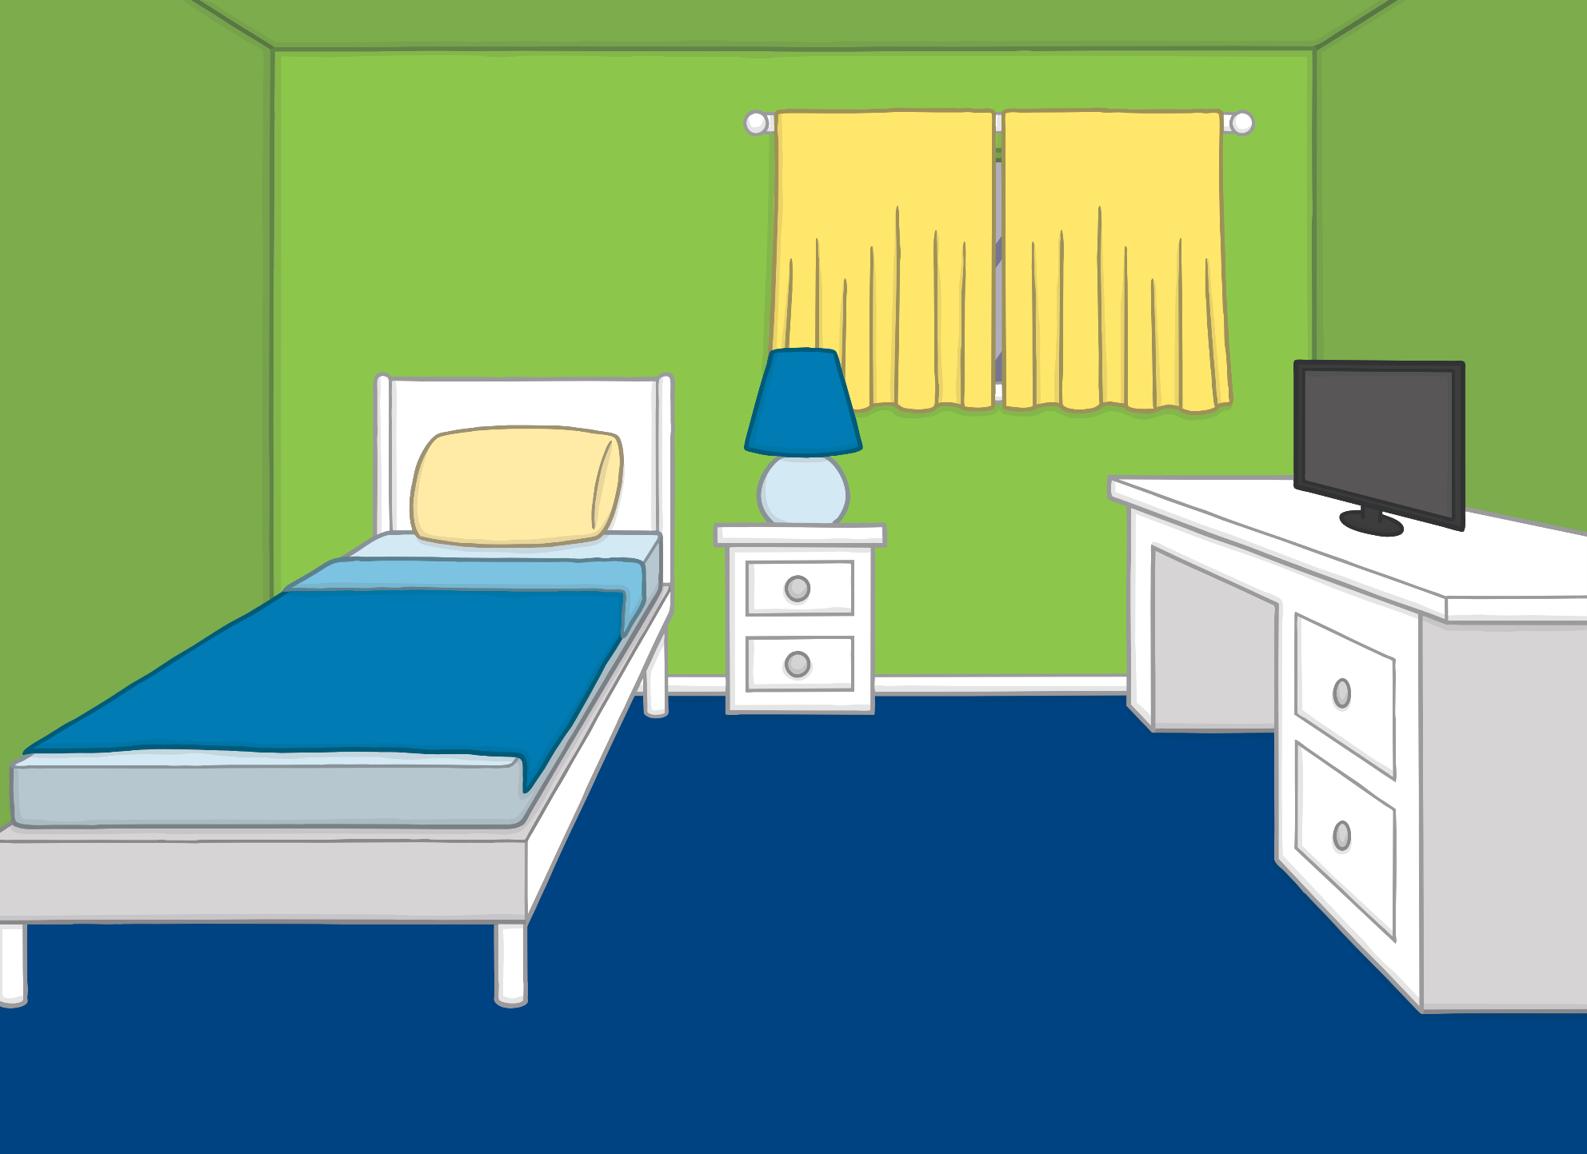
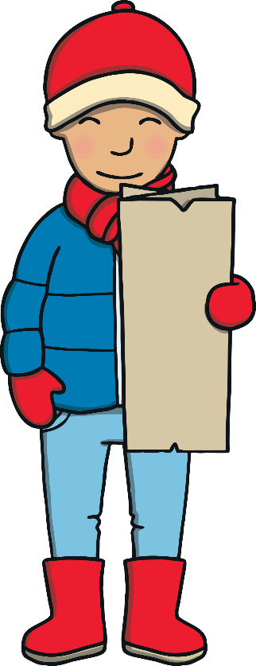


Teach
Kit, Jake and Dan were in Kit’s bedroom after school the following day.
“What’s the plan?” asked Jake. “How are we going to get to Antarctica?”
Kit smiled and pulled the magic map out from under his bed.

Slide 10

Teach
?
?
X
Who knows about the magic map?
“What is that?” asked Jake, looking surprised.
“This is a magic map,” explained Kit. “It can take us anywhere in the world. But don’t tell the grown-ups about it. Only my gran and grandad know that it exists.”

Slide 11

Teach
“I promise!” said Jake. “So boys, shall we go?”
Kit and Dan nodded eagerly. “To Antarctica!” said Kit.
The room faded around them but none of the boys noticed that the magic map had fallen out of Kit’s hand and was lying on the bedroom floor.

Slide 12

Teach
The b in words that end in mb is a silent letter. It usually appears at the end of words.
comb
thumb
Here is an exception:
X
Exceptions to the ‘mb at the end’ rule are very rare and occur when a suffix is added.
plumber
Click me for Kit’s teaching tips!

Slide 13

Teach
Kit, Jake and Dan are travelling to Antarctica, where it is very cold. Add in the missing letters to the mb words on snowflakes.

Slide 14

Teach
lamb
la_b
Click me to check!

Slide 15

Teach
_imb
limb
Click me to check!

Slide 16
Teach
_om_
comb
Click me to check!

Slide 17
Teach
numb
n__b
Click me to check!

Slide 18
Teach
b_m_
bomb
Click me to check!

Slide 19
Teach
_l_m_
climb
Click me to check!

Slide 20



Letters in the Snow
Practise
Kit, Jake and Dan can see some letters written in the snow. How many words containing mb can you make? Click the seal for a clue!

Slide 21

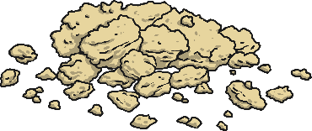



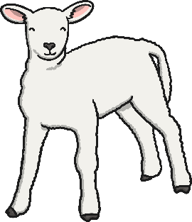

Practise
c
u
h
b
a
u
r
o
m
b
t
l

Slide 22

Apply
To the South Pole
The boys found themselves standing in a snowy land. It was bitterly cold.
“I’m glad we were wearing our winter coats when we left,” shivered Jake.
“Yes,” agreed Dan. “Now, which way to the South Pole?”
“Hey,” said Kit, pointing, “there is a signpost over there! Let’s read it!”

Slide 23
Error Checkers
Apply
Kit, Jake and Dan have spotted a signpost. Read what is written and correct any words that are spelt wrong.
To the South Pole

Slide 24


Apply
To the South Pole
Explorers Beware!
The trek you begin will be cold and challenging.
Your lyms may get numm. Check each thumb for frostbite.
Clime the snow drifts and do not shout. Loud noises act like a bom and could lead to an avalanche!
Explorers Beware!
The trek you begin will be cold and challenging.
Your lyms may get numm. Check each thumb for frostbite.
Clime the snow drifts and do not shout. Loud noises act like a bom and could lead to an avalanche!
Check

Slide 25
Apply
To the South Pole
“Sounds like we’d better not hang around,” said Jake. “Let’s follow the sign.”
“Do you reckon we might be the first children to go to the South Pole?” said Kit, as they started to walk through the snow.
“I reckon so,” laughed Dan. “Maybe we’ll get some sort of medal!”

Slide 26
Today, we have learnt…
mb
saying /m/
The adventure continues next lesson!

