Slide 2
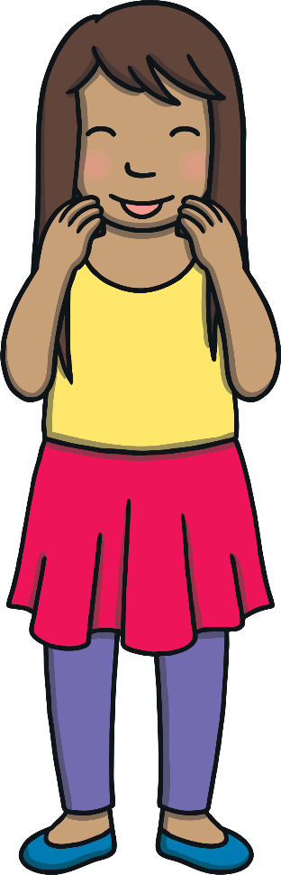
Revisit and Review
Let’s practise reading some of this week’s focus words.
comb
thumb
crumb
climb

Slide 3


Revisit and Review
Now, let’s write them with the magic pencil.
c
l
i
m
b
Play

Slide 4
Revisit and Review
Now, let’s write them with the magic pencil.
t
h
u
m
b
Play

Slide 5
Revisit and Review
Now, let’s write them with the magic pencil.
c
o
m
b
Play

Slide 6
Revisit and Review
Now, let’s write them with the magic pencil.
c
r
u
m
b
Play

Slide 7

Teach
Today, we are learning to identify different ways of spelling the /m/ sound.

Slide 8

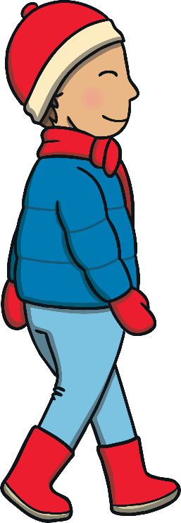
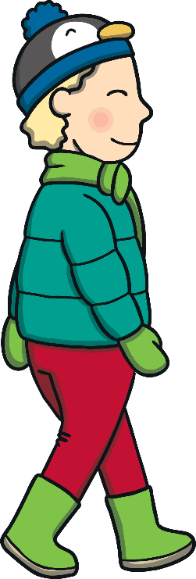
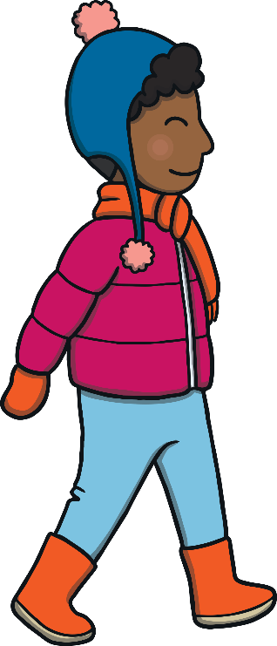
Teach
Kit, Jake and Dan were in Antarctica. They started to walk through the snow to find the South Pole. “I wonder how far it is?” said Dan.
“Well, we’ve seen a signpost so it can’t be too far,” puffed Jake.

Slide 9
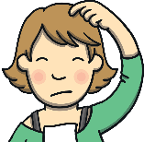
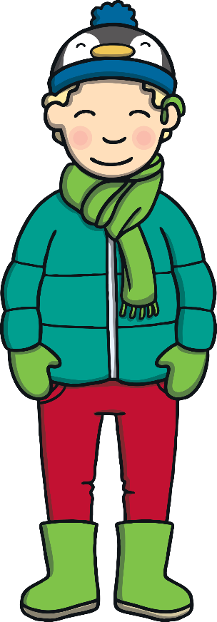
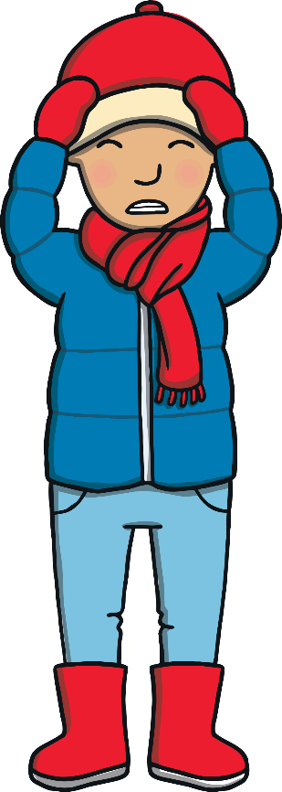
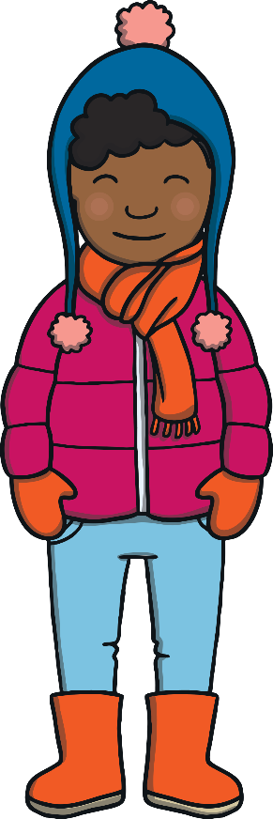
Teach
?
?
X
What could the boys use to find their way? Give reasons for your answer.
“But how will we know which direction to go in?” asked Kit. “Everywhere looks the same!” The boys looked around them. Everywhere was white with snow and ice.
“How did Shackleton find his way?” wondered Jake.

Slide 10


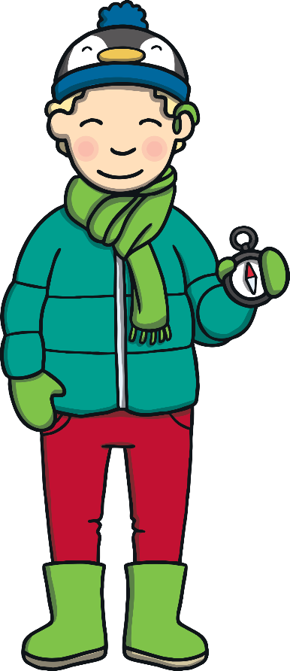
Teach
Dan reached into his pocket and pulled out a compass. “With one of these! We’re Beavers, aren’t we, so I always carry my compass with me.” Kit and Jake patted Dan on the back.
“Good thinking, Dan!” said Kit.

Slide 11

Teach
When /m/ appears at the end of a word, it can be written as
m, me or mb.
m
me
mb
farm
come
comb
storm
some
thumb
X
m is the most common way of writing /m/ at the end. This is the ‘best bet’!
dream
become
climb
Click me for Kit’s teaching tips!

Slide 12
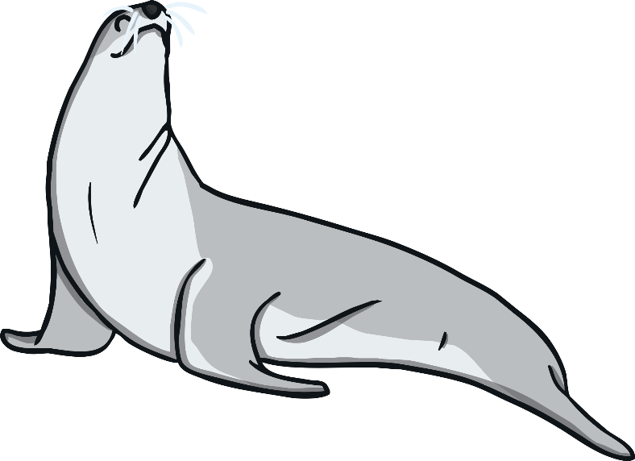
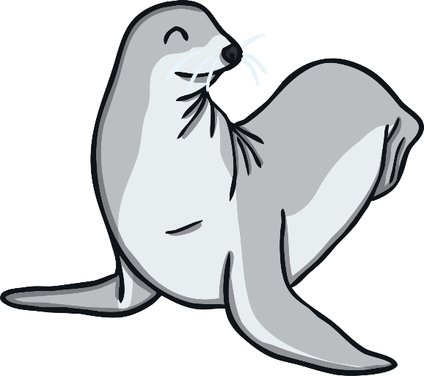

Teach
Kit, Jake and Dan see seals lying on the snow. Click on the seals to move them into the correct /m/ family ice floe.

Slide 13
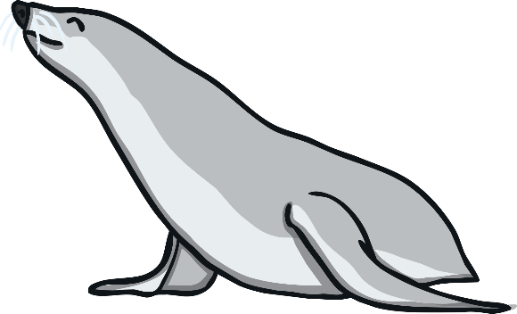
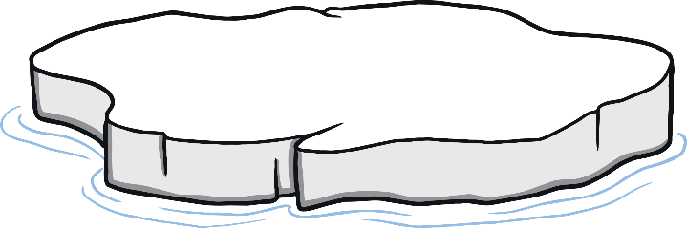
Teach
charm
charme
charmb
m

Slide 14
Teach
lam
lamb
lamme
mb

Slide 15
Teach
somb
som
some
me

Slide 16
Teach
farm
farme
farmb
m

Slide 17
Teach
climb
clime
clim
mb

Slide 18

Dan’s /m/ Compass
Practise
Dan is showing Kit and Jake how to use his compass. Click the compass and write a word containing m, me or mb.
Stop when the needle shows south!

Slide 19
Practise
m
me
mb
south
Click

Slide 20



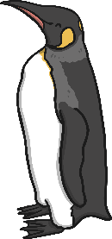
Apply
“We’re proper explorers now that we have a compass!” laughed Jake.
“We are,” agreed Kit. Suddenly, Dan stopped.
“Hey, what are those shapes in the distance?” he asked. “Are they penguins?”

Slide 21

Whizzy Word Families
Apply
Dan has spotted some penguins in the distance. Read the sentences and choose an /m/ word to replace the penguins.

Slide 22

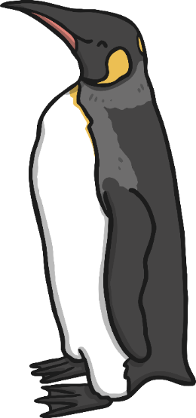
Apply
Hey everybody, let’s march quickly before our fingers go !
Hey everybody, let’s march quickly before our fingers go numb!

Slide 23

That penguin seemed to divebomb into the water.
That penguin seemed to divebomb into the water.
Apply
I wish we
had some honeycomb to eat right now.
I wish we
had some honeycomb to eat right now.
I haven’t combed my hair since we arrived.
I haven’t combed my hair since we arrived.

Slide 24
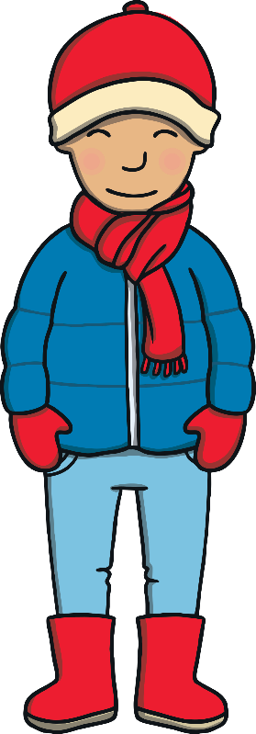
Apply
It's far too cold for us to divebomb into the water!
It's far too cold for us to divebomb into the water!
I wish we
had some honeycomb to eat right now.
I wish we
had some honeycomb to eat right now.

Slide 25

Apply
I wish we had some crumbs to feed the animals.
I wish we had some crumbs to feed the animals.

Slide 26

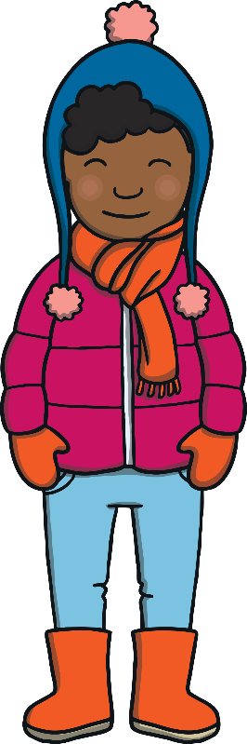
Apply
The boys smiled as the penguins waddled past them on their way to the sea.
“Those are emperor penguins,” said Jake, nodding wisely. “I read about them in my Antarctica book as well.”
“I love it in Antarctica,” laughed Kit. “I’m having the best time!”

Slide 27

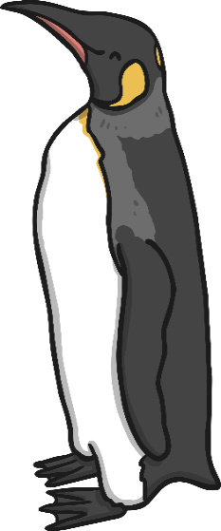
Today, we have learnt to identify different ways of spelling the /m/ sound.
The adventure continues next lesson!

