Slide 1
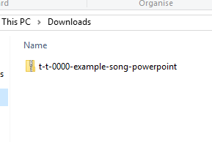
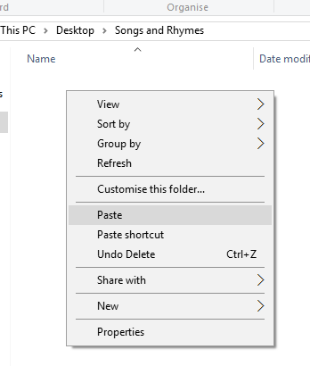

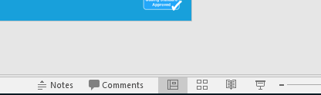
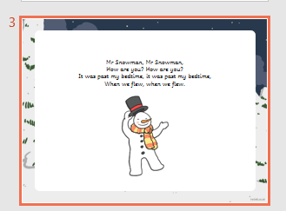
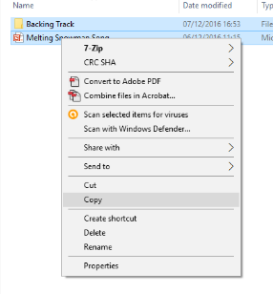
Guidance for Video/Audio in PowerPoints
1. Open the folder and copy all the files.
2. Paste the copied files into a new folder.
3. Open the PowerPoint file, enable editing and enter presentation mode (start the slide show).
Please note the embedded audio may not be compatible with early versions of PowerPoint.
You may wish to delete this slide before beginning the presentation.

Slide 2
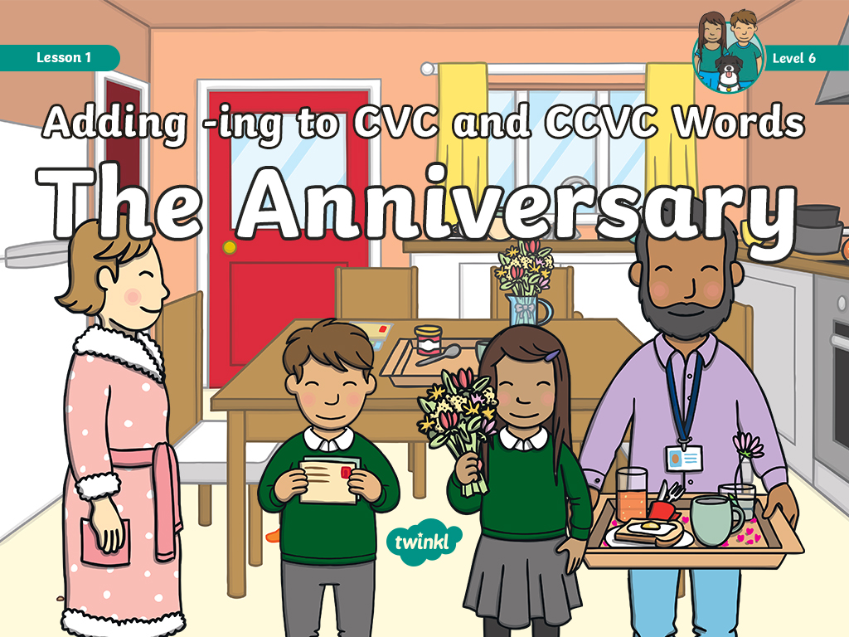

Slide 3

Revisit and Review
Let’s revisit last week’s focus words…
I’ll say them and you write them down!

Slide 4


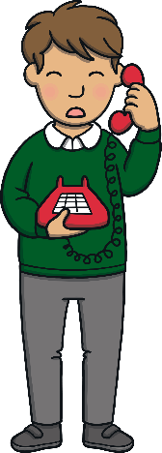



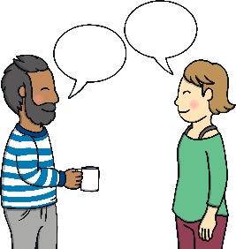

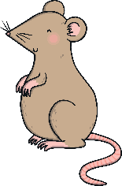





Revisit and Review

Slide 5


Teach
Watch the magic pencil write the words. Can you join in?
This week, we are learning to spell the common exception words England and tongue.

Slide 6


Teach
England
Play

Slide 7

Teach
tongue
Play

Slide 8

Teach
Today, we are learning to add –ing to CVC and CCVC words.

Slide 9
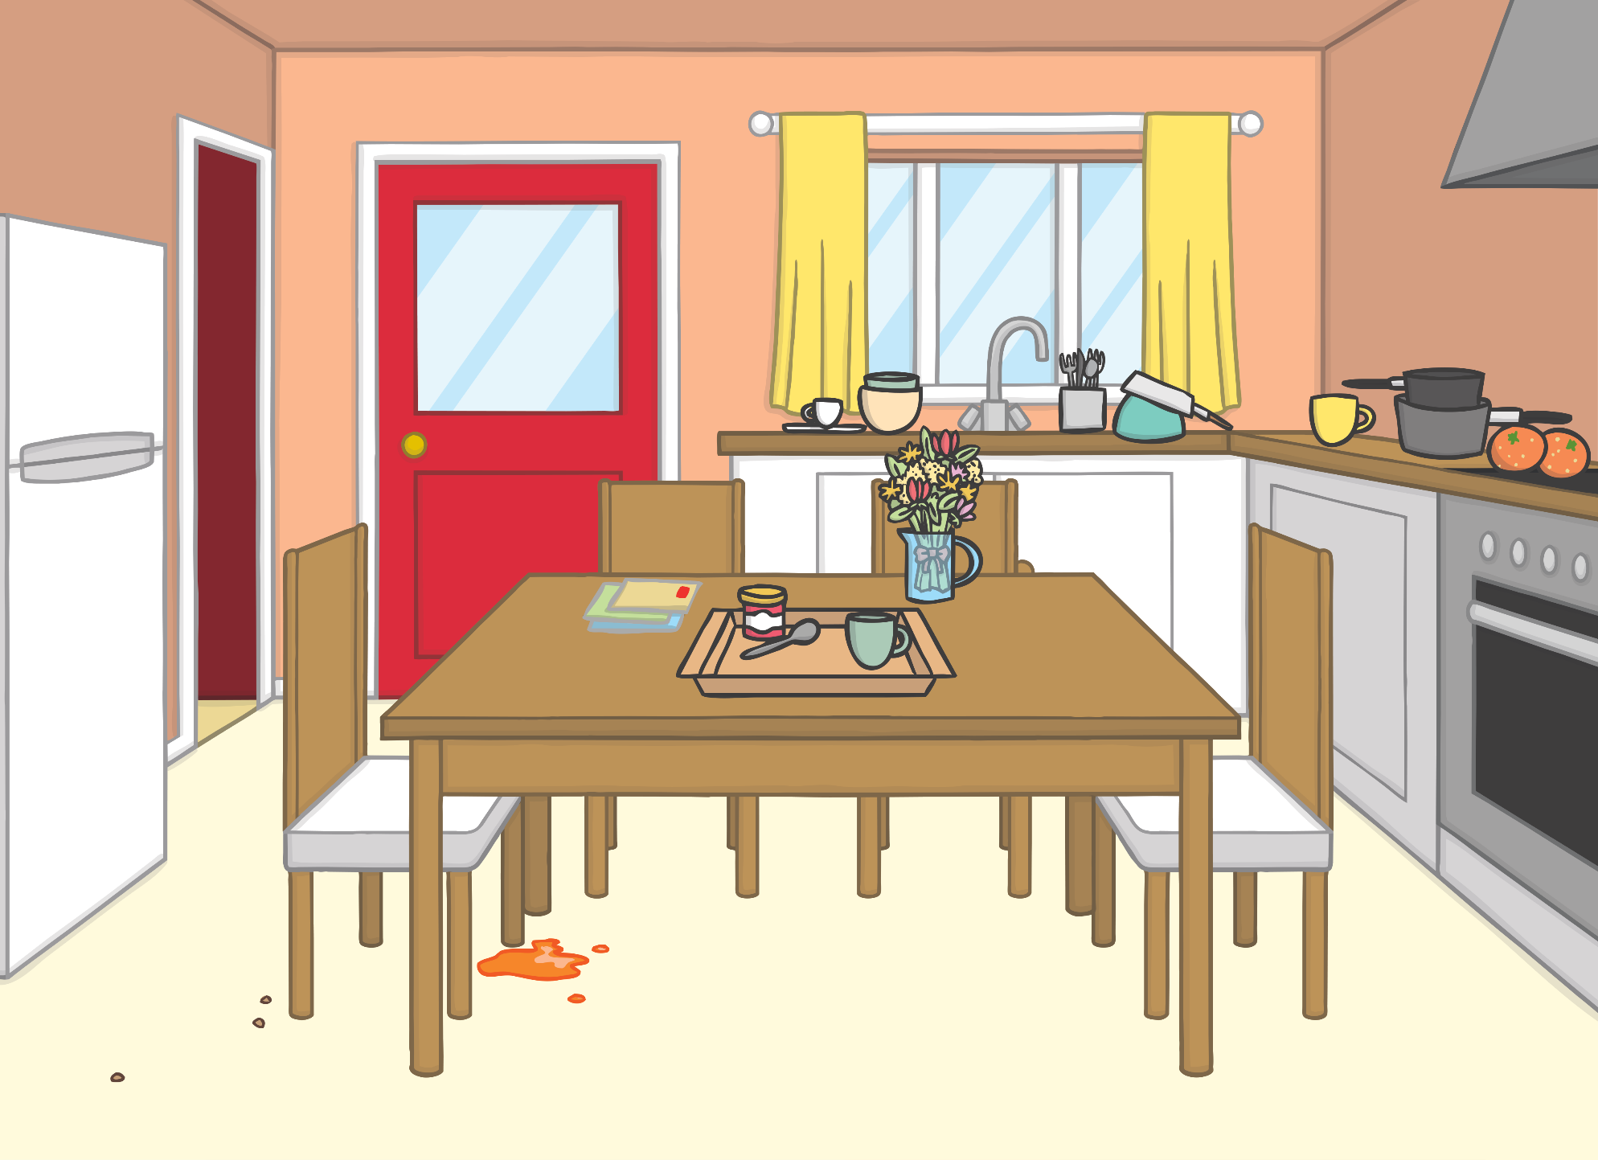



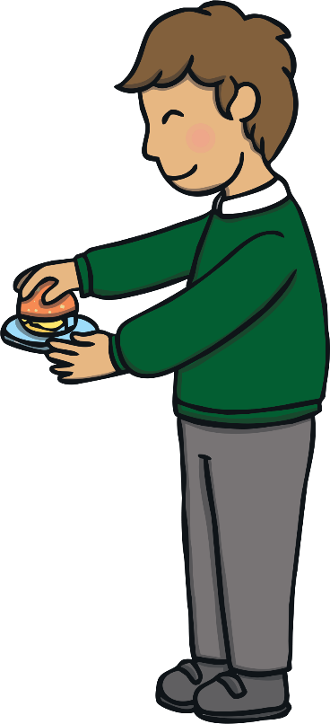
Teach
?
?
X
Why were Kit and Sam up early?
It was Friday morning and Kit and Sam were busy in the kitchen helping Dad to prepare breakfast for Mum. They had got up and dressed early because today was a special day. It was Mum and Dad’s anniversary.

Slide 10



Teach
They had made Mum’s favourite breakfast –­­ egg on toast. Kit had squeezed the orange juice himself. Sam had buttered the toast and poured the milk into Mum’s cup of tea. Dad added a fresh flower from the bouquet in a little glass and it was ready!

Slide 11

Teach
Just then, Mum walked into the kitchen and jumped with surprise.
“What’s all this?” she asked.
“It’s a special treat for our anniversary. I had two little helpers too!” said Dad.
“Wow! This is a real treat!” smiled Mum as she sat down at the table.

Slide 12

Teach
Look at these words and clap out the syllables.
hug
pop
stop
hum
X
A syllable is a ‘beat’ in a word. It is a single, unbroken sound of a spoken (or written) word. Syllables usually contain a vowel and accompanying consonants.
Click me for Kit’s teaching tips!

Slide 13
Teach
We double the consonant before adding the -ing suffix if a word:
has one syllable;
ends in a single consonant;
has a single vowel before the consonant.

Slide 14
Teach
When we add –ing to verbs, it tells us that the action is happening now.
Let’s add the –ing suffix to these verbs:
humming
hum
stop
stopping
popping
pop
hug
hugging
X
Remember, we need to double the consonant at the end first!
Click me for Kit’s teaching tips!

Slide 15
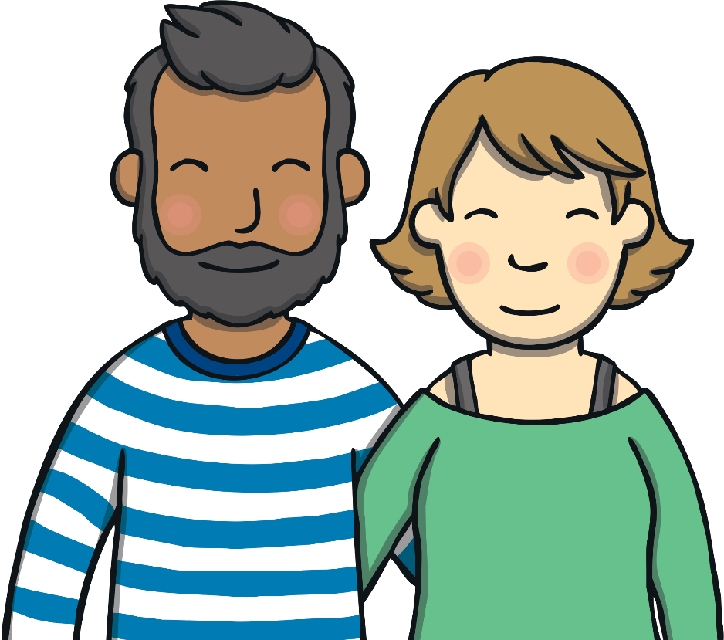
Cards Galore!
Practise
Mum and Dad are looking at their anniversary cards.
Click on the word that matches the picture.

Slide 16



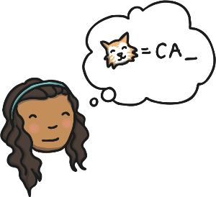



Practise
spelling

Slide 17
Practise
popping

Slide 18
Practise
hugging

Slide 19
Practise
swimming

Slide 20
Practise
winning

Slide 21
Practise
shopping

Slide 22


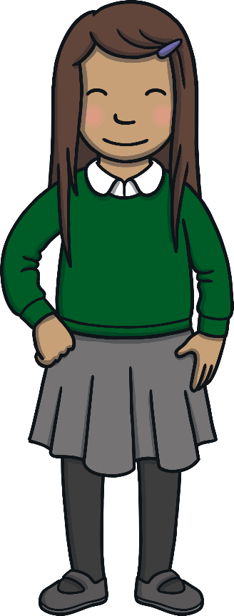
Apply
Mum looked at the cards and the large envelope. “What’s this?” she said as she picked up an envelope.
“A little surprise for us…” replied Dad excitedly. Mum smiled and began to open the envelope.

Slide 23


Text Detectives!
Apply
Mum is opening her anniversary card. Can you spot words that have had –ing added to them?

Slide 24


Apply
Dear Meg,
I have had so many great times with you. I loved stepping into our new home for the first time and planning our wedding. I love shopping with you at the weekend and swimming after work. Thank you for putting the bins out every week.
All my love,
Kiran
Dear Meg,
I have had so many great times with you. I loved stepping into our new home for the first time and planning our wedding. I love shopping with you at the weekend and swimming after work. Thank you for putting the bins out every week.
All my love,
Kiran
Check

Slide 25



Apply
Mum had just opened the large envelope. It was an anniversary present from Dad. “A trip to Northern Ireland?” she said. “Is this where we visited on our honeymoon?”
“Yes,” said Dad. “The best part is that we are all going!” Kit and Sam cheered, and Ben bounded in and barked.

Slide 26
Today, we have learnt to add -ing to CVC and CCVC words.
The adventure continues next lesson!

