Slide 2

Revisit and Review
Let’s practise reading some of this week’s focus words.
patting
humming
dropping
shopping

Slide 3
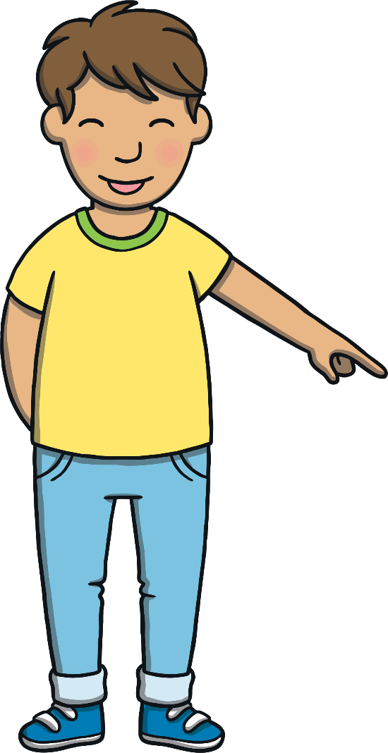

Revisit and Review
Now, let’s write them with the magic pencil...

Slide 4



Revisit and Review
p
a
t
t
i
n
g
Play

Slide 5
Revisit and Review
h
u
m
m
i
n
g
Play

Slide 6
Revisit and Review
d
r
o
p
p
i
n
g
Play

Slide 7
Revisit and Review
s
h
o
p
p
i
n
g
Play

Slide 8
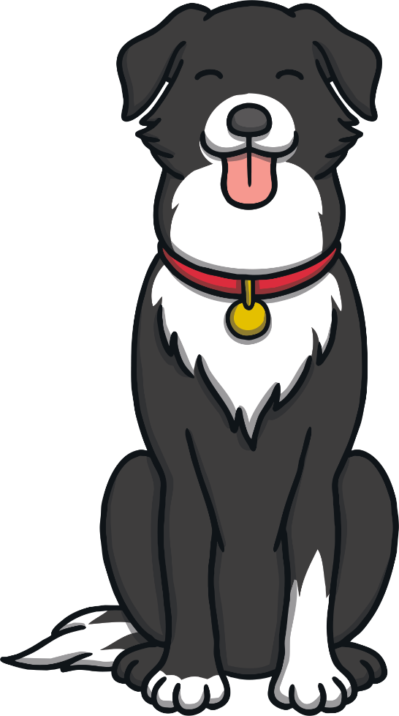
Teach
Today, we are learning to add
-ed to CVC and CCVC words.

Slide 9
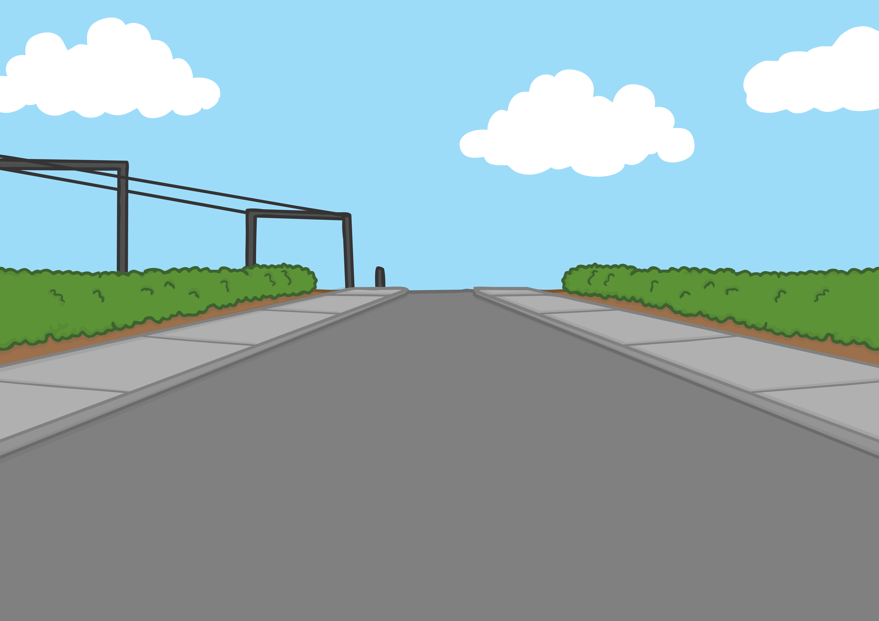
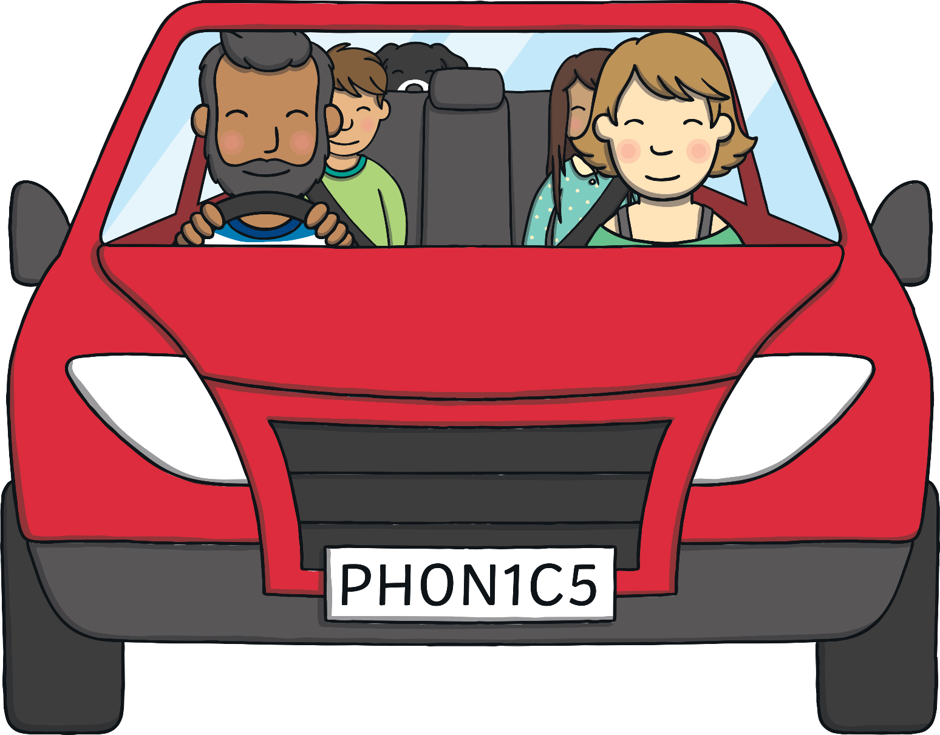
Teach
It was Mum and Dad’s anniversary. Kit and Sam had got changed into their pyjamas and set off for the ferry straight after school. “Why do we have to get on a ferry?” asked Kit, feeling puzzled.
“Well, even though Northern Ireland is part of the United Kingdom, we have to cross the Irish sea to get there so we have to fly or get a ferry!” said Dad.

Slide 10
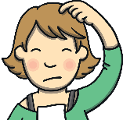
?
Teach
?
X
How were Kit and Sam travelling to Northern Ireland?
“…or swim!” added Mum. “But I don’t fancy swimming from England to Ireland, do you?”
“We’ve never been on a ferry before, have we?” asked Sam.
“No, you haven’t. The boat is so big you can’t feel it moving. You will probably sleep most of the way!” said Mum.
“We will be in Belfast before you know it!” chuckled Dad.

Slide 11
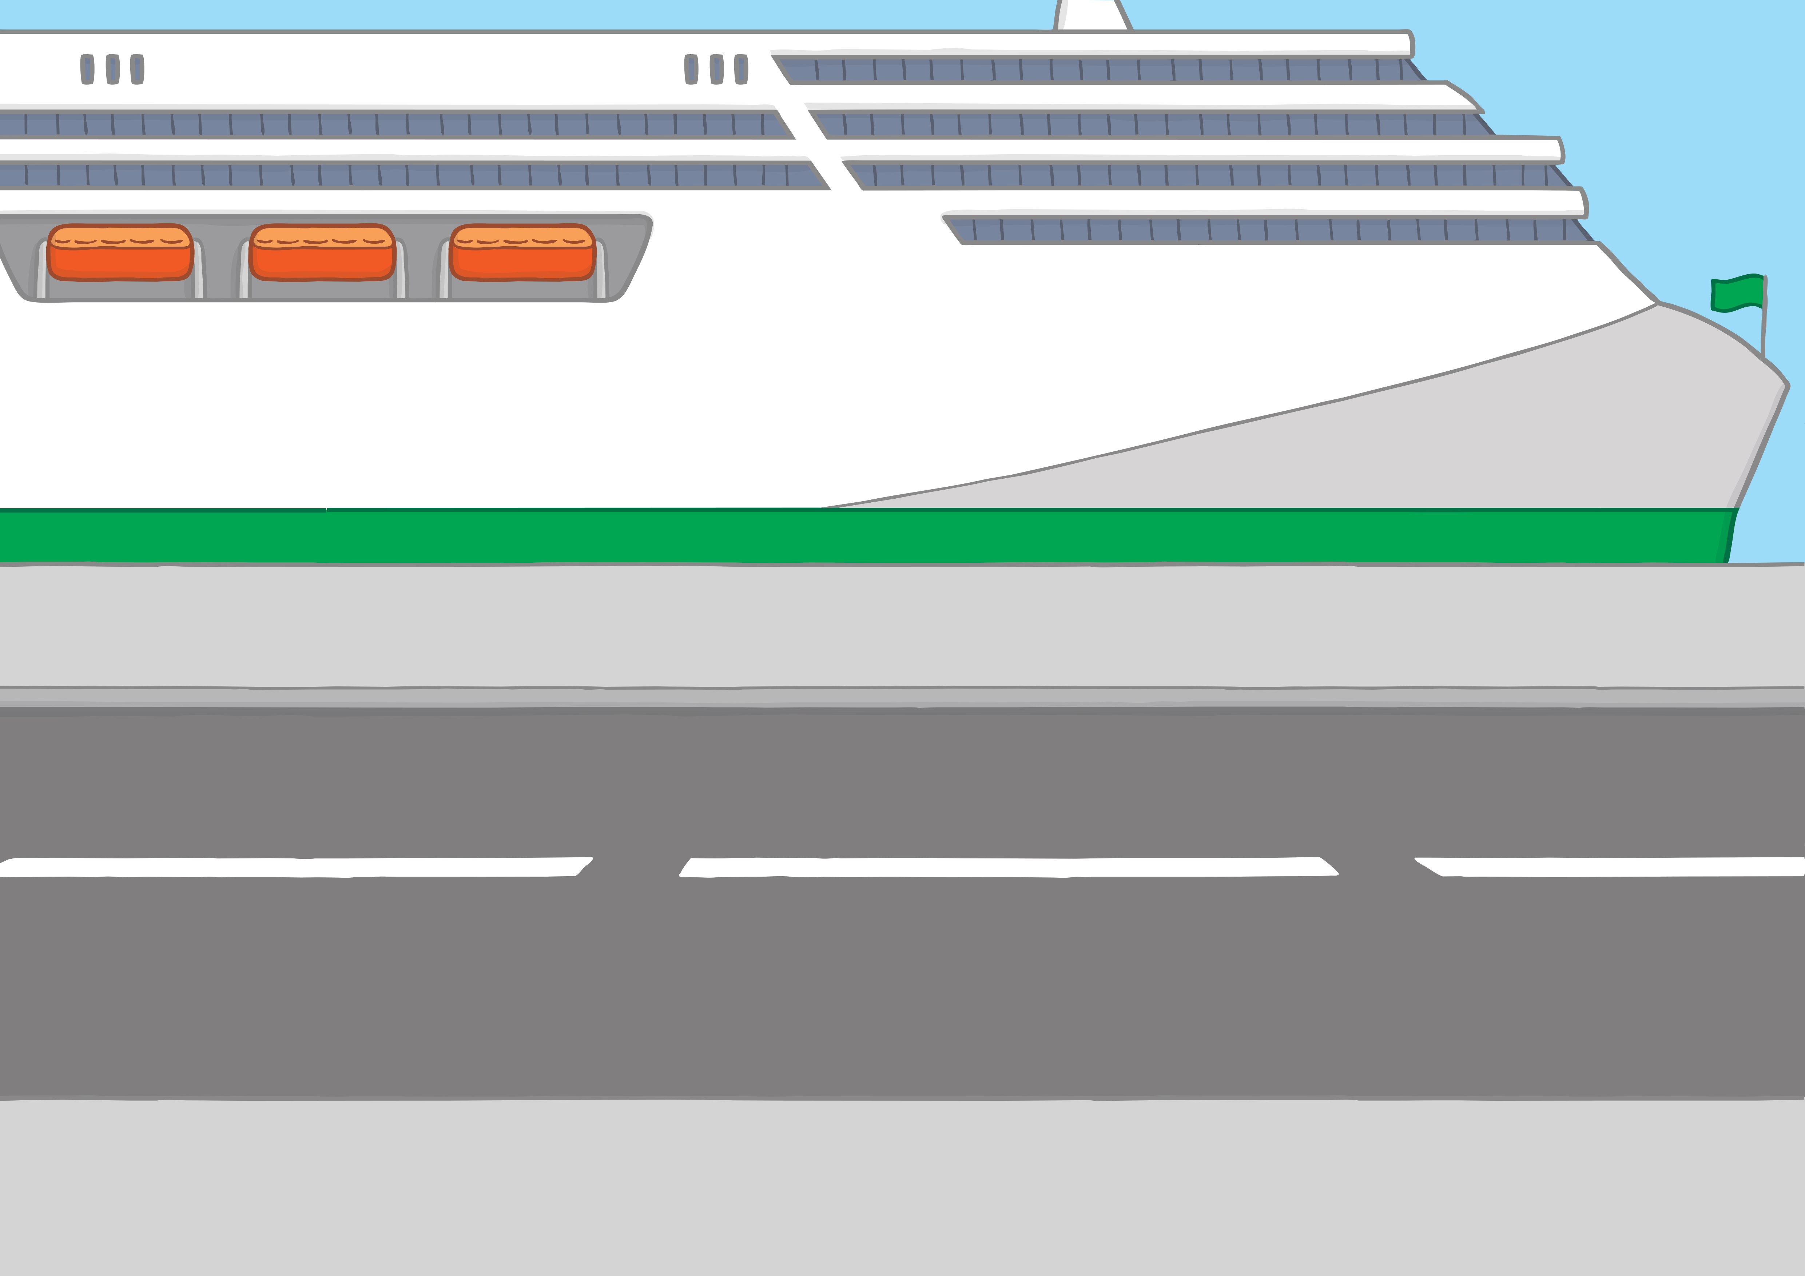

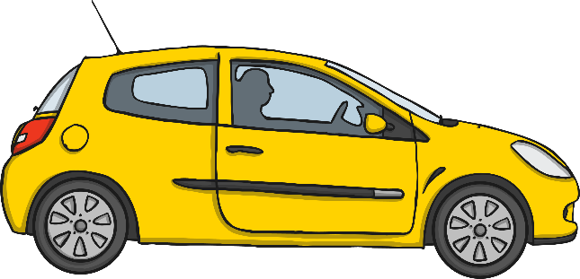
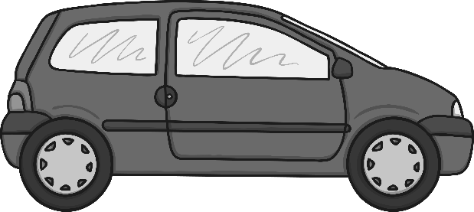
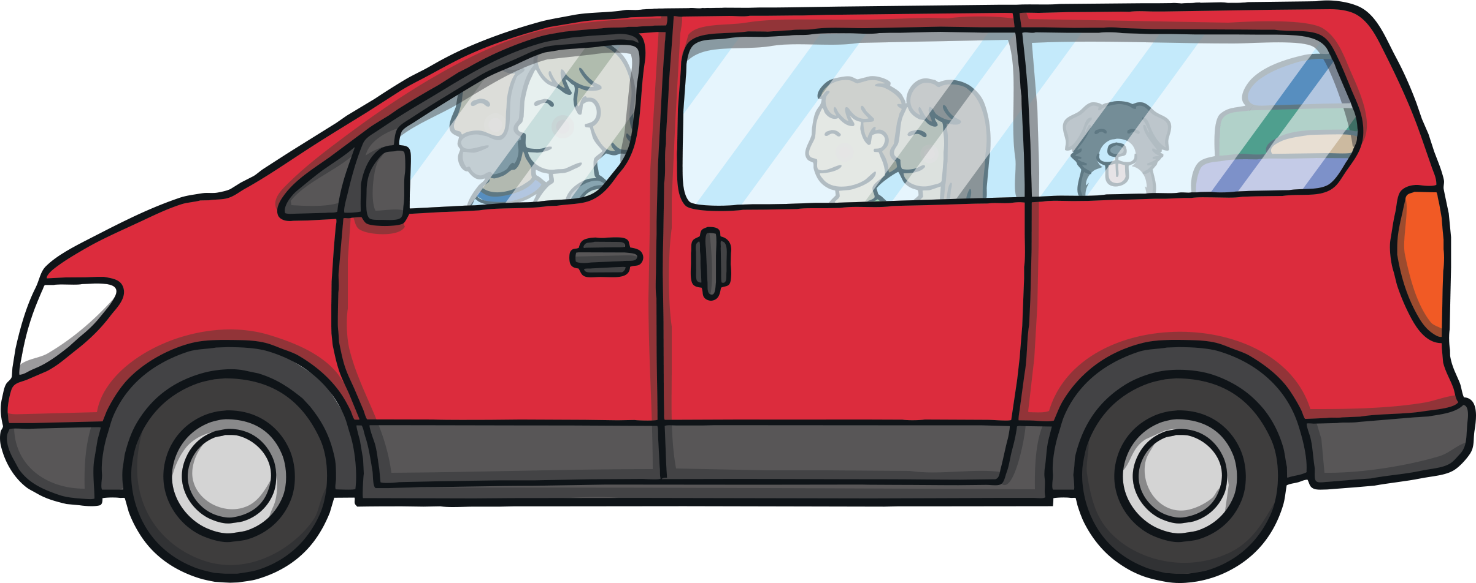
?
Teach
?
X
Why did Mum suggest that Kit and Sam go to sleep?
At the ferry port, there was a big queue of cars. “You might as well sleep now if you’re tired,” said Mum. “There can be a lot of waiting around while the ferry is getting ready.”
“That’s a good idea,” said Dad. “When you wake up, you’ll be in Northern Ireland!”

Slide 12
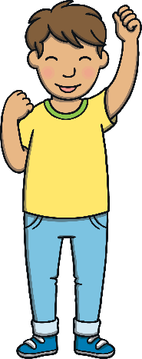
Teach
When we add the –ed suffix to a verb, it makes the action in the past tense. Let’s add the –ed suffix to these verbs:
ed
hum – hu
stop – sto
pop – po
hug – hu
mm
pp
ed
pp
ed
gg
ed
X
Remember, we need to double the consonant at the end first!
Click me for Kit’s teaching tips!

Slide 13
Teach
The family is waiting to board the ferry. Click on the cars to move up the queue. Read the words that you see.

Slide 14
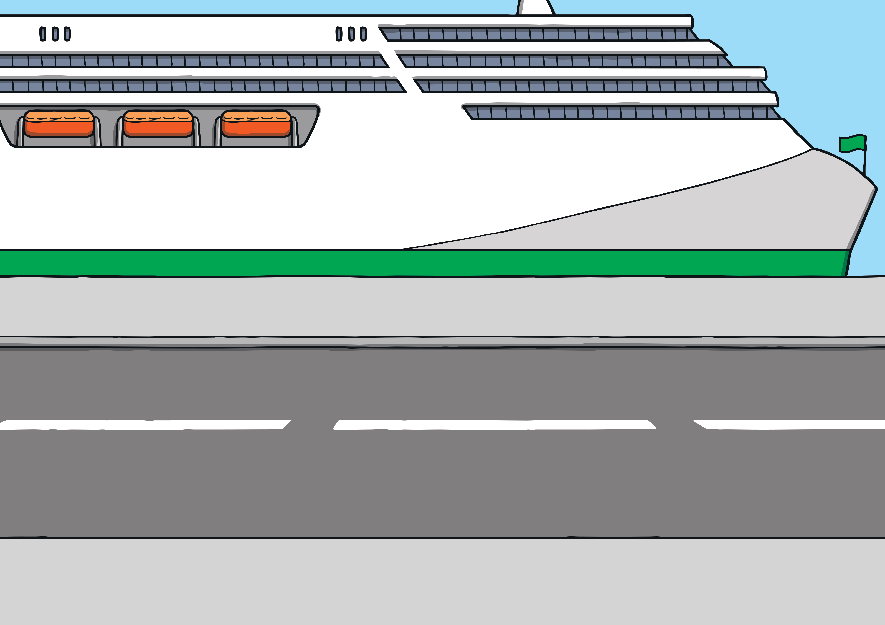
Teach
tapped
jogged
grabbed
shopped
stepped
begged

Slide 15

Traffic Lights
Practise
The lights on the ferry have CVC & CVCC words with –ed added.
Some of the letters are missing.
Can you find the missing letters?

Slide 16

Practise
fitted
fit_ed
t
d
e
l

Slide 17
Practise
dropped
droppe_
dropp__
e
p
d
r

Slide 18
Practise
clapped
cla_ped
d
i
p
e

Slide 19
Practise
jogg_d
jogged
jog__d
i
e
g
d

Slide 20
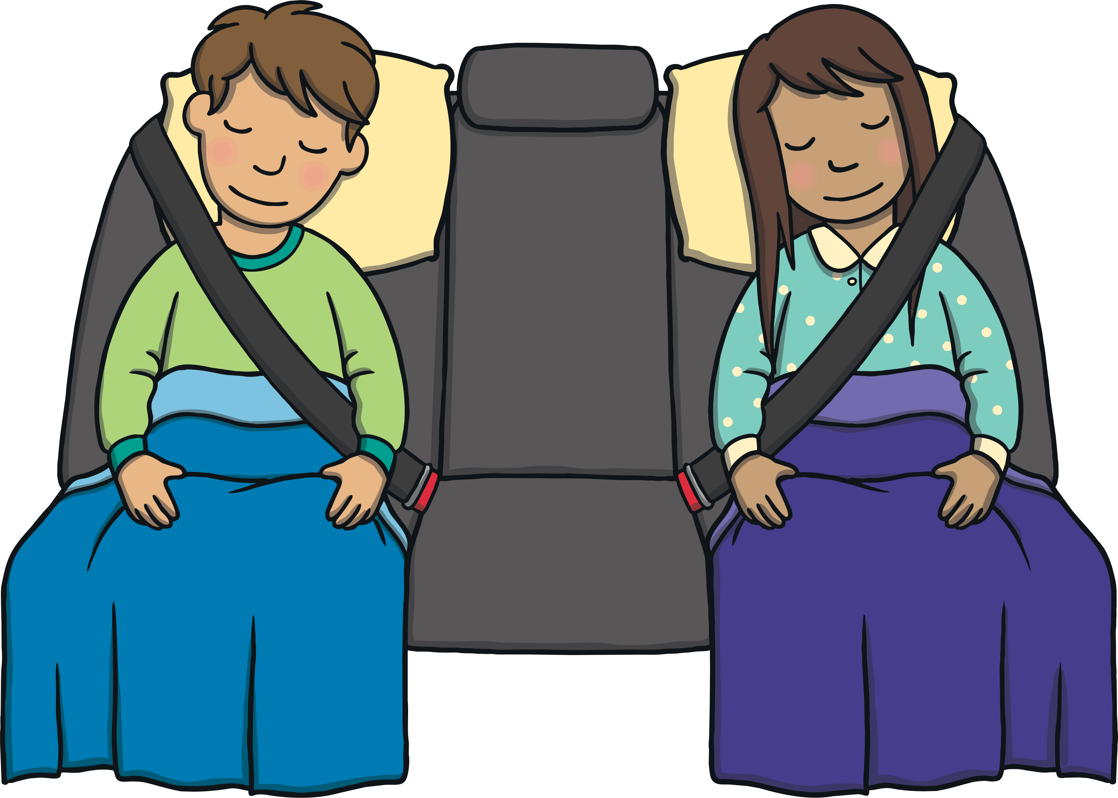
?
Apply
?
X
Where would Kit and Sam be when they woke up?
As the car boarded the ferry, Kit and Sam snuggled down with their blankets and closed their eyes. They were both tired from a hectic week at school.
“Good night, you two!” whispered Mum.
“See you in Northern Ireland!” said Dad.

Slide 21

Visiting Northern Island
Apply
Mum is reading an advert about visiting Northern Ireland. Some of the spellings are incorrect. Can you spot the spelling mistakes?

Slide 22


Book your trip now!
Visit Northern Ireland
Apply
Have you planned
your trip yet?
Have you planed
your trip yet?
Have you shoppd until you’ve droped in Belfast?
Have you shopped until you’ve droped in Belfast?
Have you stepped on the Giant’s Causeway?
Have you stepd on the Giant’s Causeway?
Check

Slide 23
Apply
Kit and Sam woke up.
“We’re here,” said Mum.
“I told you we would be here in no time!” chuckled Dad.
“So we’re in Northern Ireland?” asked Sam as she squinted her sleepy eyes.
“We sure are!” said Dad.

Slide 24
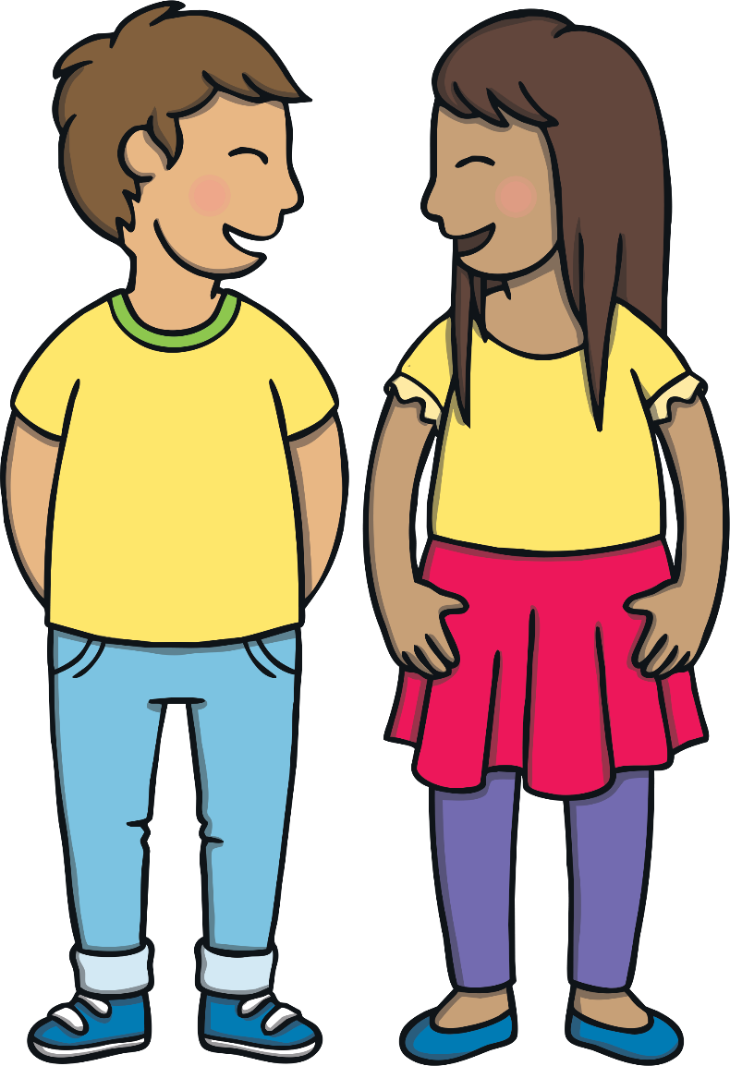
Today, we have learnt to add –ing to
CVC and CCVC words.
The adventure continues next lesson!

