Slide 2
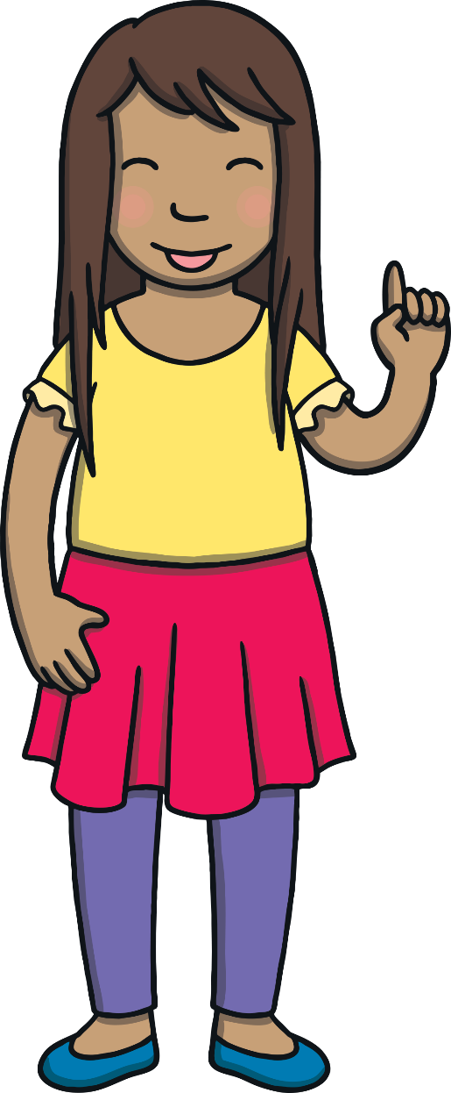
Revisit and Review
Let’s practise reading some of this week’s focus words.
jogged
fitted
clapped
stopped

Slide 3
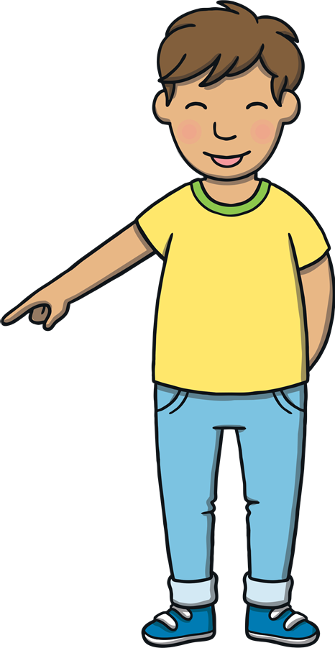

Teach
Now, let’s write them with the magic pencil…

Slide 4



Teach
j
o
g
g
e
d
Play

Slide 5
Teach
f
i
t
t
e
d
Play

Slide 6
Teach
c
l
a
p
p
e
d
Play

Slide 7
Teach
s
t
o
p
p
e
d
Play

Slide 8
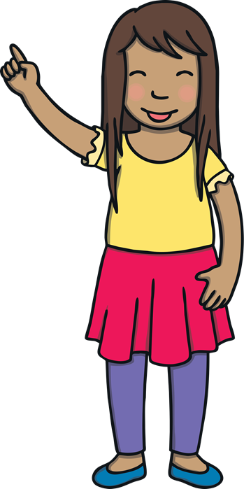
Teach
Today, we are learning to add –ing and –ed to CVC and CCVC words.

Slide 9
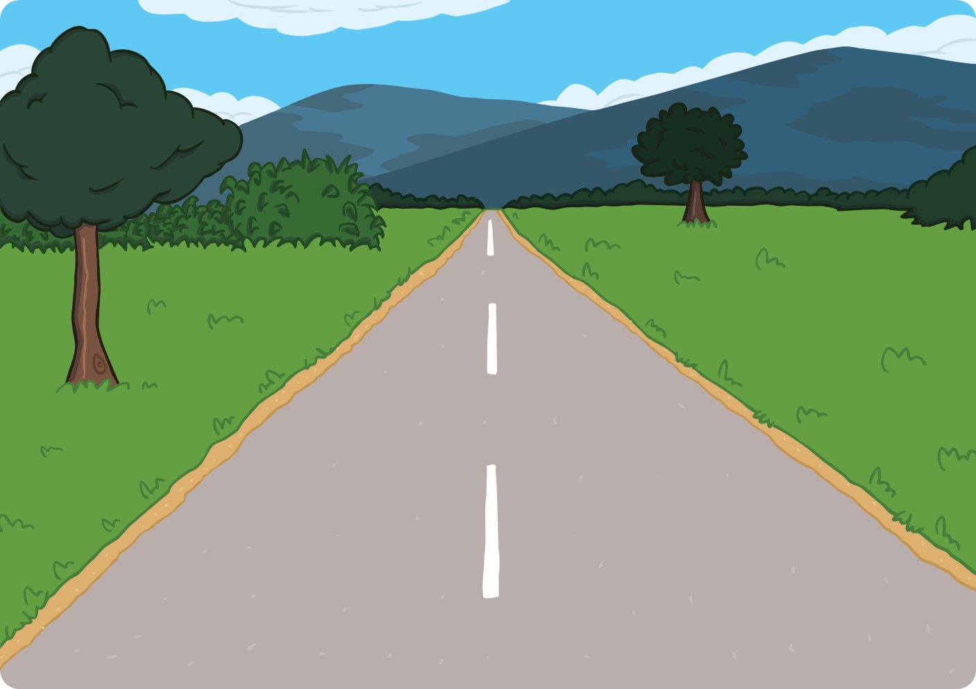
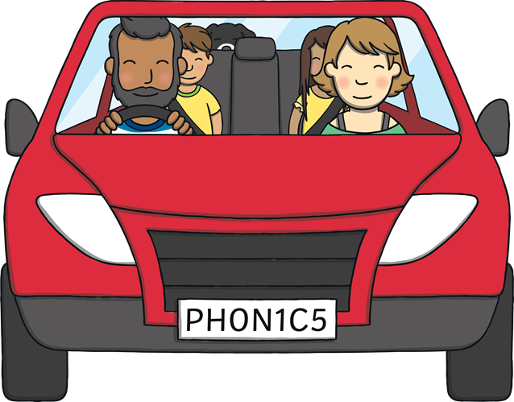
Teach
The family had been driving for more than an hour. “Nearly there! It will be worth it when we get there!” said Dad.
“Northern Ireland looks so different to where we live! There is so much green and countryside!” commented Sam.

Slide 10
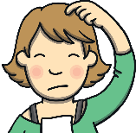
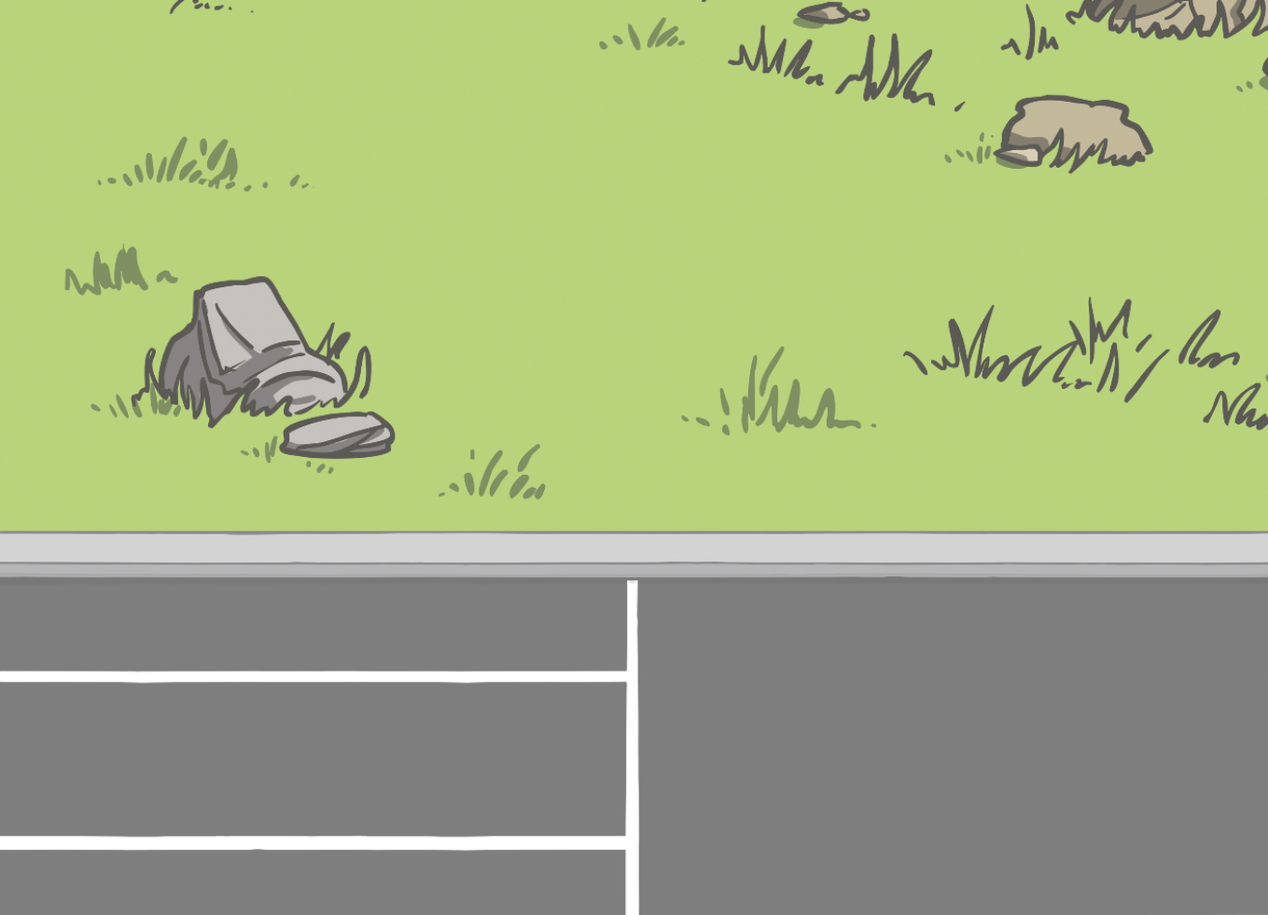
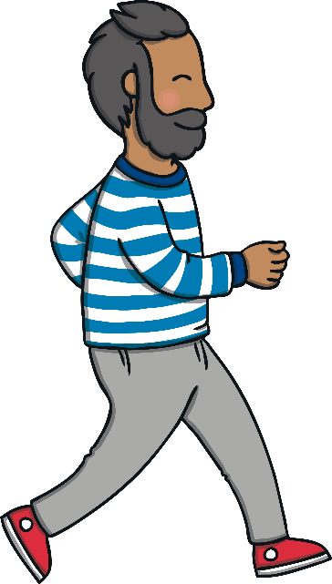
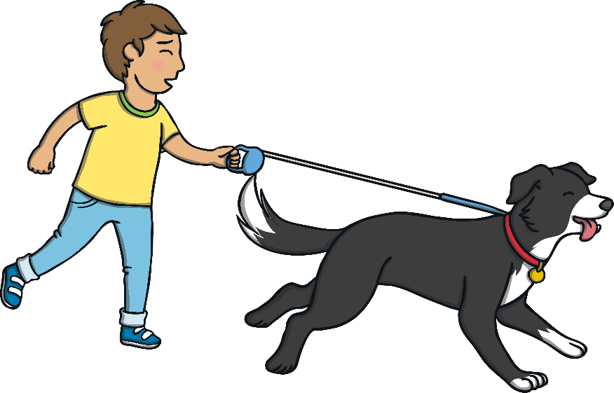
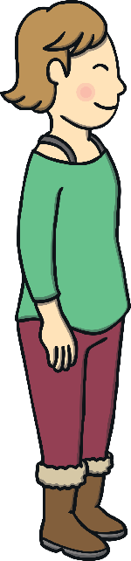
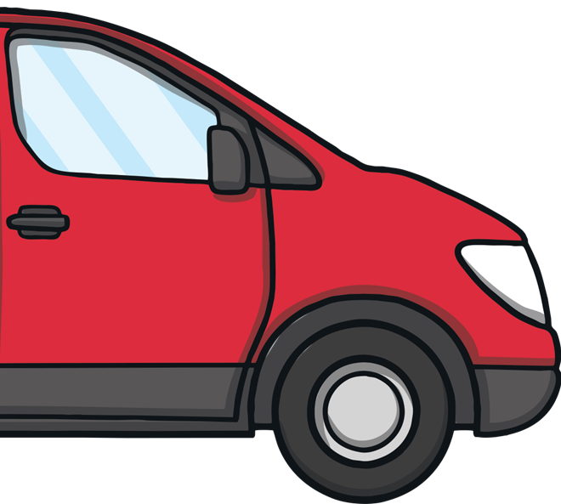
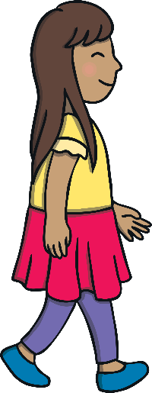
?
Teach
?
X
Why was Mum excited to be back at the Giant’s Causeway?
“We’re here!” called Dad.
“The Giant’s Causeway!” said Mum. “It’s so exciting to be back here again.”
Dad stopped the car and everybody got out and stretched their legs.
“Let’s explore,” said Dad. They jogged after Ben who led the way as he ran towards the entrance.

Slide 11
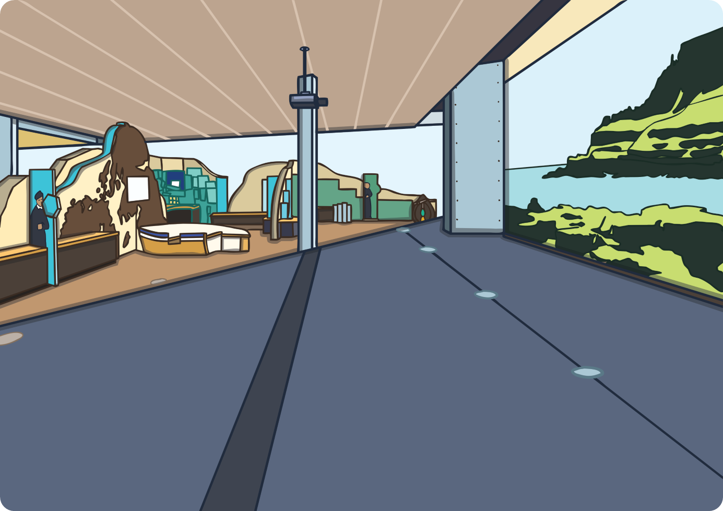

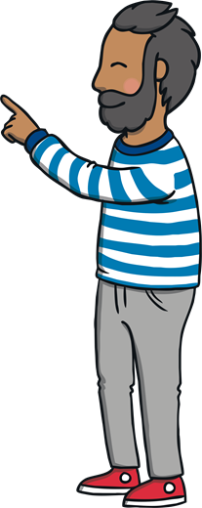
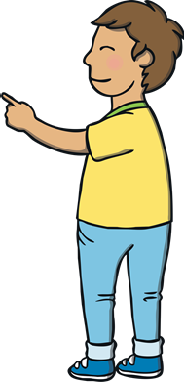
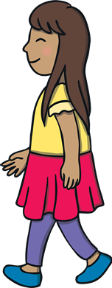
Teach
“This is new!” said Mum. “This centre wasn’t here when we came a long time ago! Shall we pop in?”
Dad tied Ben up outside and patted his head. “Won’t be long, boy,” Dad said.
Inside, Kit was already exploring.
“Look over here!” he shouted. “The legend of the Giant’s Causeway,” he read aloud.

Slide 12

Teach
Kit and Sam are reading the visitor information. Can you spot any –ing or –ed words that have a double consonant?

Slide 13
Teach
The Legend of the Giant
Experts believe that thousands of years ago, a volcano under the earth bubbled and erupted, leaving pieces of the ground rubbing together to make beautiful stones.
Locals tell a legend of how it was made. They say that a giant lived in Northern Ireland and made the amazing shaped stones by grabbing and dragging parts of the land so he could step across them and scare the Scottish giant!
What do you believe?
Experts believe that thousands of years ago, a volcano under the earth bubbled and erupted, leaving pieces of the ground rubbing together to make beautiful stones.
Locals tell a legend of how it was made. They say that a giant lived in Northern Ireland and made the amazing shaped stones by grabbing and dragging parts of the land so he could step across them and scare the Scottish giant!
What do you believe?
Check

Slide 14
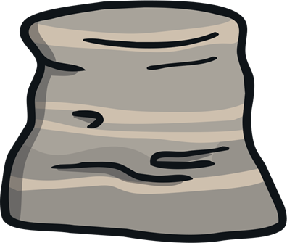
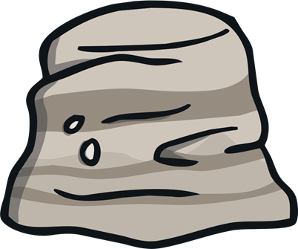
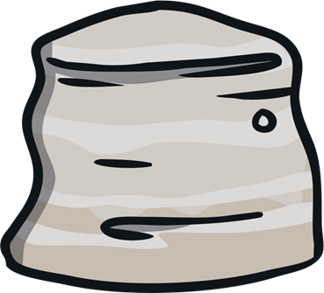
Suffix Stones
Practise
Each of the following sentences have an –ing or –ed word missing. Help Kit and Sam choose the correct stone to fit into the sentence.

Slide 15
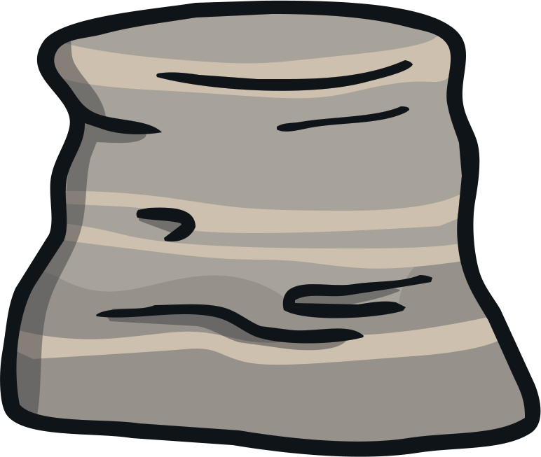
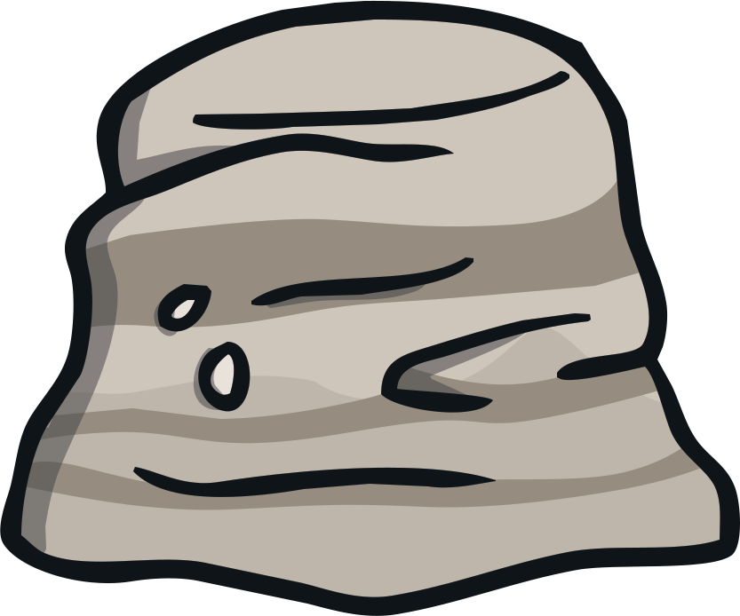
Practise
The girl begged her mum for a puppy.
begged
begged
begging

Slide 16
Practise
The man was jogging around the lake.
jogging
jogged
jogging

Slide 17
Practise
Grandma was napping on the sofa.
napping
napping
napped

Slide 18
Practise
The new jumper fitted Kit well.
fitted
fitting
fitted

Slide 19
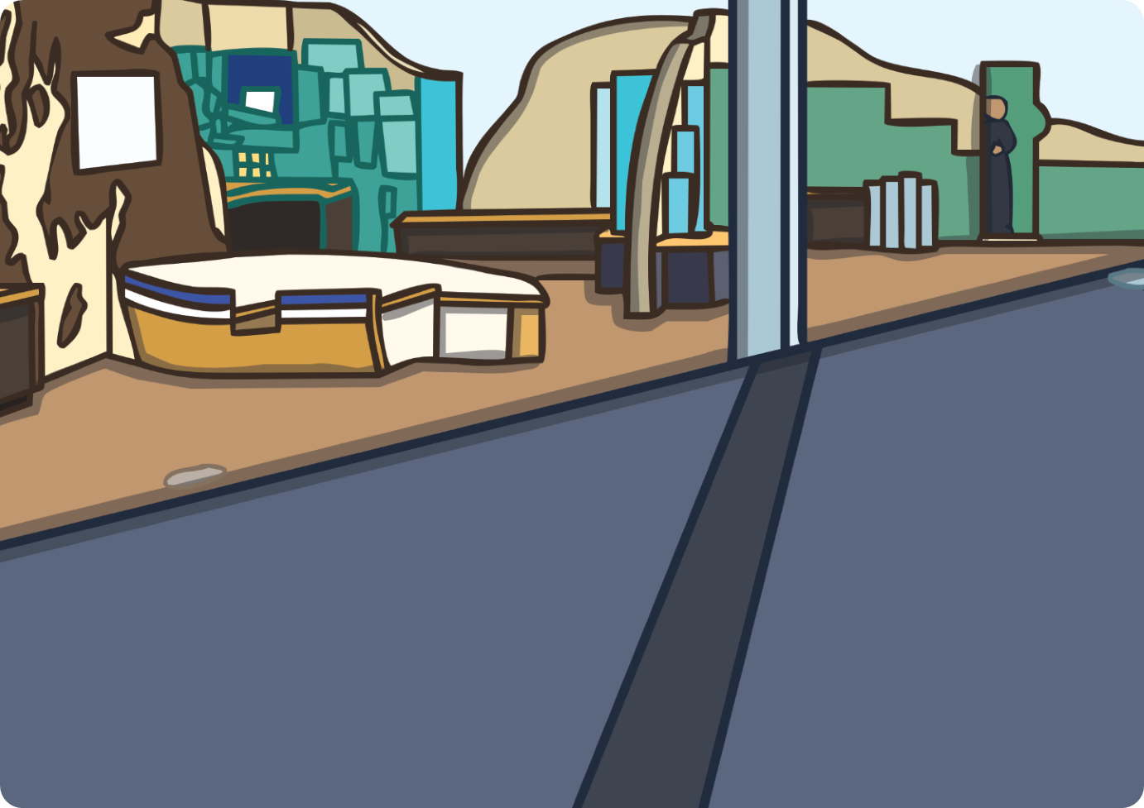
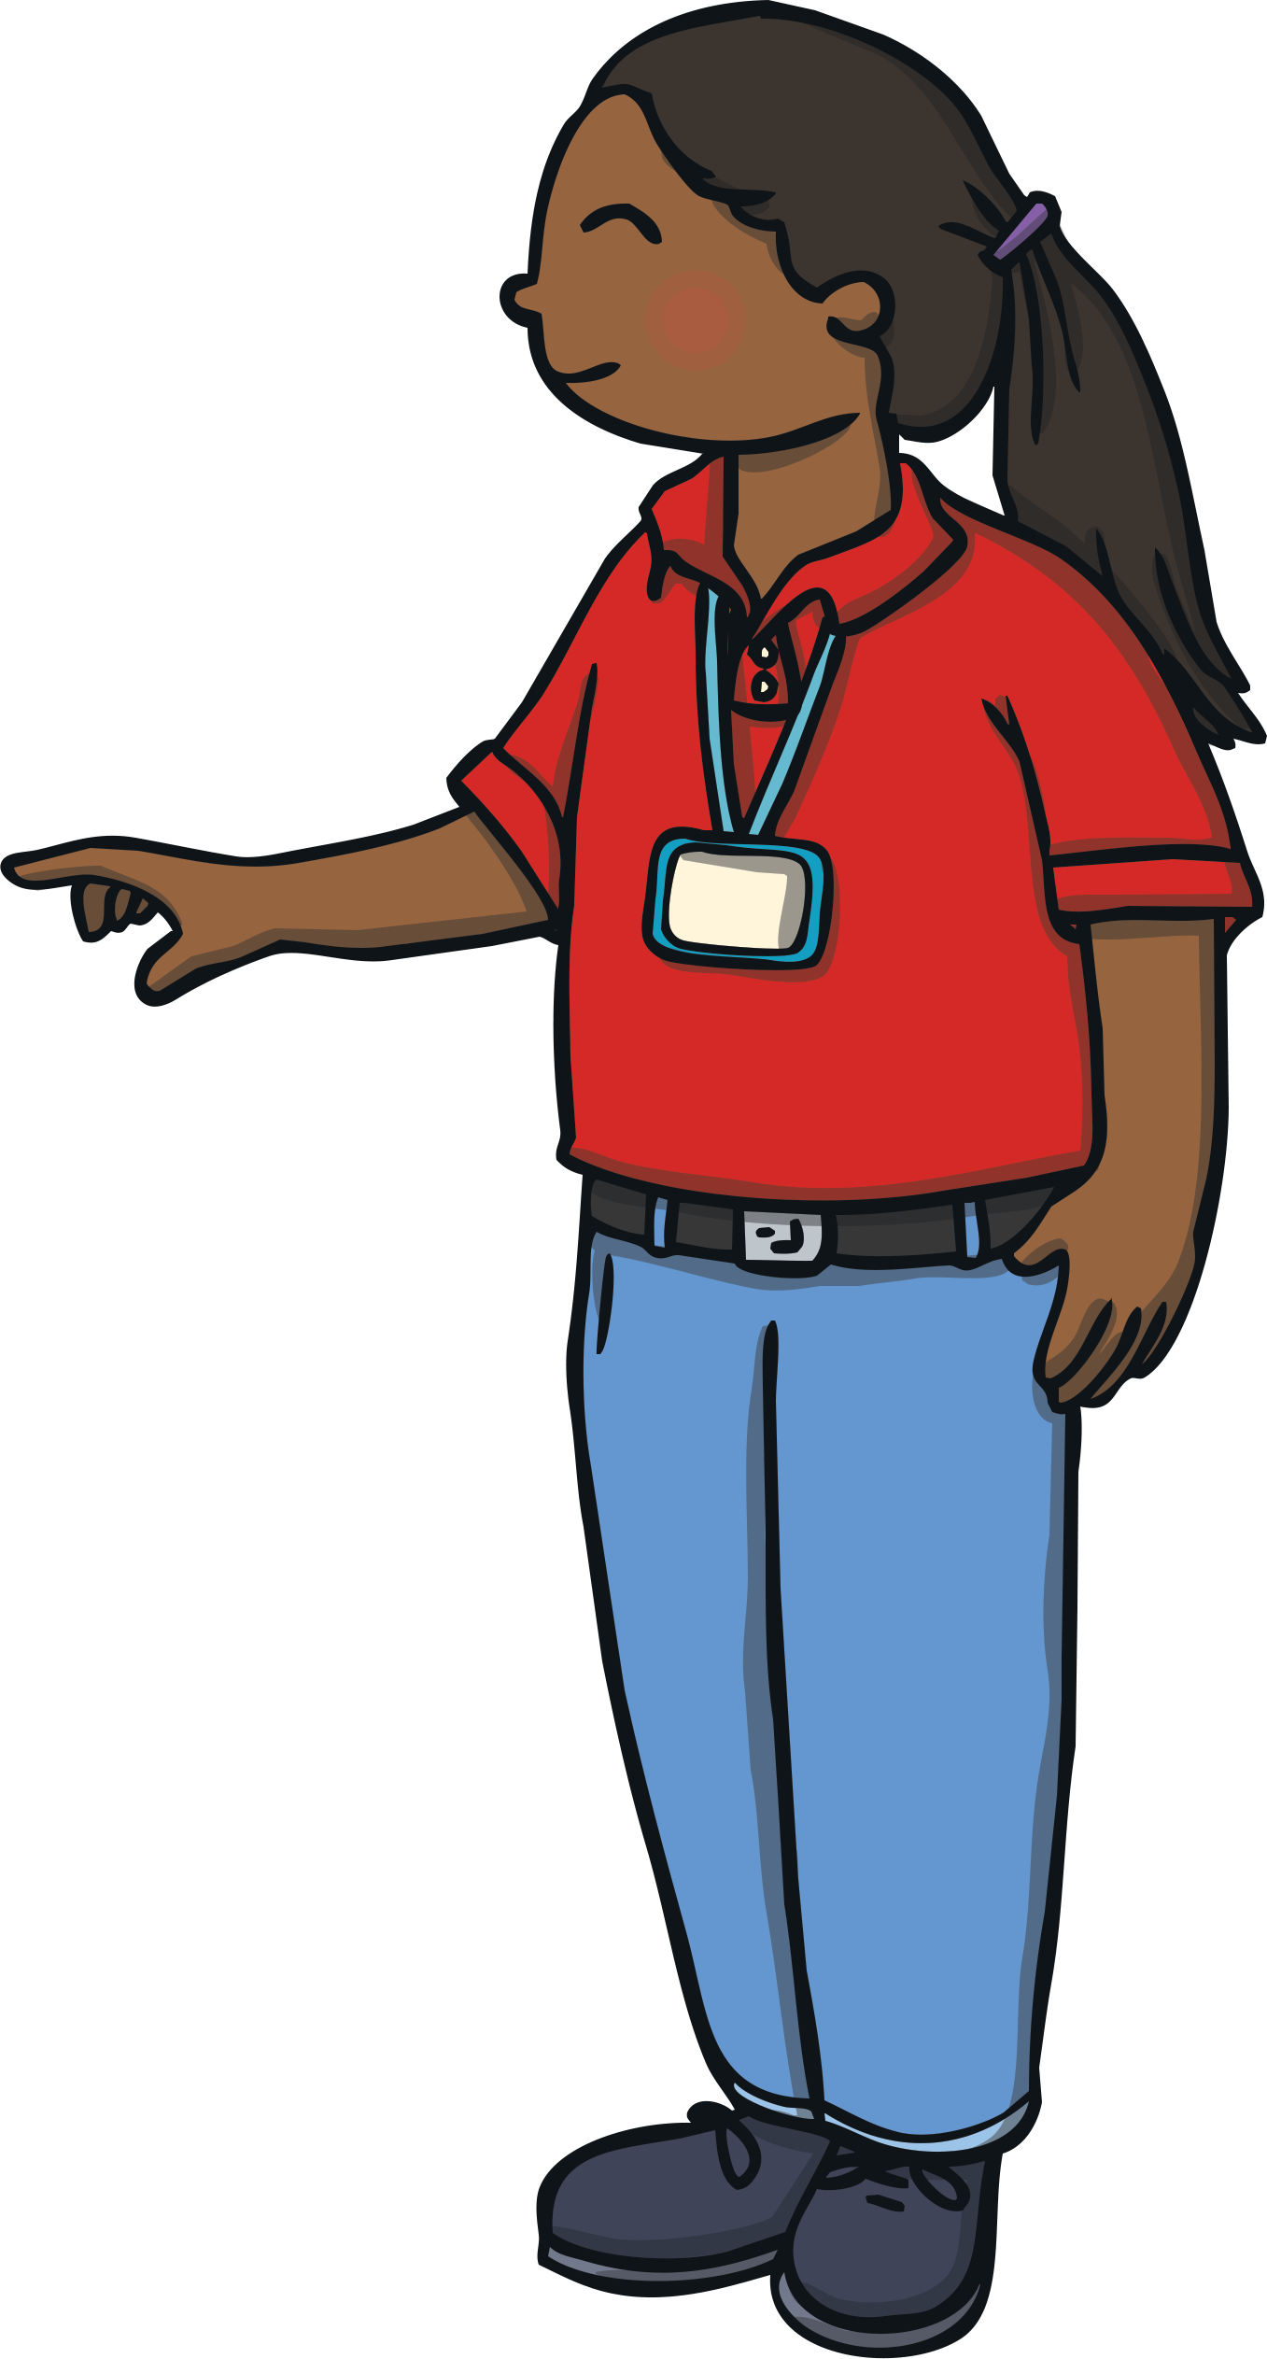
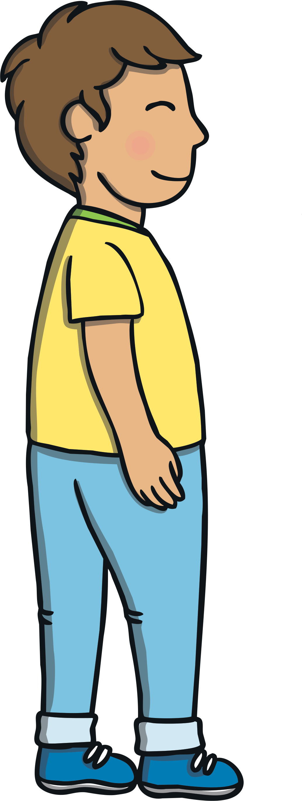
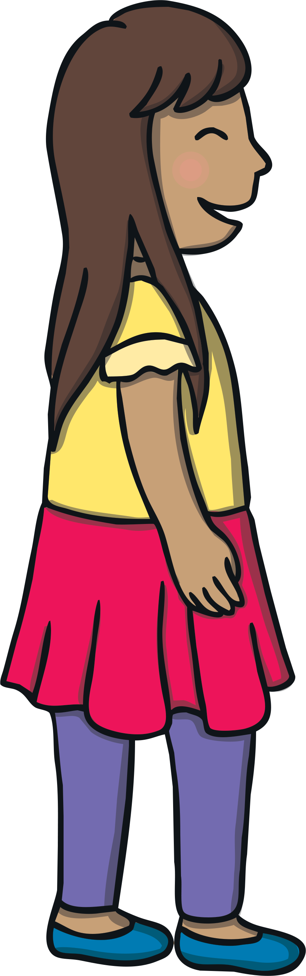
Apply
Kit and Sam looked at the display. “This is the story of how the Giant’s Causeway was made!” the guide said in a strong accent. “Would you like me to tell you the story?” she asked.
“Yes, please!” replied Sam and Kit excitedly.
“I am Eva and I am a guide here,” she replied.

Slide 20
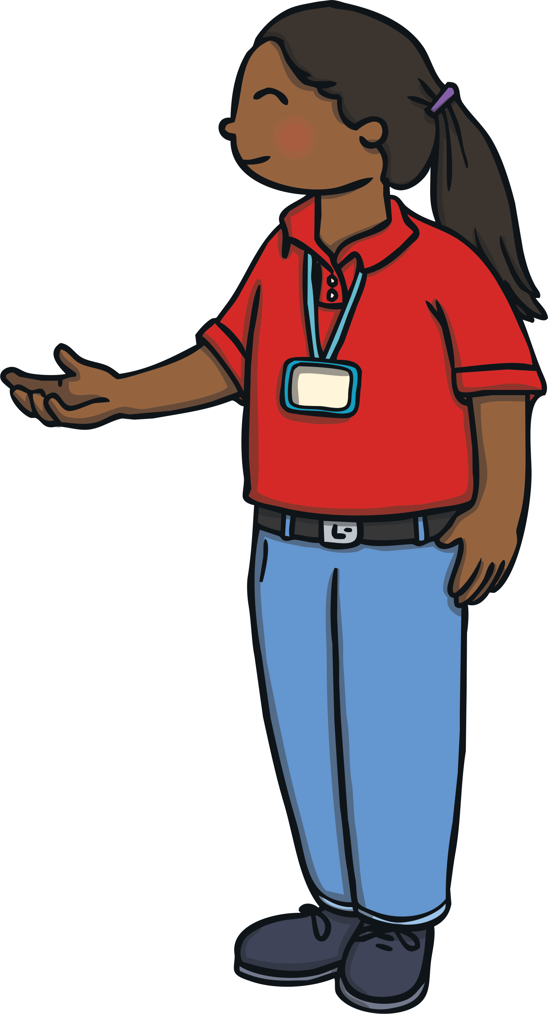
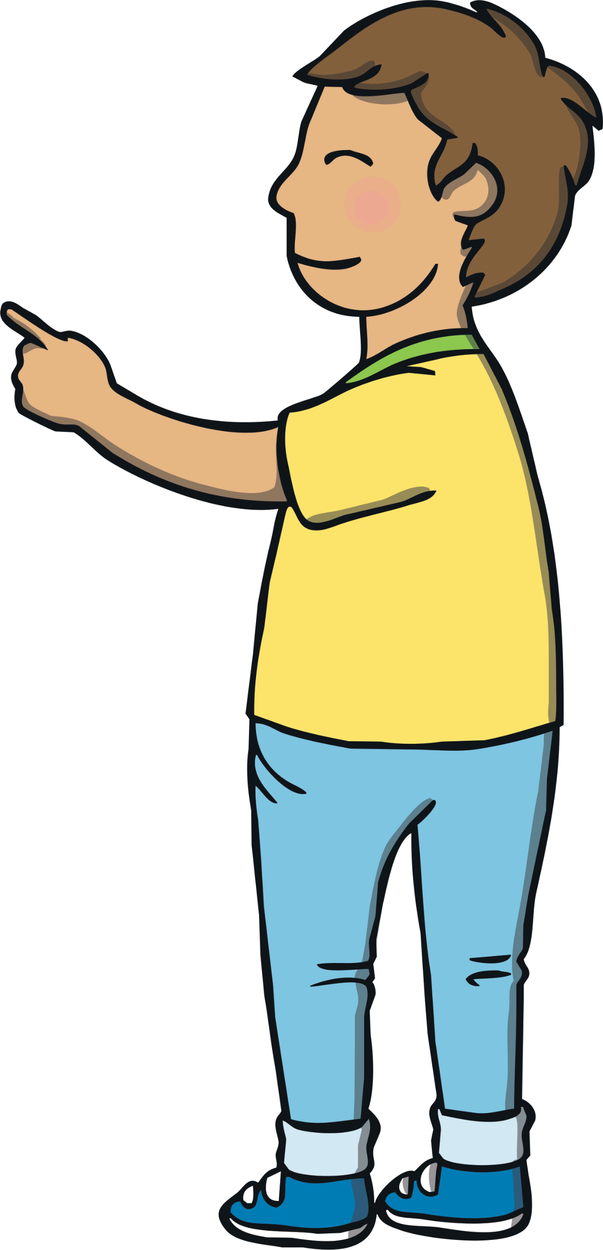
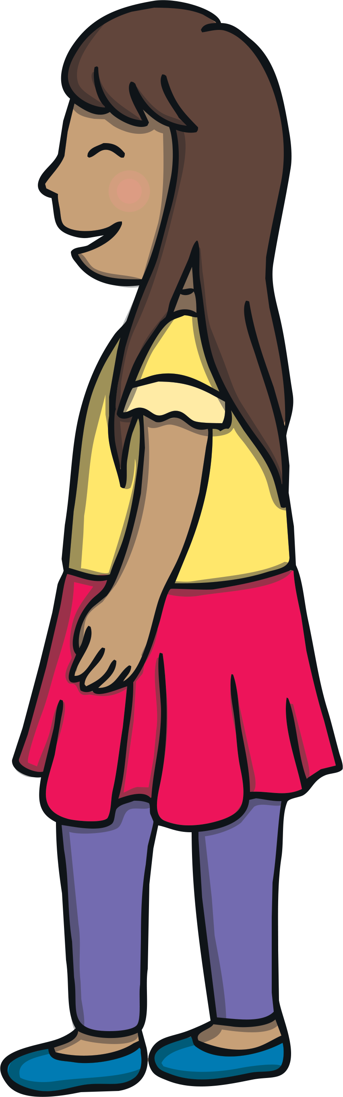
Apply
“Locals say that a giant, called Finn McCool, once lived here. He could see Scotland across the water, where another giant lived. The giant grabbed pieces of rock to make a path across the sea. As he got closer, he realised the Scottish giant was much bigger than himself and he didn’t want to fight him anymore! He stepped away and ran back home. He ran so fast that his boot came off!” said Eva enthusiastically, pointing to the pictures.

Slide 21
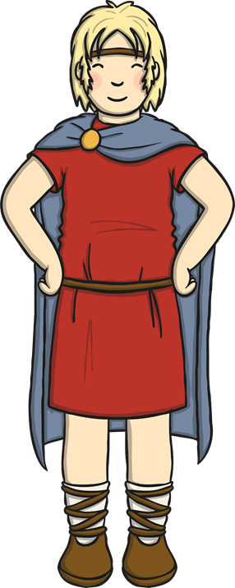
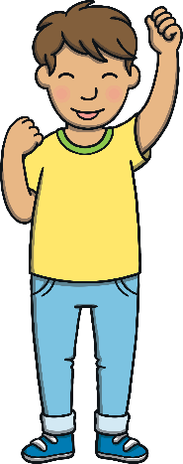
Super Suffixes
Apply
Sam has found a model of Finn McCool that has some extra information. Can you choose the correct suffix for the root word?
X
Remember, if the word has one syllable, ends in a single consonant and has a single vowel before the consonant, then we double the consonant before adding the suffix.
Click me for Kit’s teaching tips!

Slide 22

Apply
I am Finn McCool. I grabbed the rocks to make a path across the sea.
I am Finn McCool. I grabbed the rocks to make a path across the sea.
When I saw the other giant, I ran back
When I saw the other giant, I ran back
to my wife and we planned a trick.
to my wife and we planned a trick.
She dressed me up as a baby and I pretended to be napping in a cot.
She dressed me up as a baby and I pretended to be napping in a cot.
Check
Our planning paid off and when the bigger giant saw a huge baby he stepped back and ran away.
Our planning paid off and when the bigger giant saw a huge baby he stepped back and ran away.

Slide 23
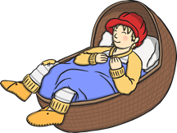
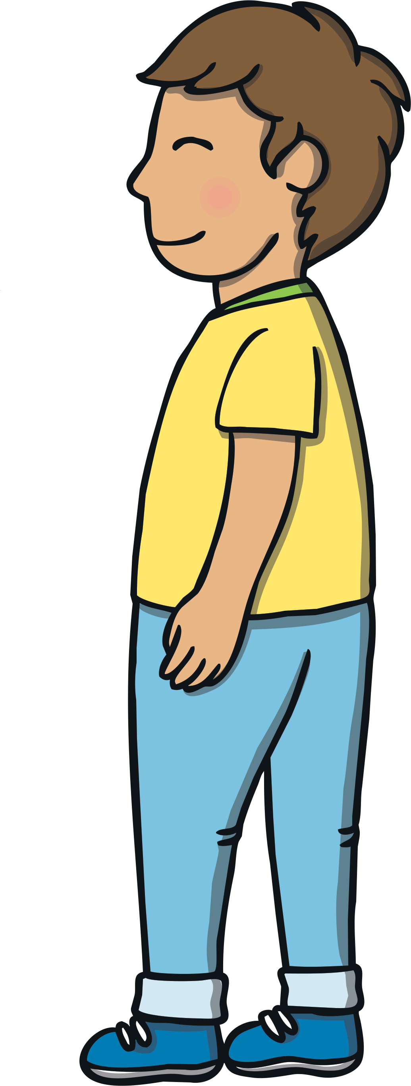
?
?
Apply
X
What did Finn and his wife do to trick the other giant?
“The trick worked and the Scottish giant was so worried about the size of the giant baby, he destroyed the path across the sea so that nobody could come to Scotland and fight him. That is the legend,” said Eva.

Slide 24
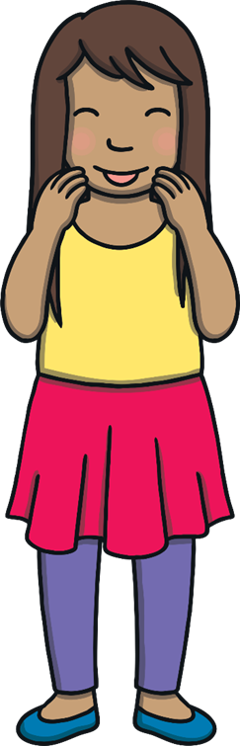
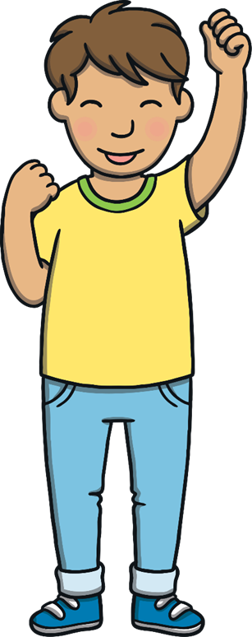
Today, we have learnt to add –ing and –ed to CVC and CCVC words.
The adventure continues next lesson!

