Slide 1
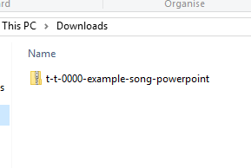
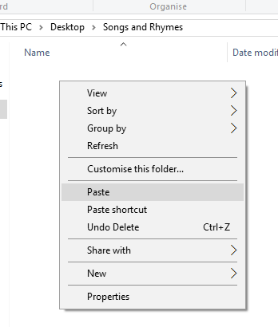

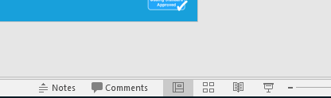
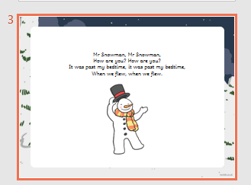
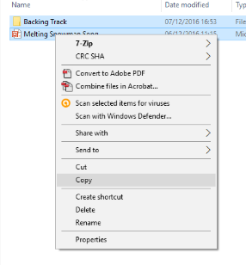
Guidance for Video/Audio in PowerPoints
1. Open the folder and copy all the files.
2. Paste the copied files into a new folder.
3. Open the PowerPoint file, enable editing and enter presentation mode (start the slide show).
Please note the embedded audio may not be compatible with early versions of PowerPoint.
You may wish to delete this slide before beginning the presentation.

Slide 3
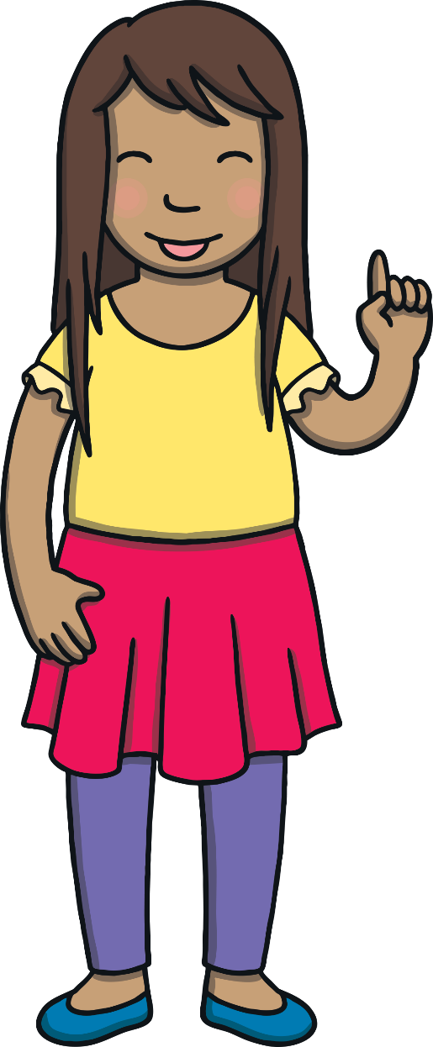
Revisit and Review
Let’s practise reading some of this week’s focus words.
patting
fitted
humming
clapped
dropping
stopped
shopping
England
jogged
tongue

Slide 4
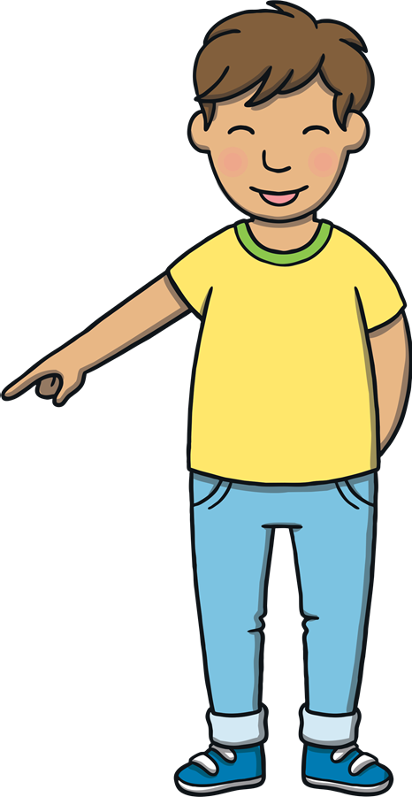

Teach
Now, let’s write them with the magic pencil…

Slide 5



Teach
p
a
t
t
i
n
g
Play

Slide 6
Teach
h
u
m
m
i
n
g
Play

Slide 7
Teach
d
r
o
p
p
i
n
g
Play

Slide 8
Teach
s
h
o
p
p
i
n
g
Play

Slide 9



Teach
j
o
g
g
e
d
Play

Slide 10
Teach
f
i
t
t
e
d
Play

Slide 11
Teach
c
l
a
p
p
e
d
Play

Slide 12
Teach
s
t
o
p
p
e
d
Play

Slide 13
Teach
E
n
g
l
a
n
d
Play

Slide 14
Teach
t
o
n
g
u
e
Play

Slide 15
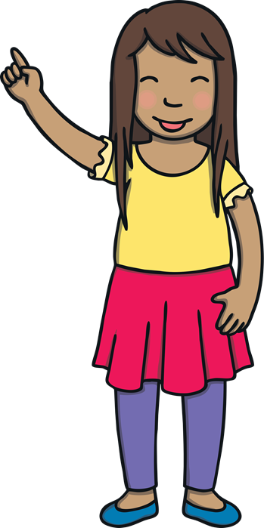
Teach
Today, we are learning to write sentences that contain
CVC and CCVC words with suffixes –ing and –ed added.
We are also learning to use the irregular past tense.

Slide 16
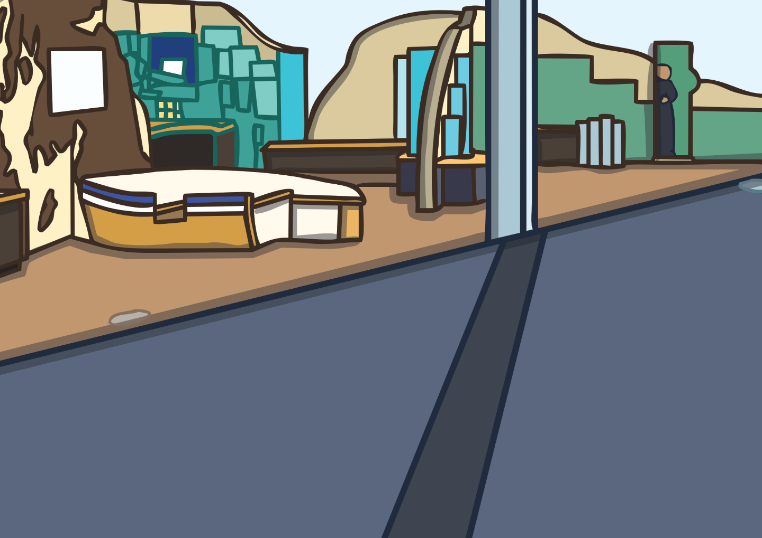
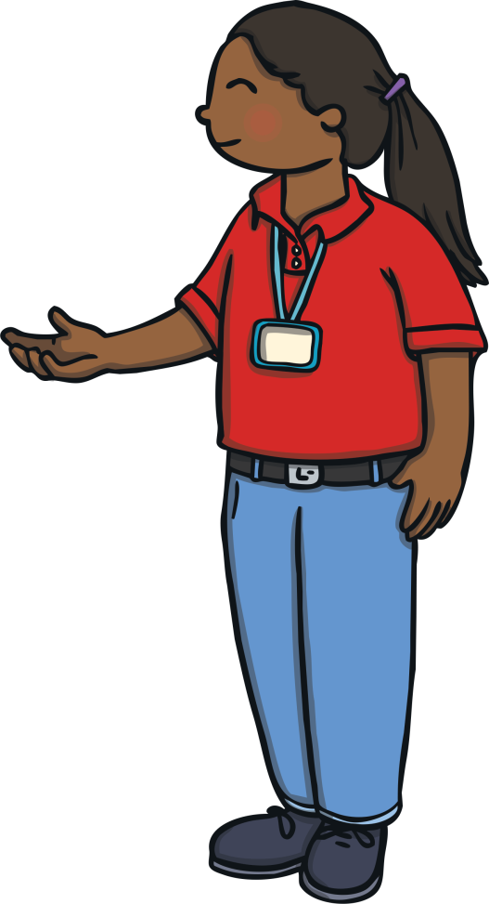
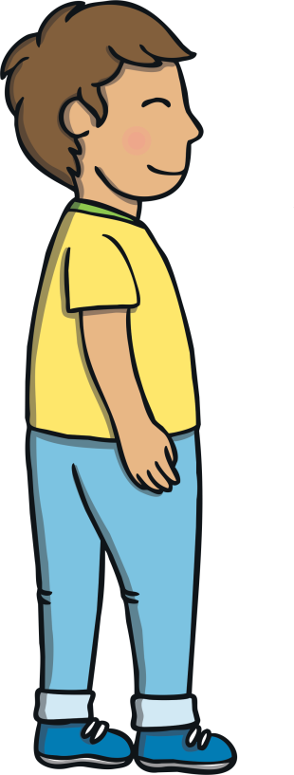
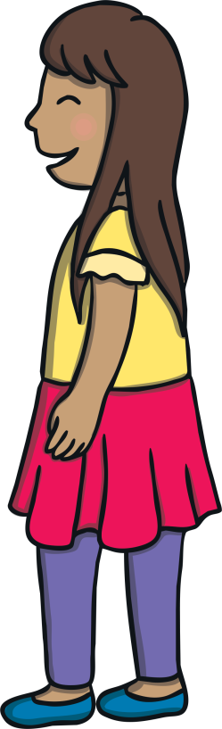
Teach
Kit and Sam’s family were at The Giant’s Causeway visitor centre. Eva, the guide, had just told them the legend of how the unusual stones were made.
“Wow! Is that really true?” asked Kit.
“Well, that is what the locals believe. You can see the stones and the boot for yourself. There are even matching stones you can still see in Scotland that remain,” said Eva.

Slide 17
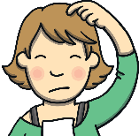
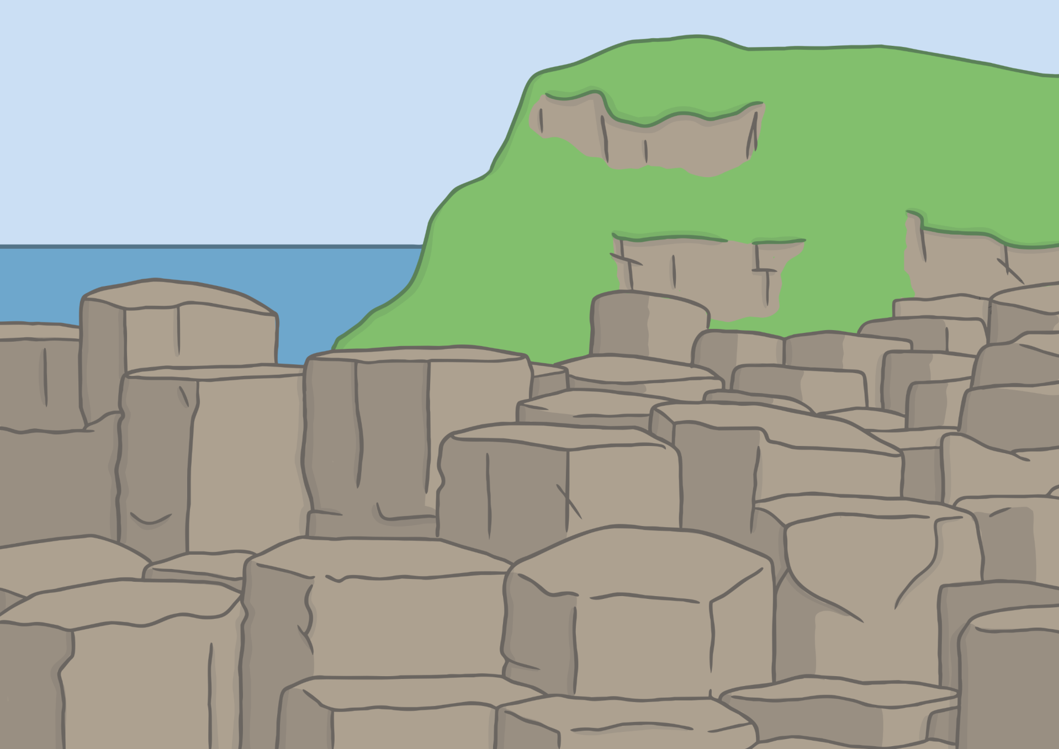
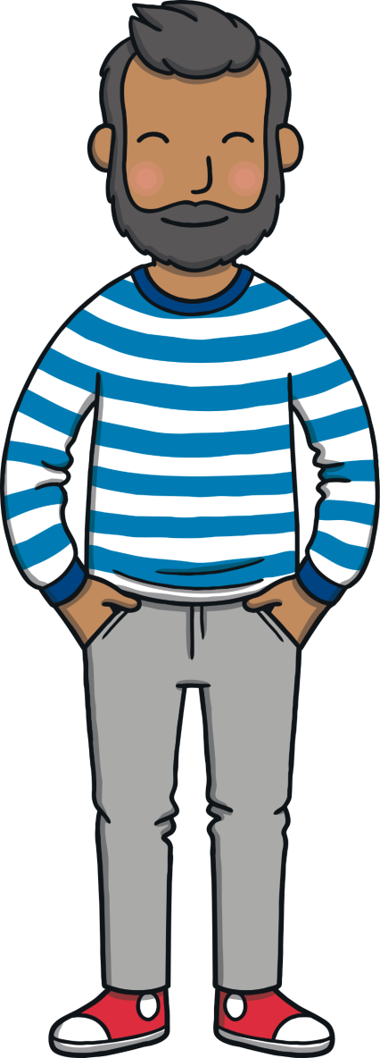
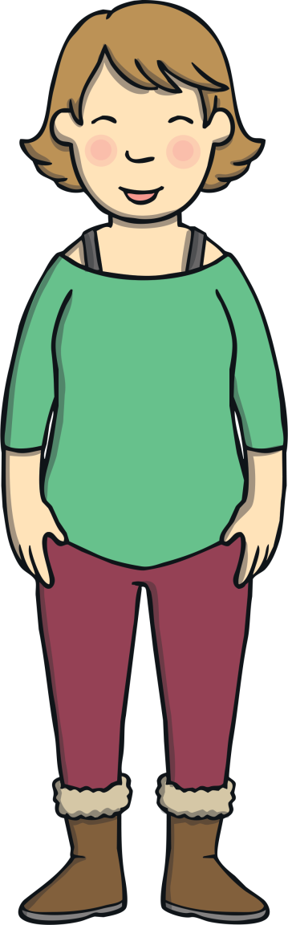
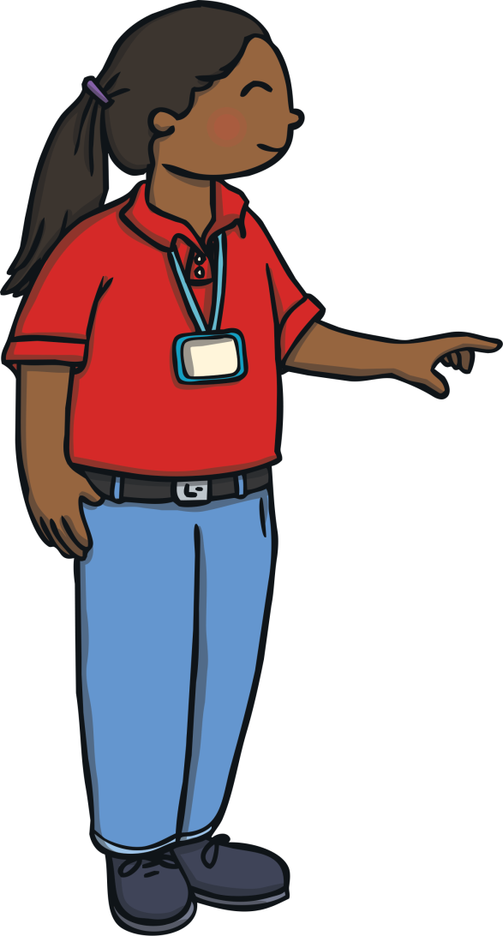
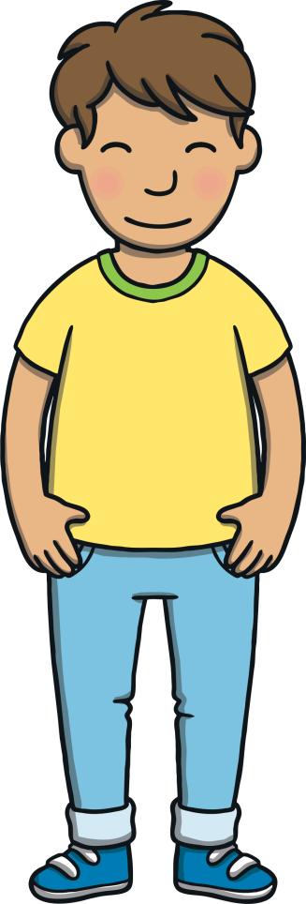
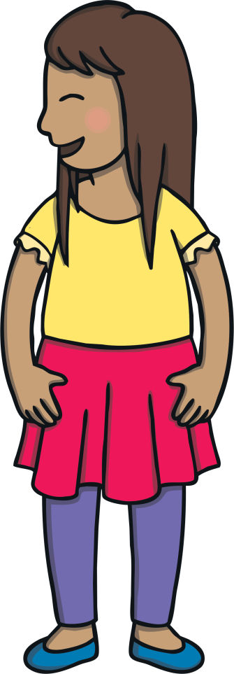
?
Teach
?
X
What do you think the word ‘awe’ means?
The family followed Eva as she stepped outside for the tour.
“So, here we are! Here are the beautiful hexagonal stones that we are famous for. I think you’ll agree that it is quite a sight!” said Eva.
“The stones are so unusual! I have never seen anything like it,” said Sam in awe.

Slide 18
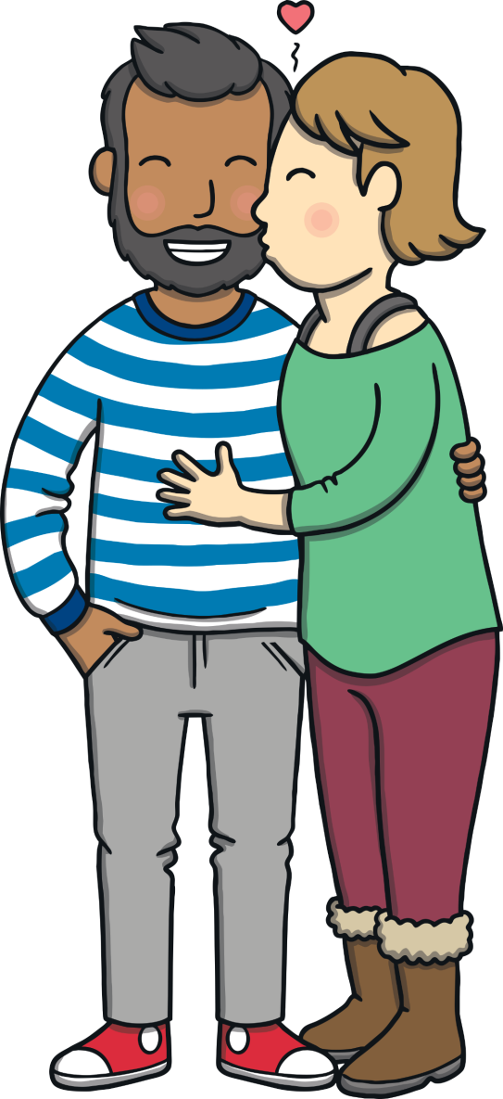
Teach
“It’s just how I remembered it. Thank you,” said Mum as she kissed Dad.
“It’s such a clear day,” said Dad. “You can see all the way to Scotland!”
Dad picked up a pebble and threw it into the sea. It skimmed across the water. Ben barked and Kit and Sam picked up a pebble and tried to throw it like Dad but it just plopped into the water.

Slide 19
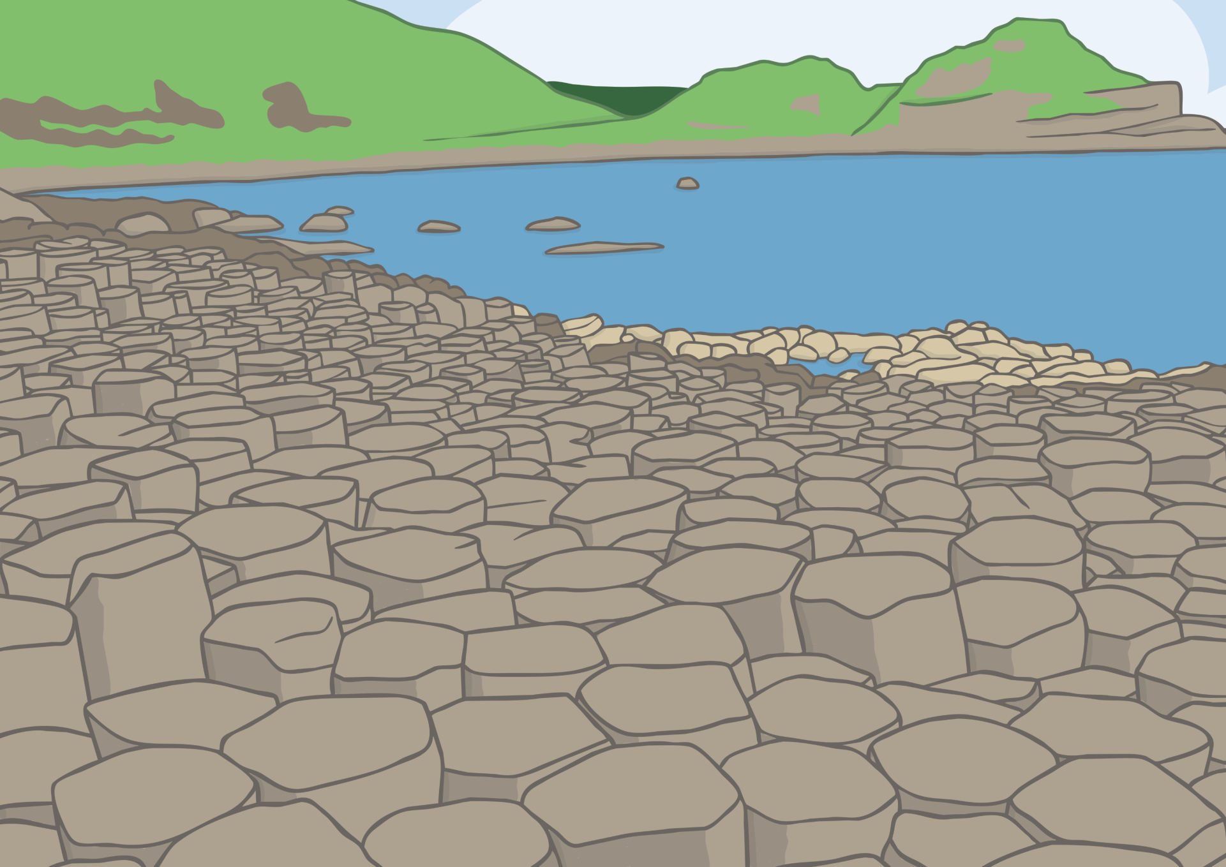
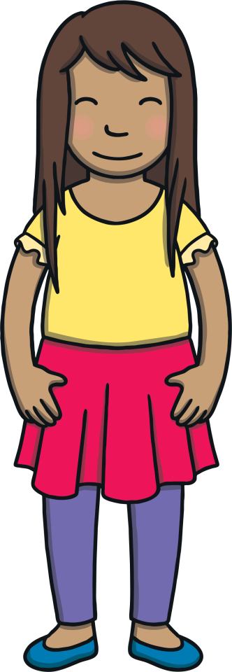
?
Teach
?
X
Why did Eva tell Kit and Sam to be careful?
“Can we get closer?” Kit asked the guide.
“Yes, you can stand on the stones if you wish but just take care as they are uneven and lots of people like to take pictures here,” said Eva.
Kit and Sam stepped onto the stones and posed for photographs.
“This is where the legend began,” said the tour guide. “Here, we are not far from Scotland. It’s just across the sea.”

Slide 20
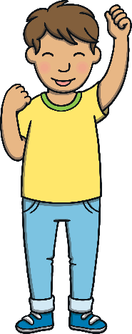
Teach
When we change some verbs into the past tense, they do not follow the –ed rule. We call these irregular verbs.
For example:
run
ran
X
You will know and use lots of irregular verbs already!
Click me for Kit’s teaching tips!

Slide 21
Teach
For these irregular spellings, we just have to learn them. If we use the –ed rule, they will not sound quite right.
For example:
win
winned
won

Slide 22
Teach
Work in partners to write down the irregular past tense for these verbs.
Remember, these words do not follow the –ed rule.
Saying a sentence out loud will help you.
Today, I see.
Yesterday, I saw.

Slide 23
Teach
Today, I…
Yesterday, I…
run
dig
cut
win
sit
let
drink
go
ran
dug
cut
won
sat
let
drank
went

Slide 24
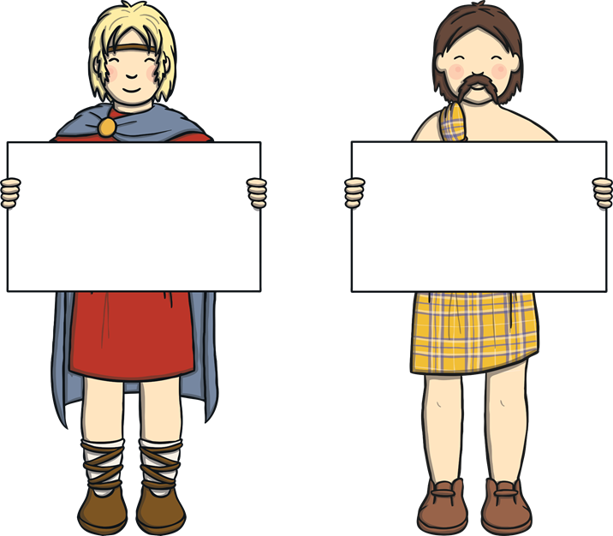
Irregular Giant
Practise
Finn McCool and his Scottish rival are holding past tense sentences.
Can you click on the giant who is holding the sentence containing the correct verb within the sentence?

Slide 25
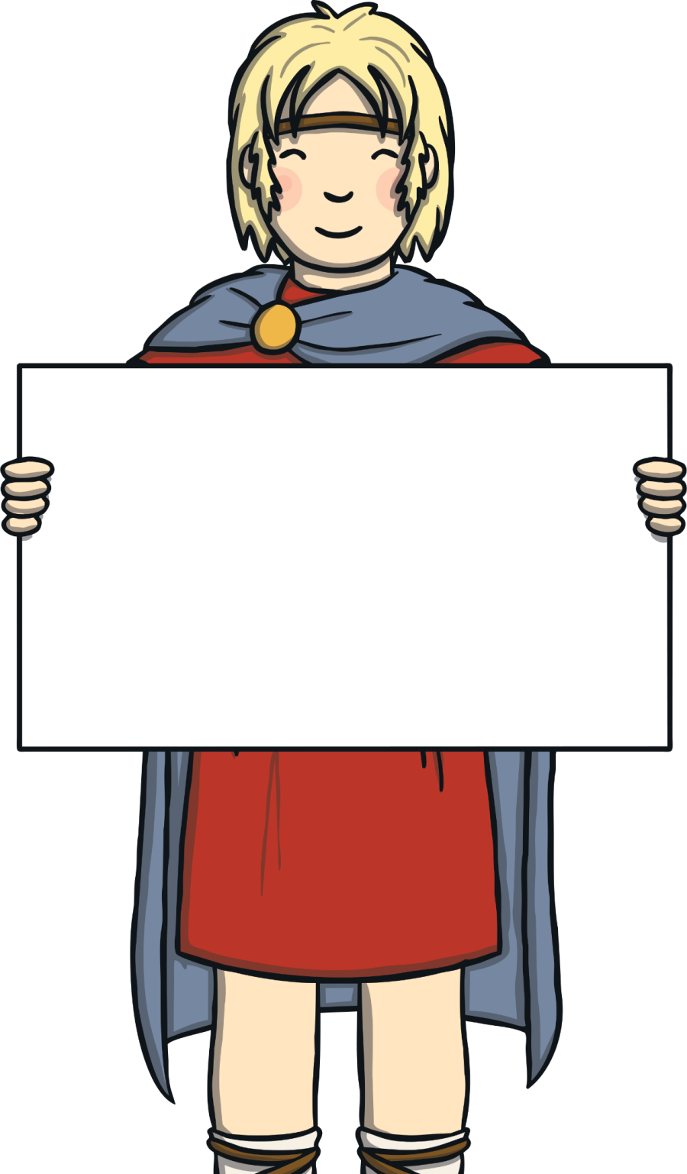
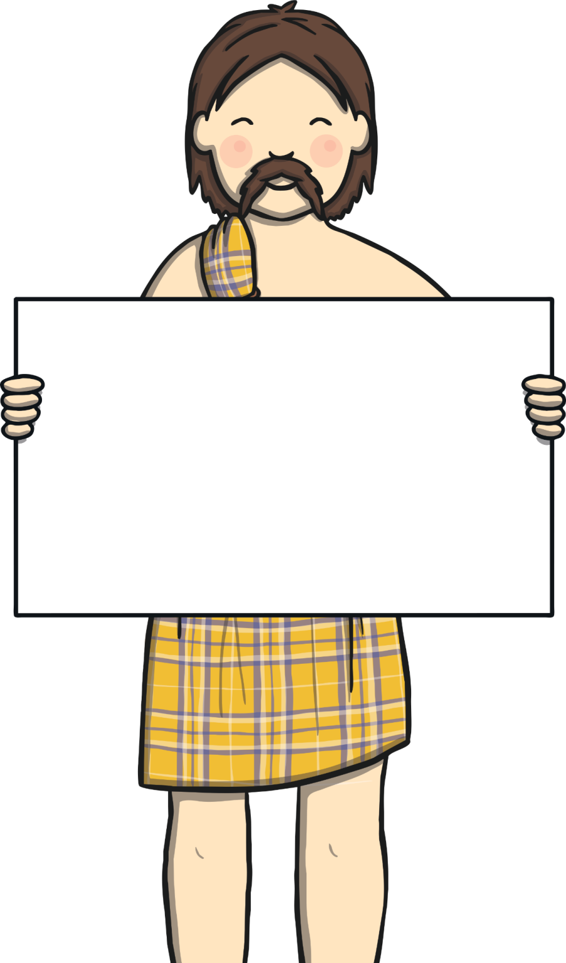
Practise
I ran from the dog.
I ran from the dog.
I runned from the dog.
I runned from the dog.

Slide 26
Practise
I finded a leaf on the floor.
I finded a leaf on the floor.
I found a leaf on the floor.
I found a leaf on the floor.

Slide 27
Practise
I had my hair cutted.
I had my hair cutted.
I had my hair cut.
I had my hair cut.

Slide 28
Practise
My mum goed swimming.
My mum goed swimming.
My mum went swimming.
My mum went swimming.

Slide 29
Practise
Grandad dug up a worm.
Grandad digged up a worm.
Grandad dug up a worm.
Grandad digged up a worm.

Slide 30
Practise
We sitted on the floor.
We sitted on the floor.
We sat on the floor.
We sat on the floor.

Slide 31
Practise
I saw a big plane.
I seed a big plane.
I saw a big plane.
I seed a big plane.

Slide 32
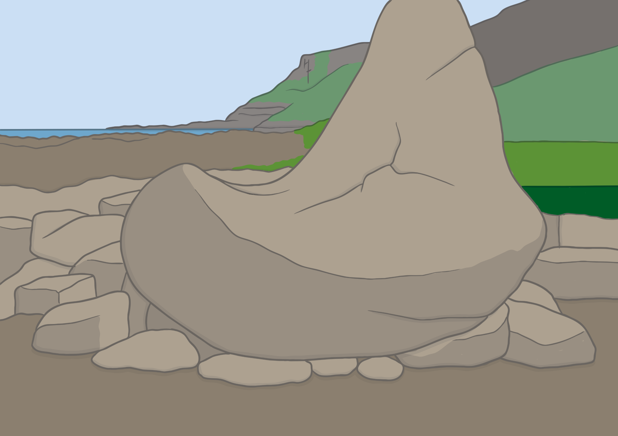
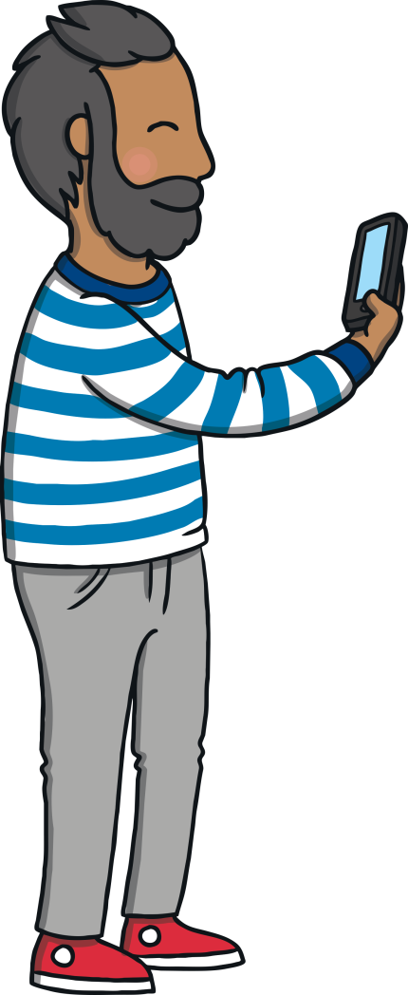


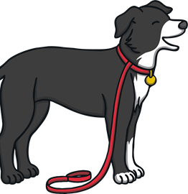
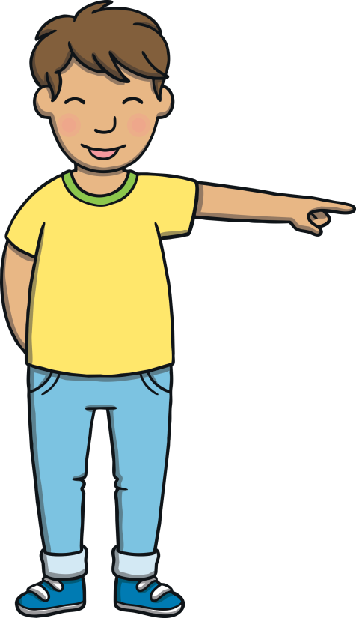

?
Apply
?
X
What did Kit do to try to measure the boot?
Eva led them further down the coast. “This is the boot from the legend,” she explained. Kit and Sam stood next to the boot looking at it.
“It’s huge!” said Kit, dropping Ben’s lead and trying to stretch his arms across it. Dad snapped another photo.

Slide 33

Sentence Scribers
Apply
Listen to Kit talk about the legend of The Giant’s Causeway and write down each sentence on a whiteboard or piece of paper.
X
Encourage children to listen out for any words that have had the –ing or –ed suffixes added.
Click me for Kit’s teaching tips!

Slide 34


Apply
1
The giant dragged bits of rock to make a path.
2
The giant and his wife planned a trick.
Check
3
He pretended to be a napping baby.

Slide 35
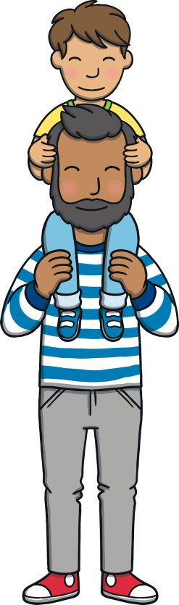
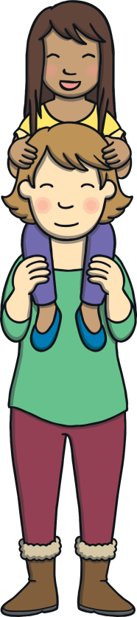
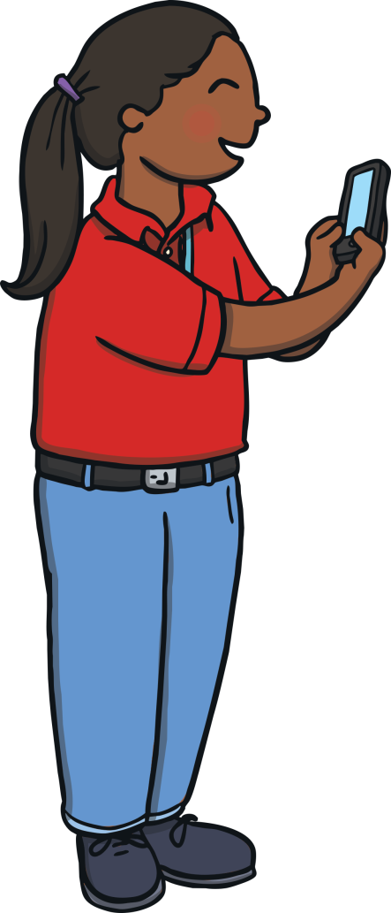
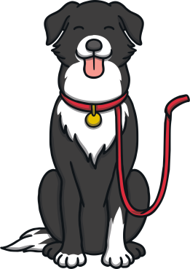
Apply
Eva offered to take a family picture. Mum and Dad put Kit and Sam onto their shoulders and Ben sat in front of them.
“Say ‘Finn McCool’,” said Eva.
“Finn McCool!” shouted everybody.

Slide 36
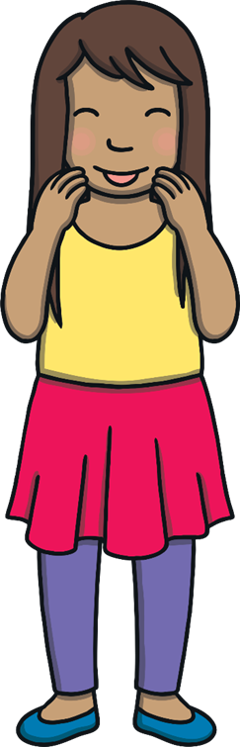
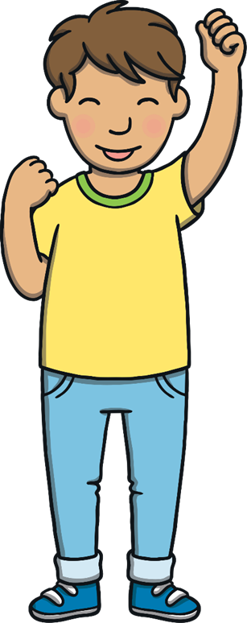
Today, we have learnt to add –ing and –ed to CVC and CCVC words.
We have also learnt about the irregular past tense.

