Slide 2
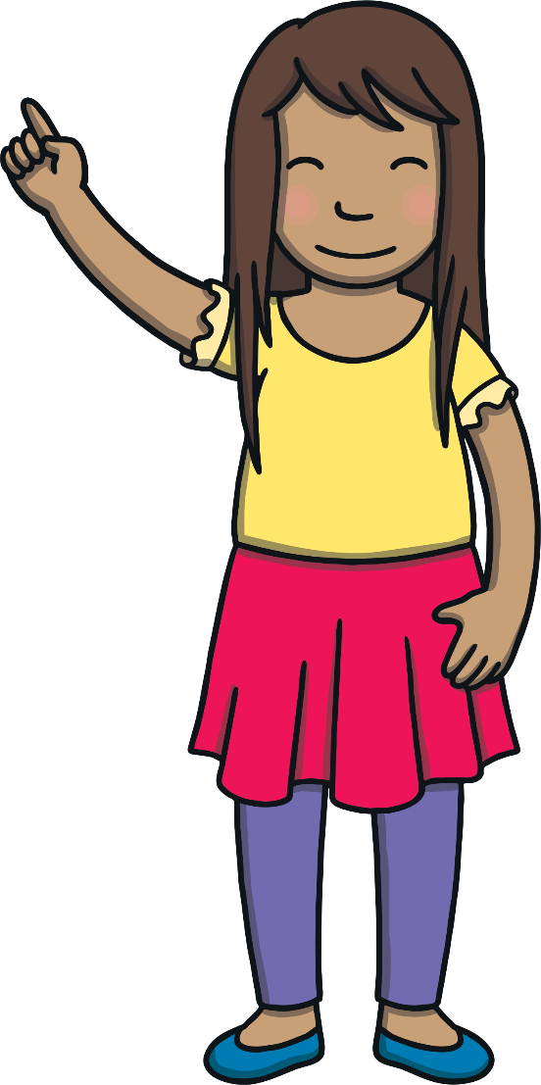
Revisit and Review
Let’s practise reading some of this week’s focus words.
patting
jogged
humming
fitted
dropping
clapped
shopping
stopped
England
tongue

Slide 3
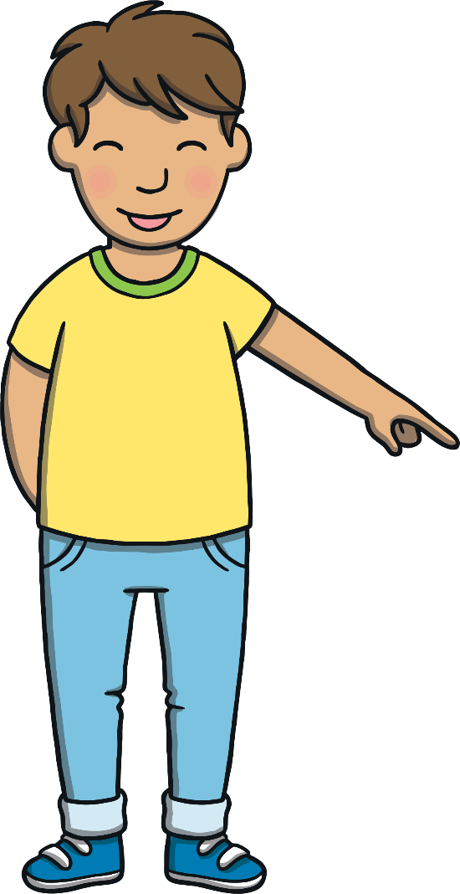

Revisit and Review
Now, let’s write them with the magic pencil...

Slide 4



Revisit and Review
p
a
t
t
i
n
g
Play

Slide 5
Revisit and Review
h
u
m
m
i
n
g
Play

Slide 6
Revisit and Review
d
r
o
p
p
i
n
g
Play

Slide 7
Revisit and Review
s
h
o
p
p
i
n
g
Play

Slide 8


Revisit and Review
j
o
g
g
e
d
Play

Slide 9
Revisit and Review
f
i
t
t
e
d
Play

Slide 10
Revisit and Review
c
l
a
p
p
e
d
Play

Slide 11
Revisit and Review
s
t
o
p
p
e
d
Play

Slide 12
Revisit and Review
E
n
g
l
a
n
d
Play

Slide 13
Revisit and Review
t
o
n
g
u
e
Play

Slide 14
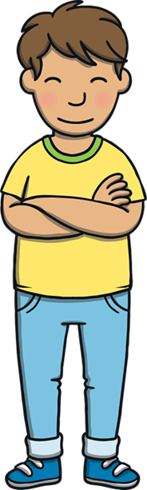
Teach
Today, we are learning to write sentences that contain CVC and CVCC words with the suffixes –ing and –ed added. We are also learning to identify and use the irregular past tense.

Slide 15
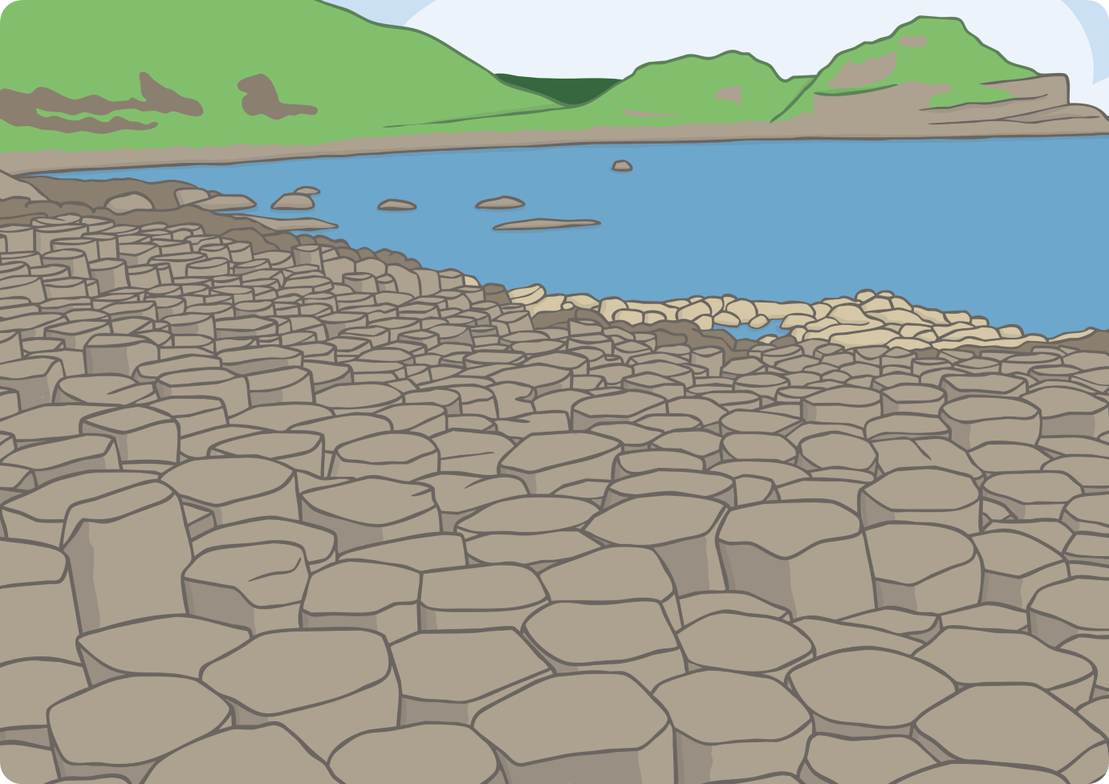
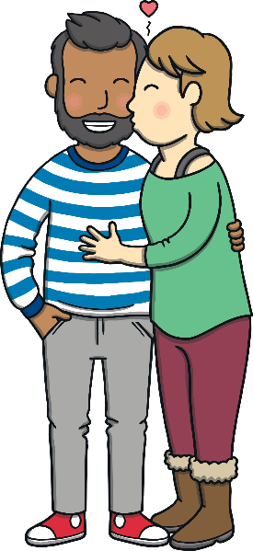
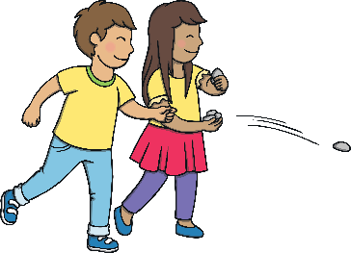
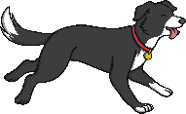
Teach
Kit and Sam had been at the Giant’s Causeway all day and couldn’t wait to tell their friends about the legend of the giant, Finn McCool. Mum and Dad had loved reliving their honeymoon and Ben had definitely had a good time doing a bit of swimming!
“What a lovely day it has been!” said Dad. “Let’s take in the view before we leave.”

Slide 16
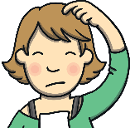
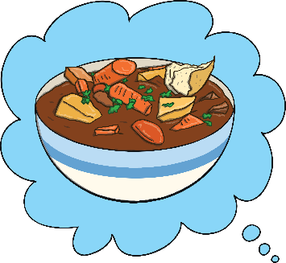
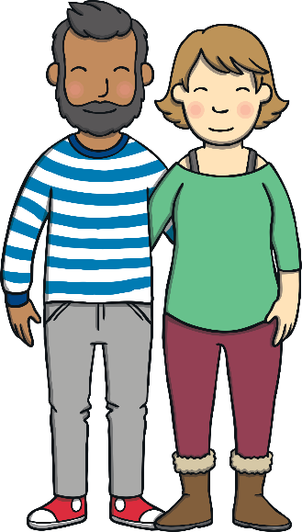
?
Teach
?
X
Why did Mum tut at dad?
“I think it’s time to find our hotel and explore the lovely Irish food!
“You and your food…” tutted Mum.
“Well, you cant beat Irish Stew,” said Dad. “It’s an important part of visiting other places - tasting their specialities!”

Slide 17
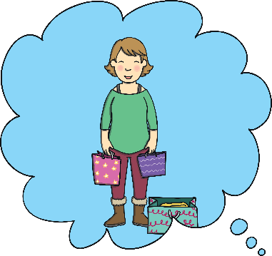
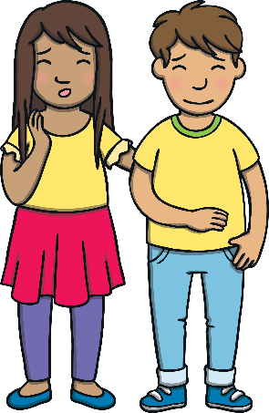
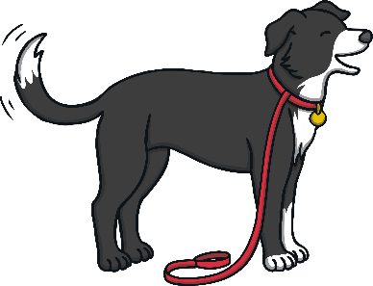
Teach
“What are we going to do tomorrow, Dad?” asked Sam.
“That’s Mum’s choice,” replied Dad.
“I have chosen to visit Belfast centre to go shopping!” said Mum excitedly.
“There are other sights as well as just the shops,” laughed Dad.

Slide 18

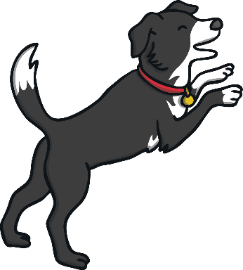
Teach
We are going to write a sentence to explain what happened in the story.

Slide 19
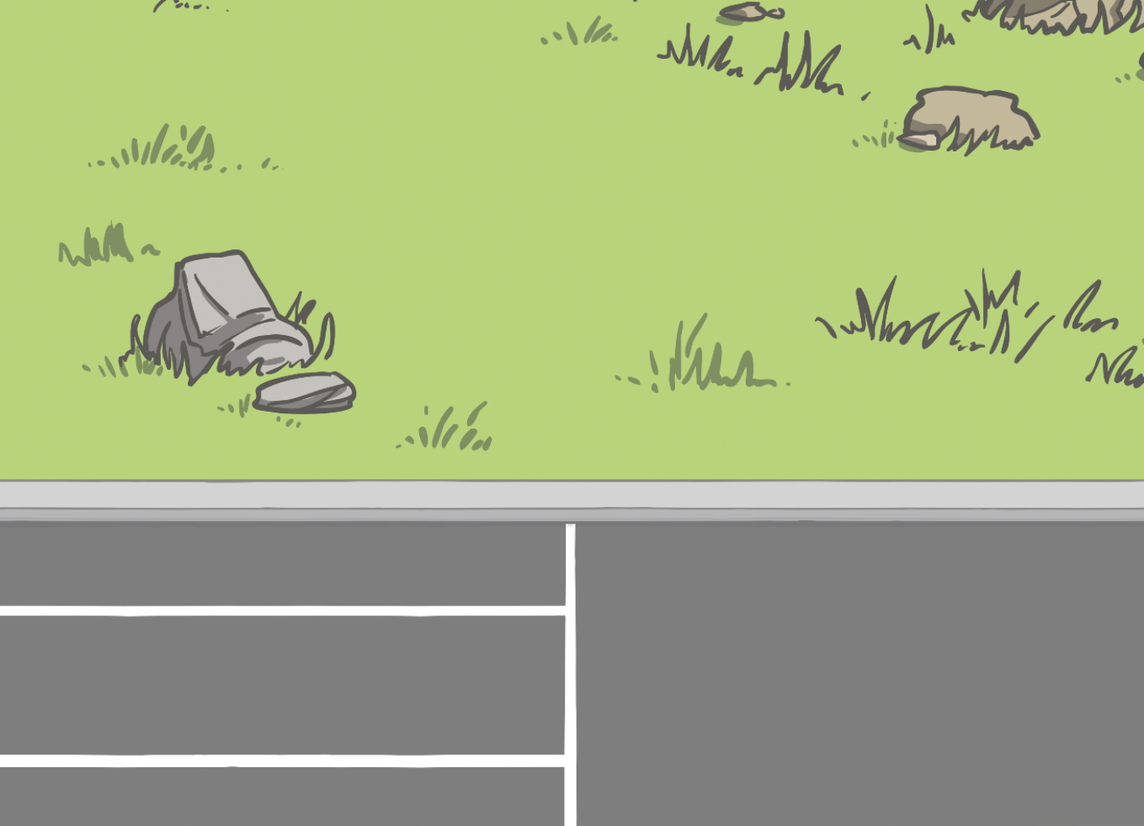
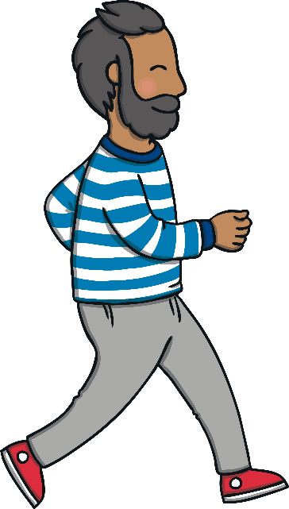
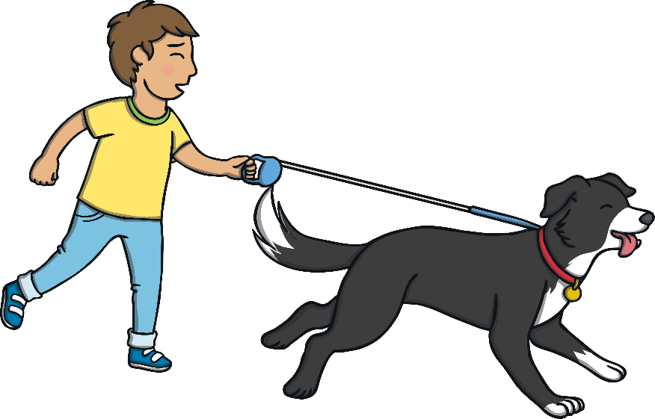


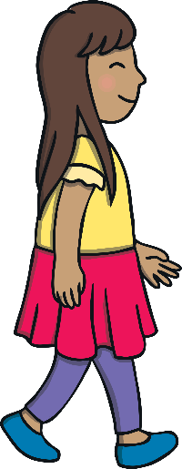

Practice
What did Ben do as he got out of the car?
Work with a partner to write a sentence to answer the question.
He led the way and pulled Kit, who was holding the lead.
Show

Slide 20
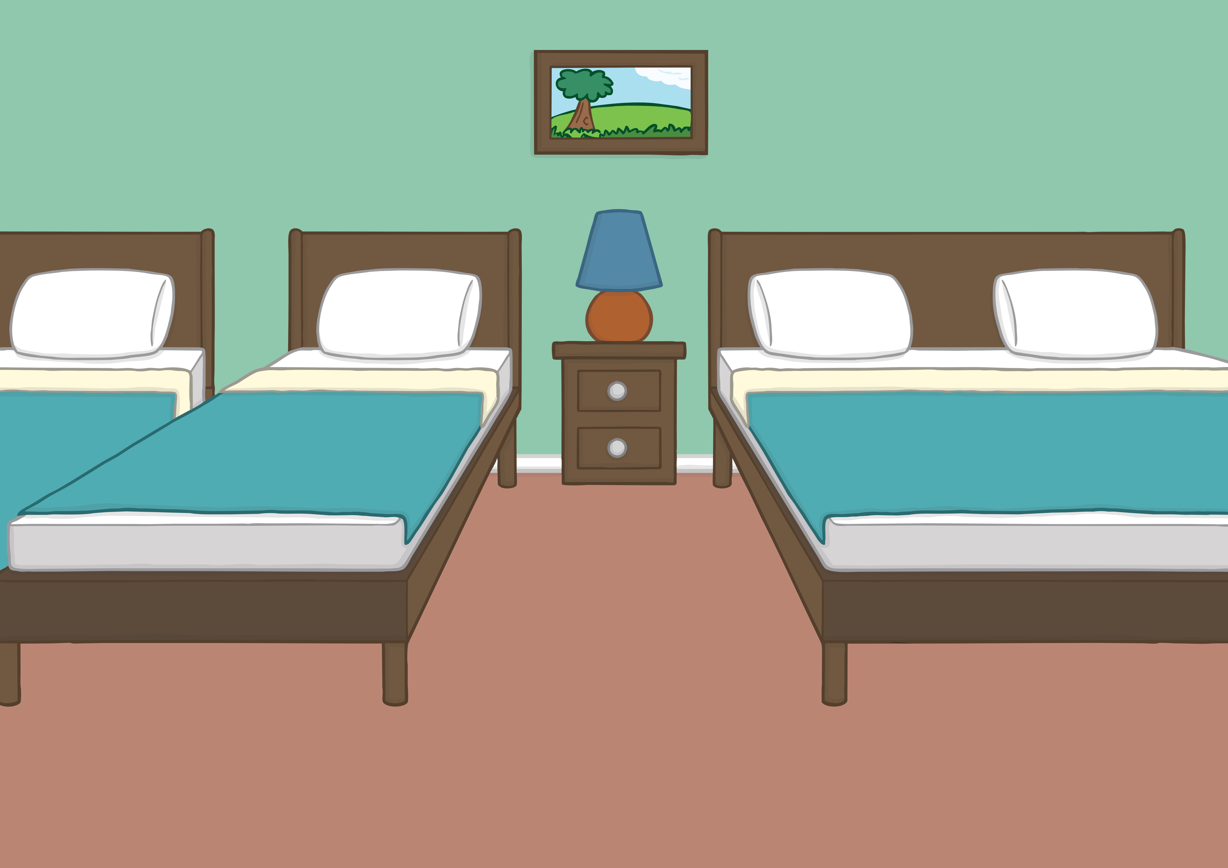

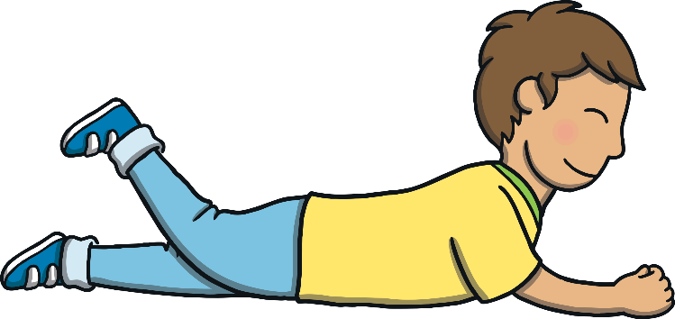
Apply
Back at the hotel, Kit and Sam were lying on Mum and Dad’s bed and began making a scrapbook of their adventure so far.
“We can show everybody at home and tell them the story of Finn McCool!” said Kit as he was cutting and sticking a postcard into the scrapbook.

Slide 21


Dad’s Snaps
Apply
Kit and Sam are looking through pictures on Dad’s phone. Can you write sentences to match the pictures?

Slide 22

Apply

Slide 23
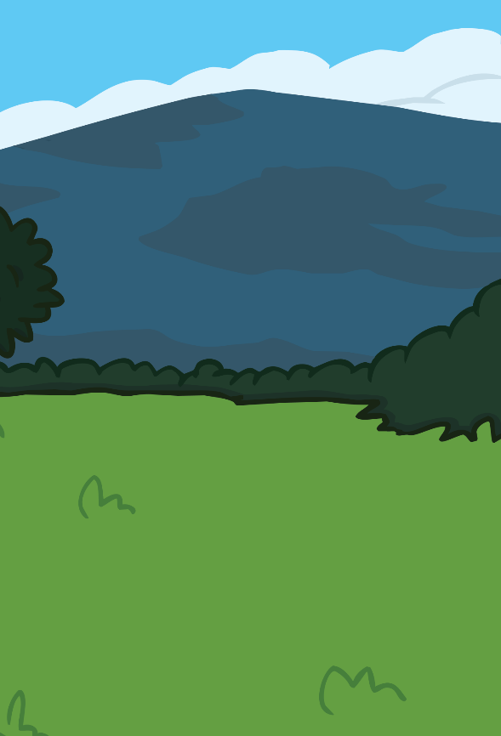
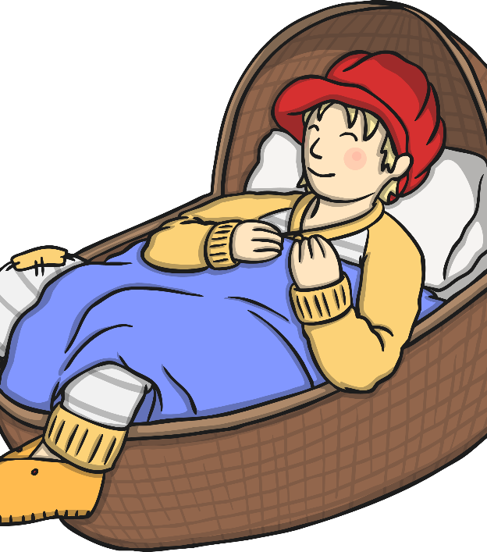
Apply

Slide 24
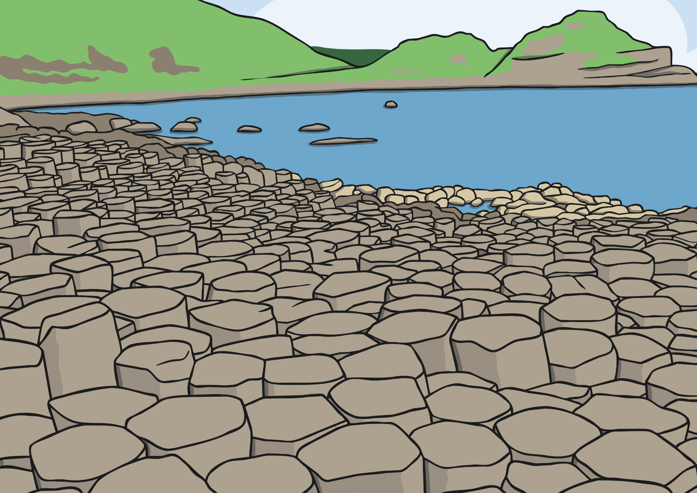
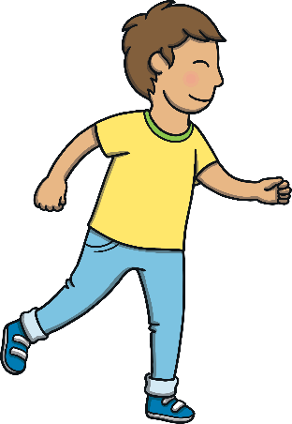
Apply

Slide 25
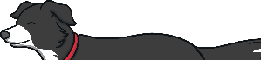
Apply

Slide 26
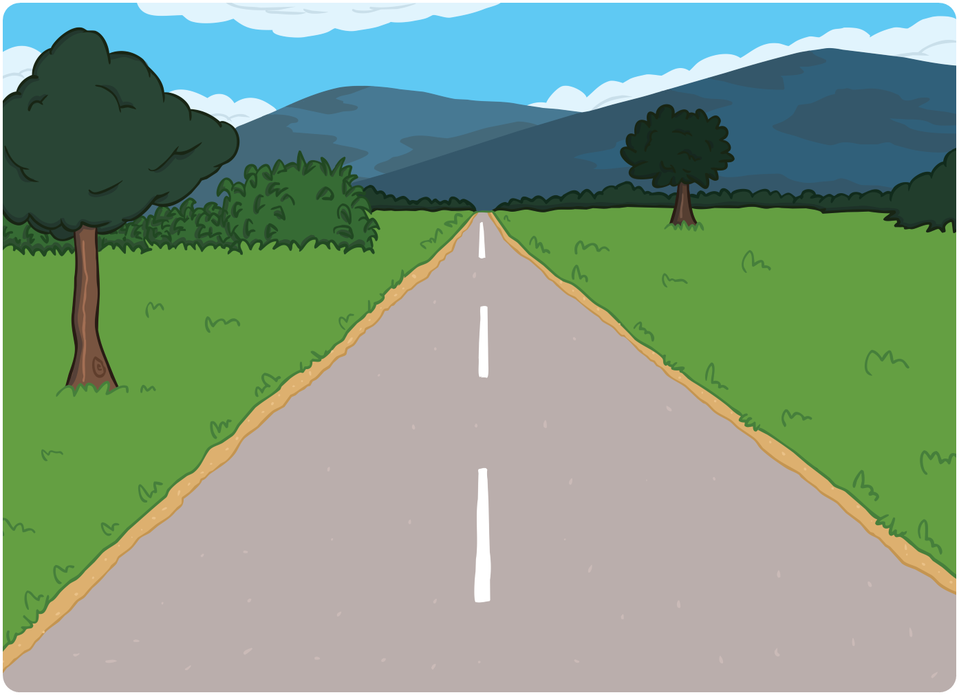
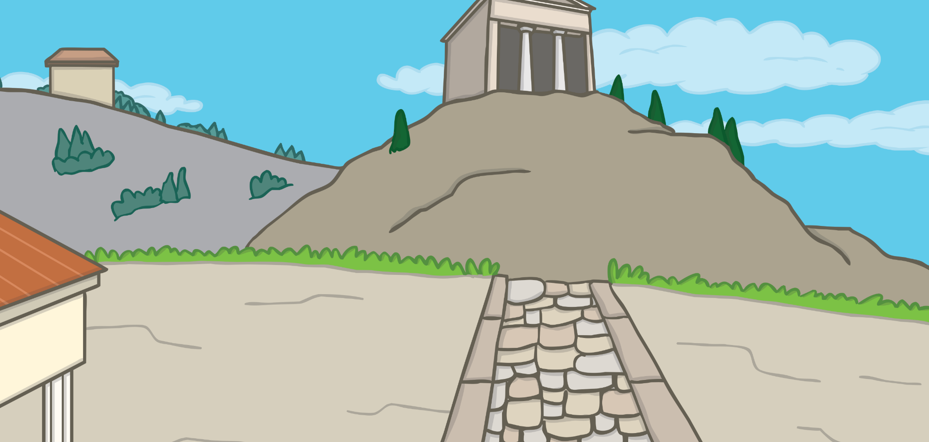
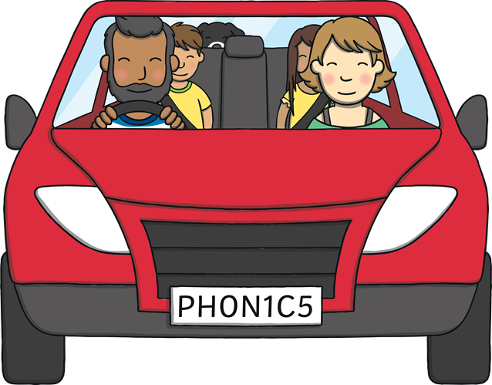
Exploring Northern Ireland
Apply
A ‘Let’s Write Together!’ Book

Slide 27
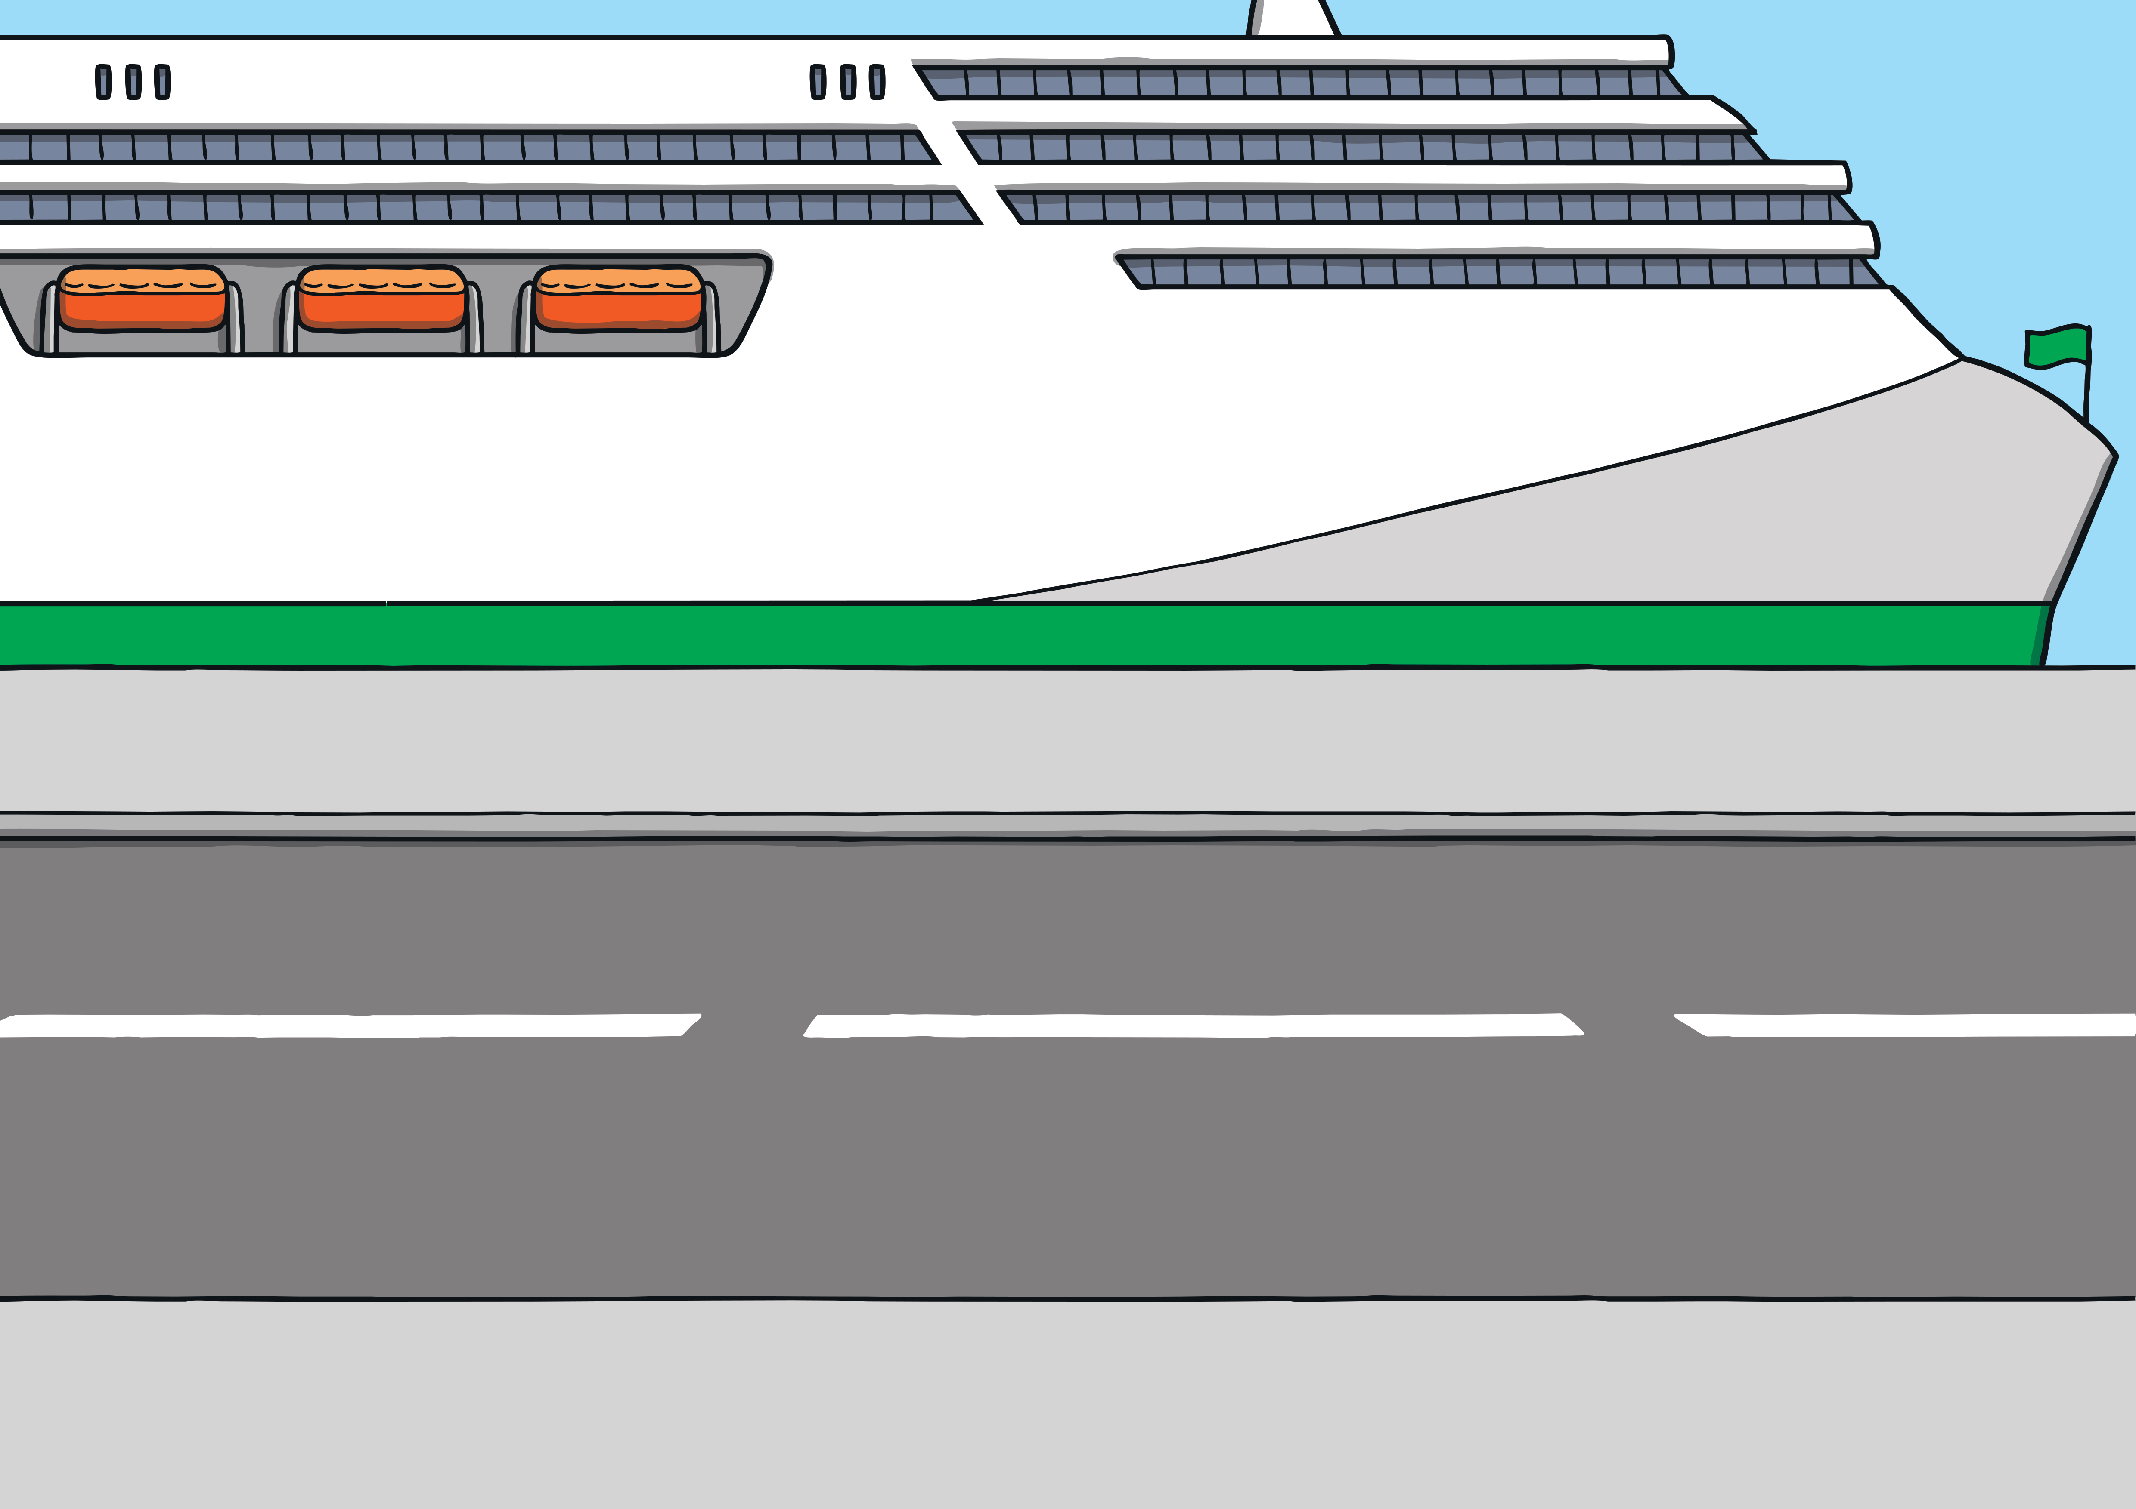
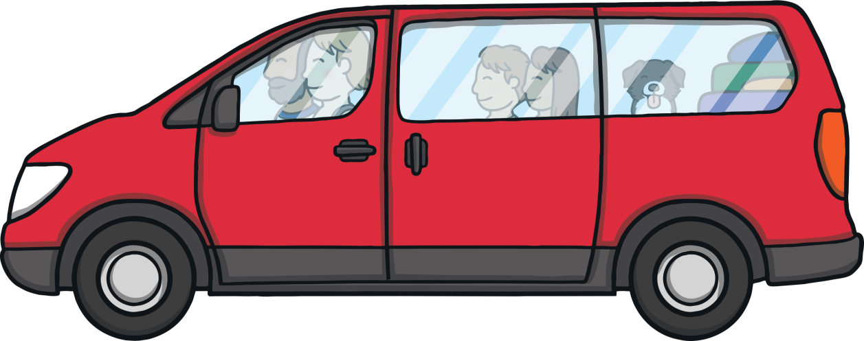
Apply
Show Suggestions
Dad had planned a surprise for Mum for their wedding anniversary. We fitted our bags into the car and went on holiday on a ferry!

Slide 28
Apply
Show Suggestions
We slept on the ferry and woke up to find that we were not in England anymore! As we drove, we noticed so many green fields and we finally stopped at the Giant’s Causeway.

Slide 29
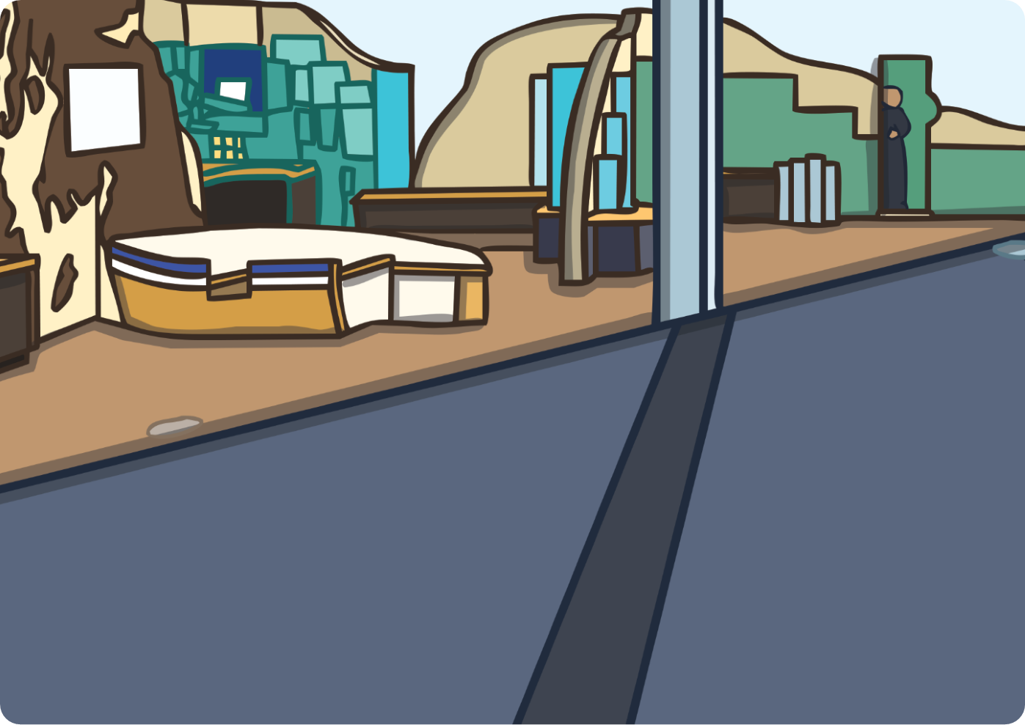
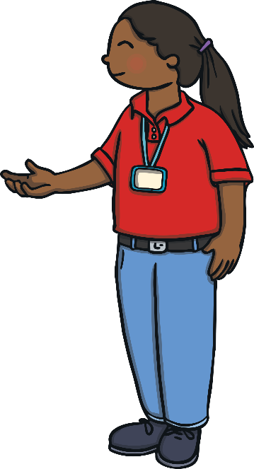
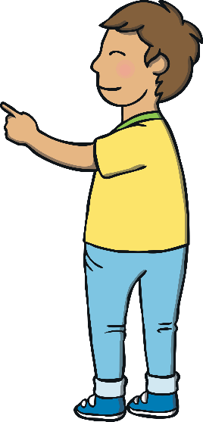
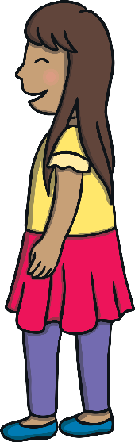
Teach
Show Suggestions
We met Eva. She told us all about the history and the legend of Finn McCool. Finn was a giant who made the beautiful stones by grabbing rocks to make a path.

Slide 30
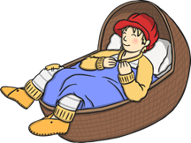
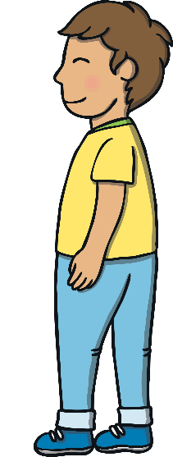
Apply
Show Suggestions
In the story, the Scottish giant stepped over to Ireland. He was tricked by Finn, who pretended to be a baby napping in a cot. The Scottish giant was so scared that he stepped back and broke up the stones, stopping other giants coming to fight him.

Slide 31
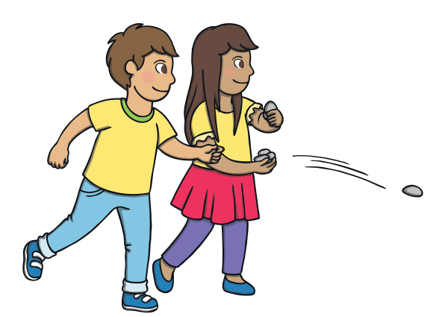
Apply
Show Suggestions
Outside, we got to the edge of the rocks and saw the amazing hexagonal stones and even the Giant’s boot that we heard about in the story. Dad skimmed pebbles across the water. We tried but they just plopped in!

Slide 32
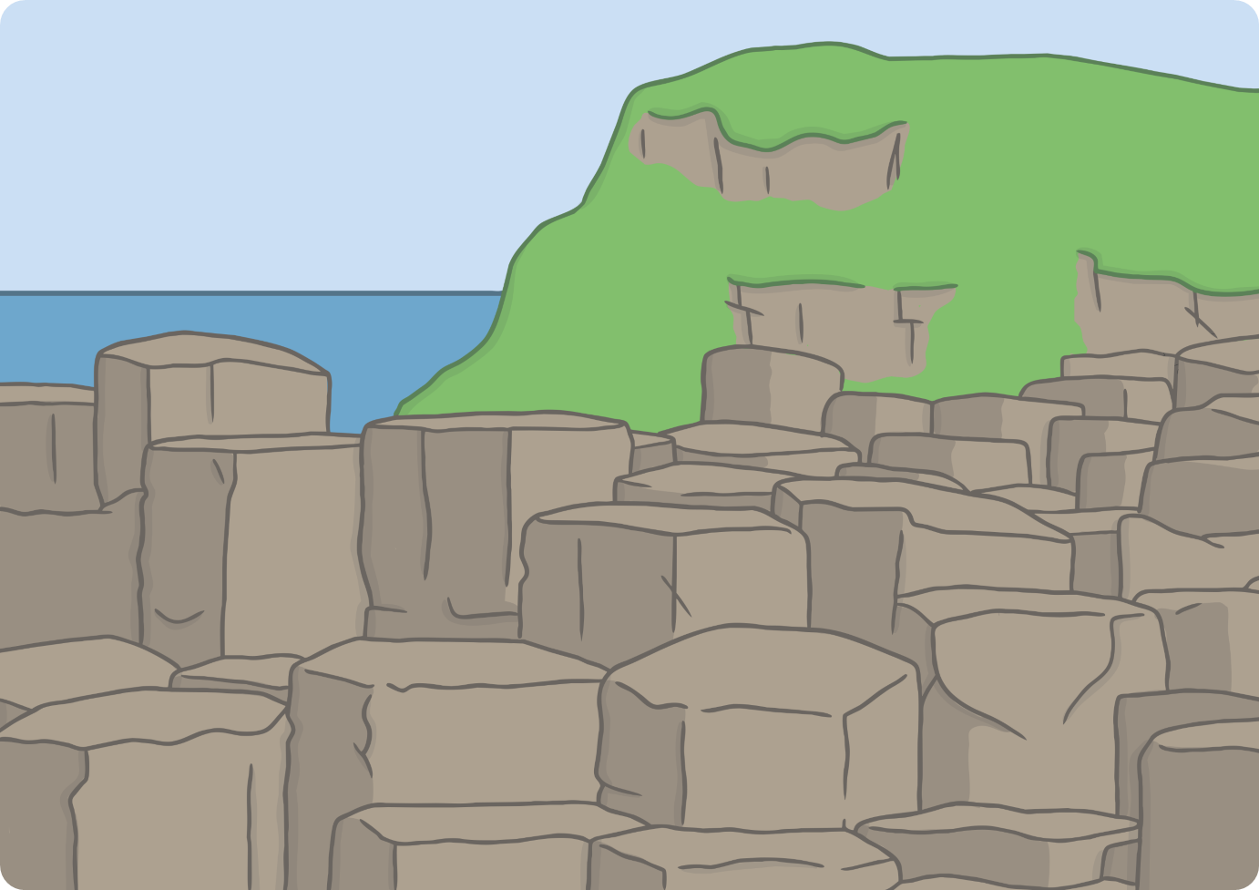

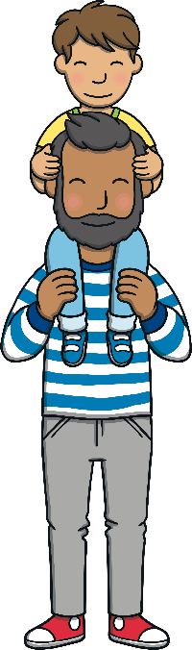
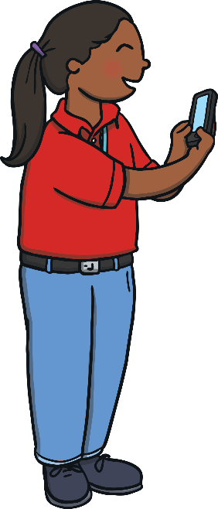
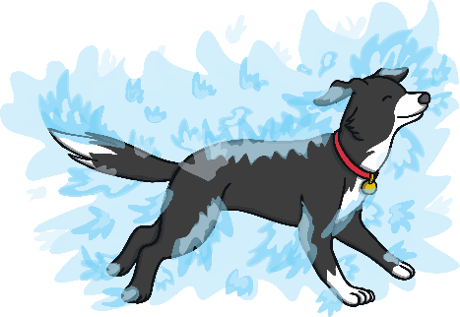
Apply
Show Suggestions
We stepped onto the stones and posed for a photo. Ben had his own fun by swimming in the sea and getting us all a bit wet!

Slide 33

Apply
Show Suggestions
“Well, what a lovely break. We have visited the Giant’s Causeway and shopped until we dropped!” said Mum. “Do we get to do that every anniversary from now on?”
“Yeah!” clapped Sam and Kit.
“We will have to see,” said Dad as he looked at all the shopping bags.

Slide 34
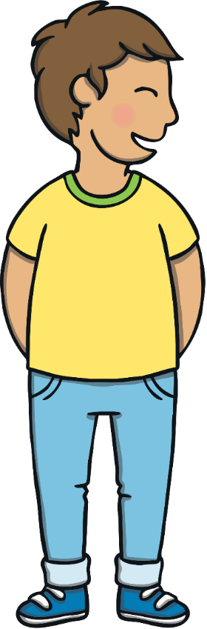

Today, we have learnt to write sentences that contain CVC and CCVC words with suffixes –ing and –ed added. We have also used the irregular past tense to create our own story.

