Slide 1

Back to school!
Mrs Garland
Mrs Garland

Slide 2
What are we learning about?!
The Stone Age
The Romans – Roman Day
Land Use
The Rainforest
British Artists
Fruit and Veg
History Topics
Geography Topics
Art and DT Topics

Slide 3

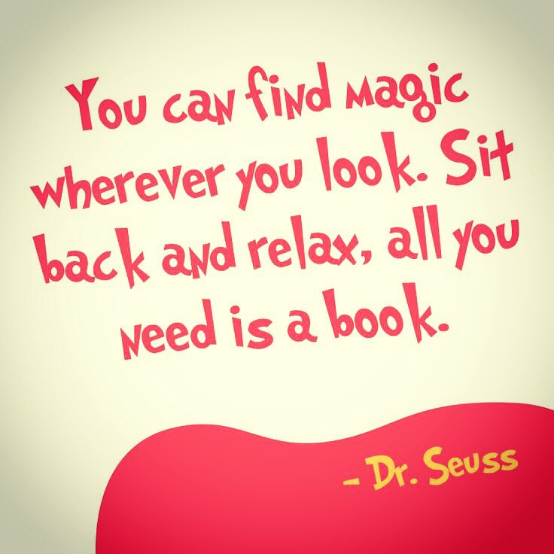

Reading
Reading should be happening every day – even for just 5 minutes. Reading to your child as well as them reading to you is hugely beneficial for their vocabulary and comprehension skills.
Reading Records and current books should be in school everyday.
Records are checked daily (as long as the children get them out of their bags when asked!)
Rewards for Reading.

Slide 4

Homework
Spellings weekly starting this Wednesday. Test will be the following Wednesday.
Times Tables weekly. Times Tables tests also a Wednesday.
Reading Daily.
Handed out Wednesday, to be back by following Tuesday.

Slide 5

P.E
Topics:
Tag Rugby
Hockey
Netball
Circuits
Rounders
Athletics
Tuesdays – Inside
Thursday – Outside
Correct P.E kit is essential. If not wearing correct P.E kit regularly, will have to bring in a bag and change
Come to school wearing P.E kits

Slide 6


Dojo Points – Class treat if target is met
Team Points
Raffle Tickets
Extra playtime
Time Out
Speaking to Parents

Slide 7

Question Time!

